Slide 1

Startsida
Notes:
textbox
No alt text provided
textbox
No alt text provided
image
No alt text provided

Slide 2
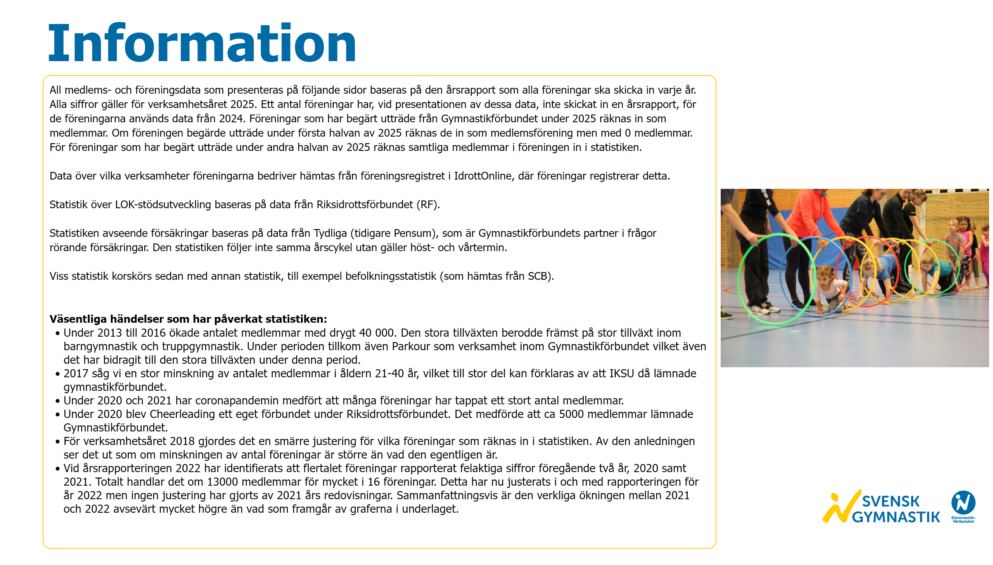
Information
Notes:
textbox
No alt text provided
textbox
No alt text provided
image
No alt text provided
image
No alt text provided

Slide 3
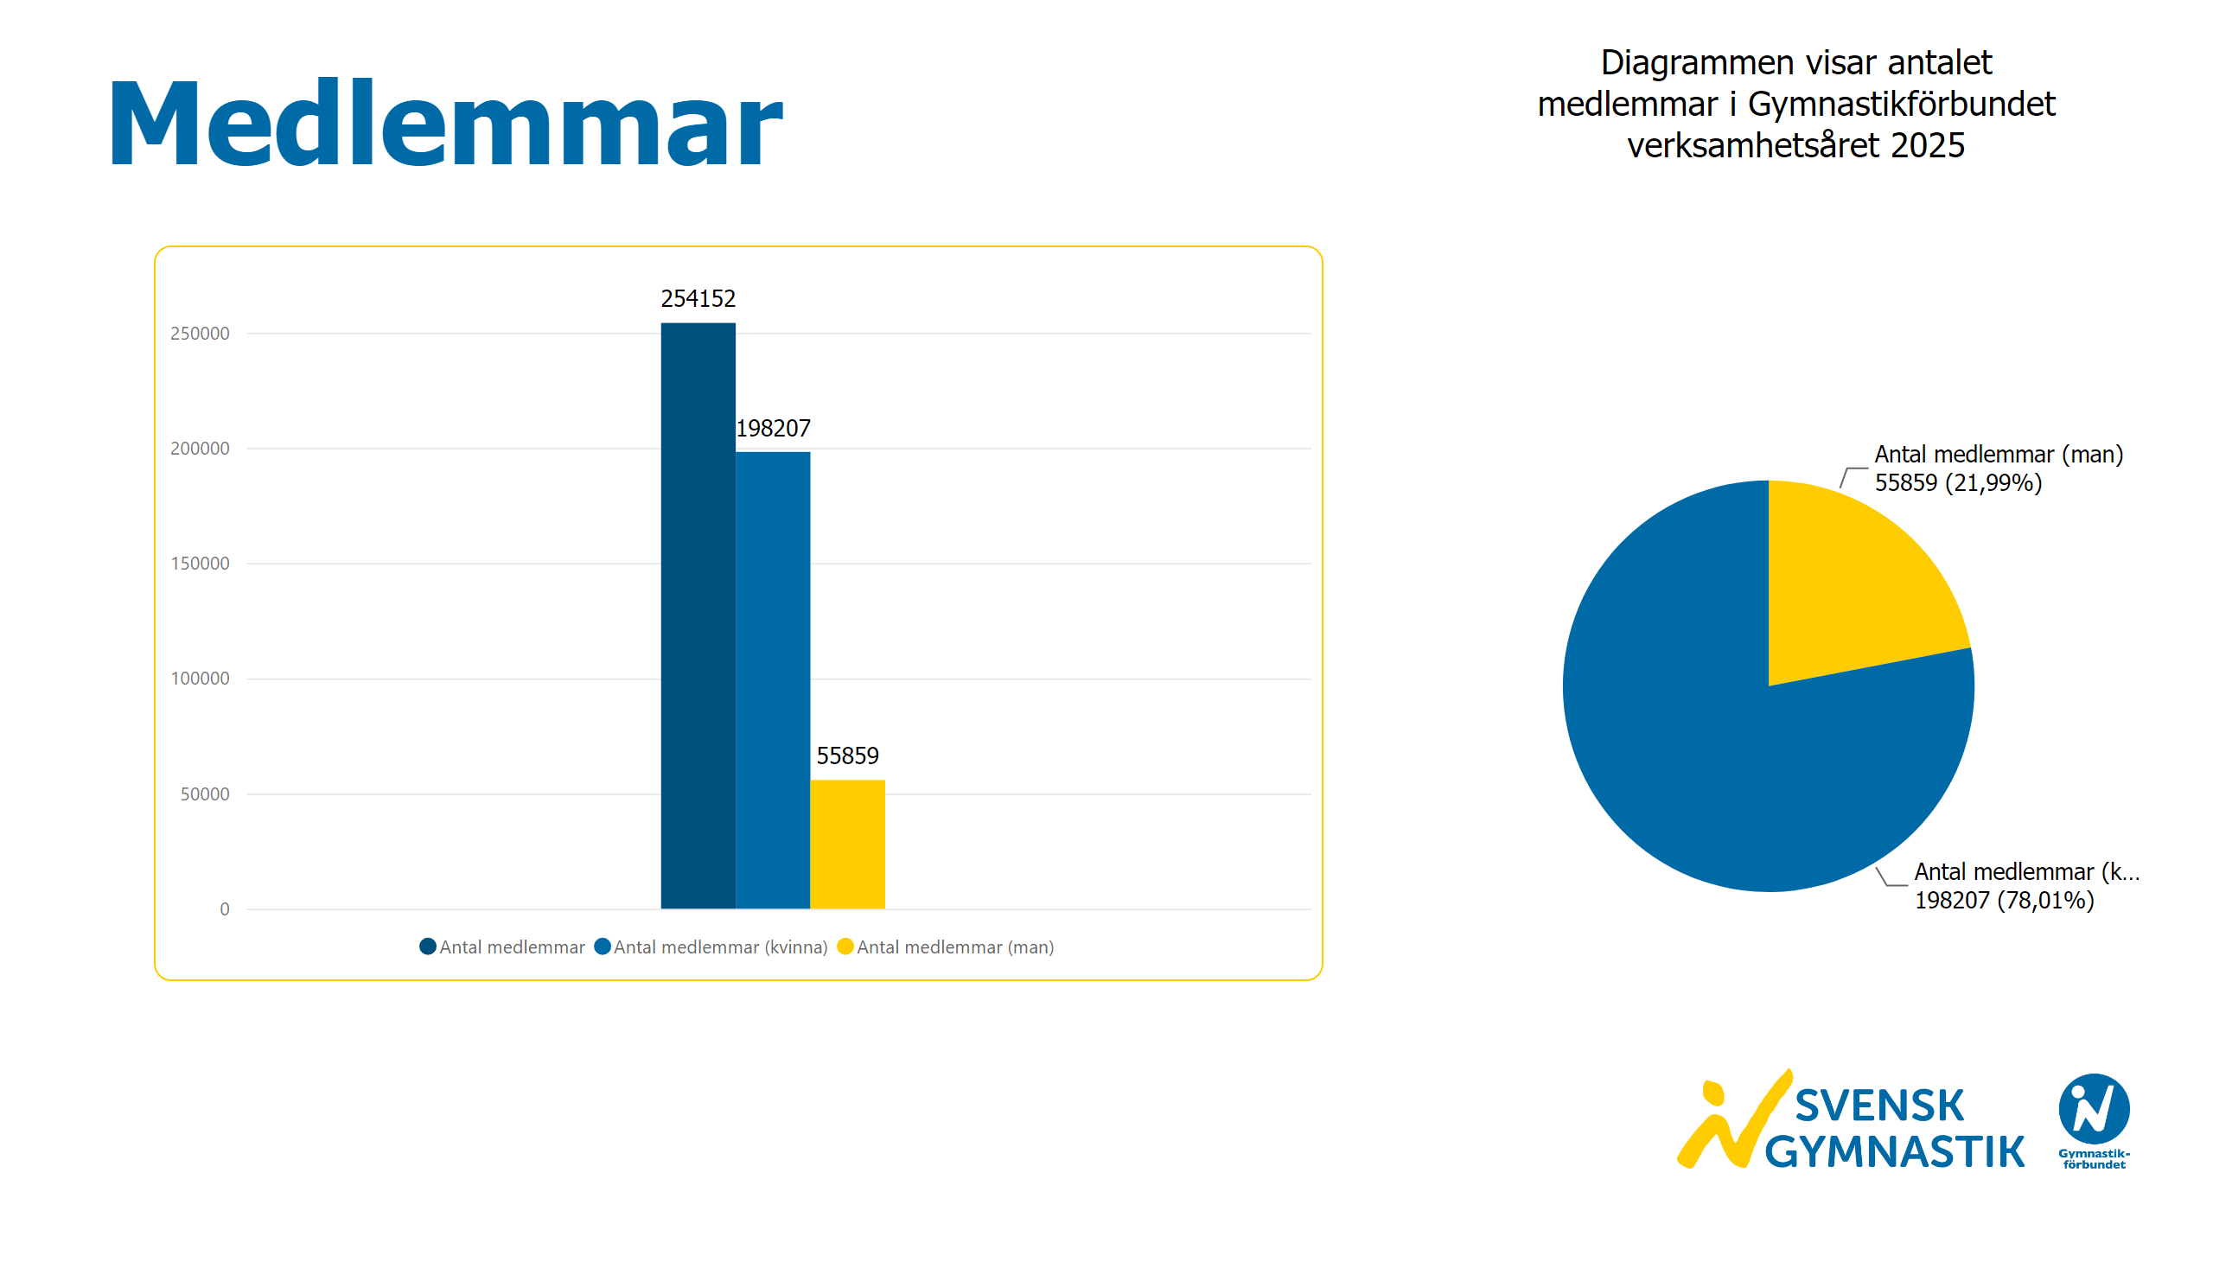
Medlemmar
Notes:
textbox
No alt text provided
textbox
No alt text provided
clusteredColumnChart
No alt text provided
pieChart
No alt text provided
image
No alt text provided

Slide 4
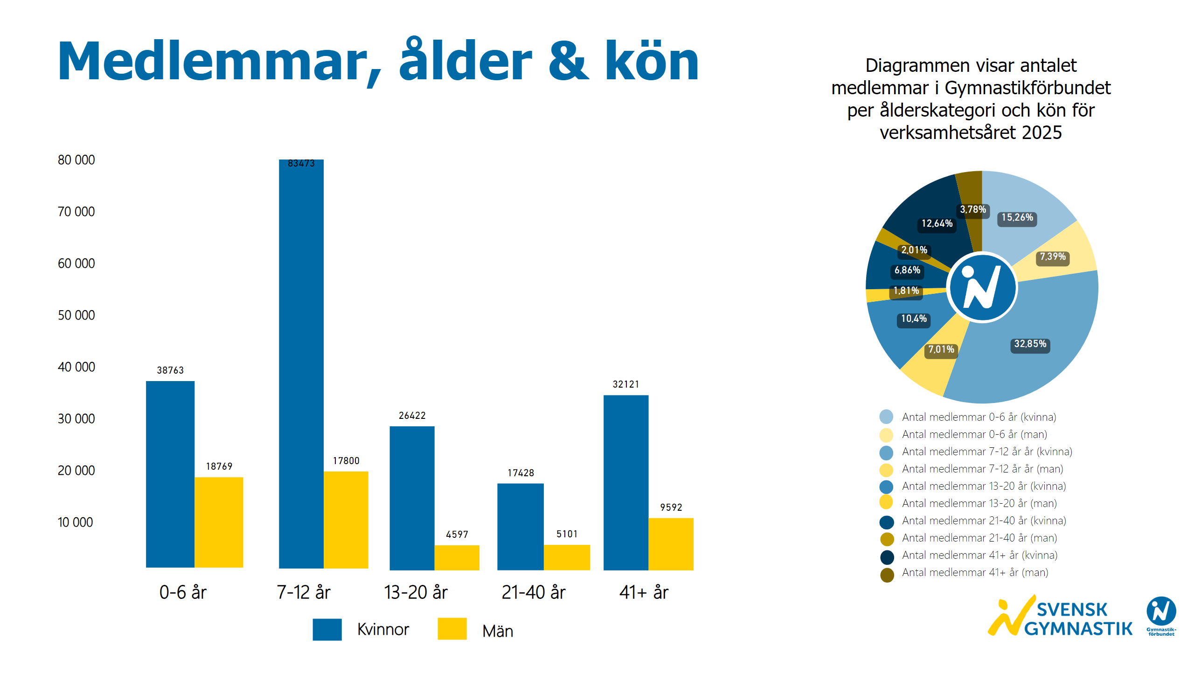
Ålder och kön
Notes:
textbox
No alt text provided
textbox
No alt text provided
image
No alt text provided
textbox
No alt text provided
textbox
No alt text provided
basicShape
No alt text provided
textbox
No alt text provided
basicShape
No alt text provided
textbox
No alt text provided
clusteredColumnChart
No alt text provided
clusteredColumnChart
No alt text provided
clusteredColumnChart
No alt text provided
clusteredColumnChart
No alt text provided
clusteredColumnChart
No alt text provided
donutChart
No alt text provided
textbox
No alt text provided
basicShape
No alt text provided
basicShape
No alt text provided
basicShape
No alt text provided
basicShape
No alt text provided
basicShape
No alt text provided
basicShape
No alt text provided
basicShape
No alt text provided
basicShape
No alt text provided
basicShape
No alt text provided
basicShape
No alt text provided
image
No alt text provided

Slide 5
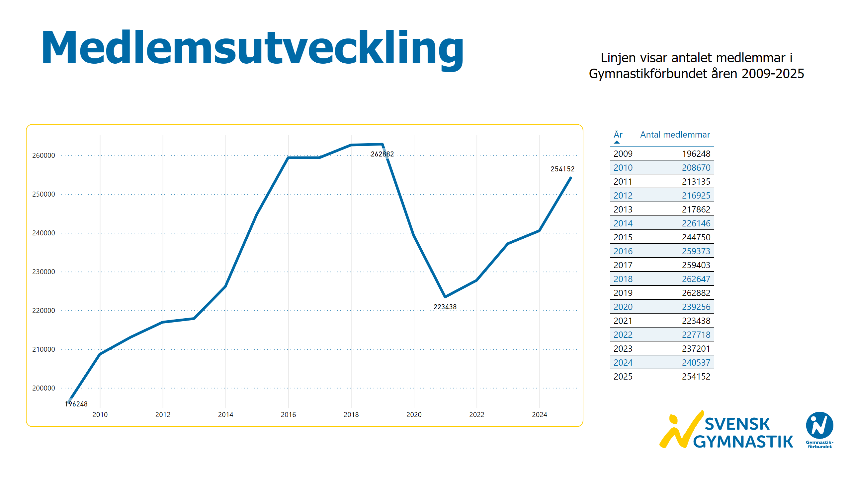
Medlemsutveckling
Notes:
textbox
No alt text provided
textbox
No alt text provided
lineChart
No alt text provided
textbox
No alt text provided
image
No alt text provided
tableEx
No alt text provided

Slide 6
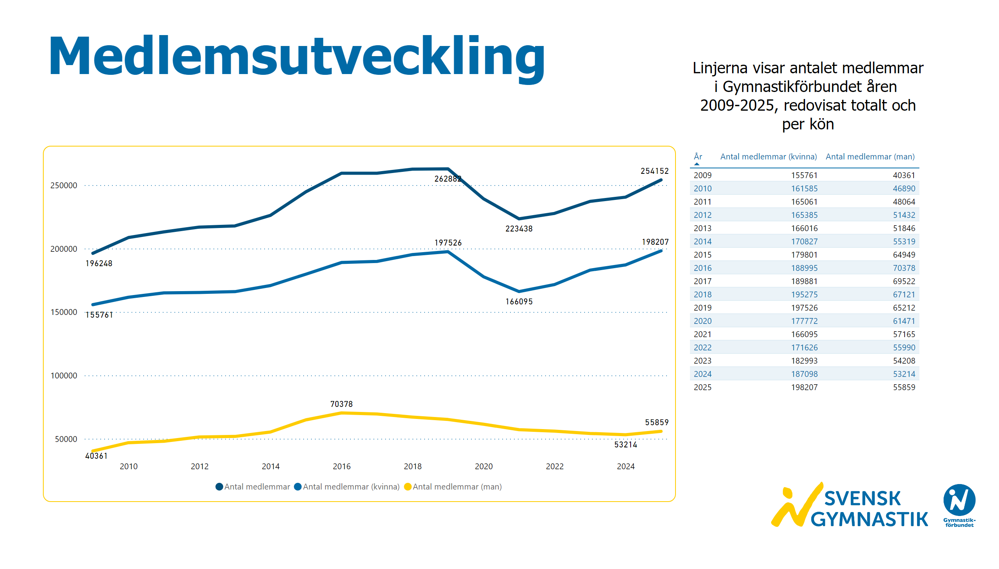
Medlemsutveckling kön
Notes:
textbox
No alt text provided
textbox
No alt text provided
lineChart
No alt text provided
image
No alt text provided
tableEx
No alt text provided

Slide 7
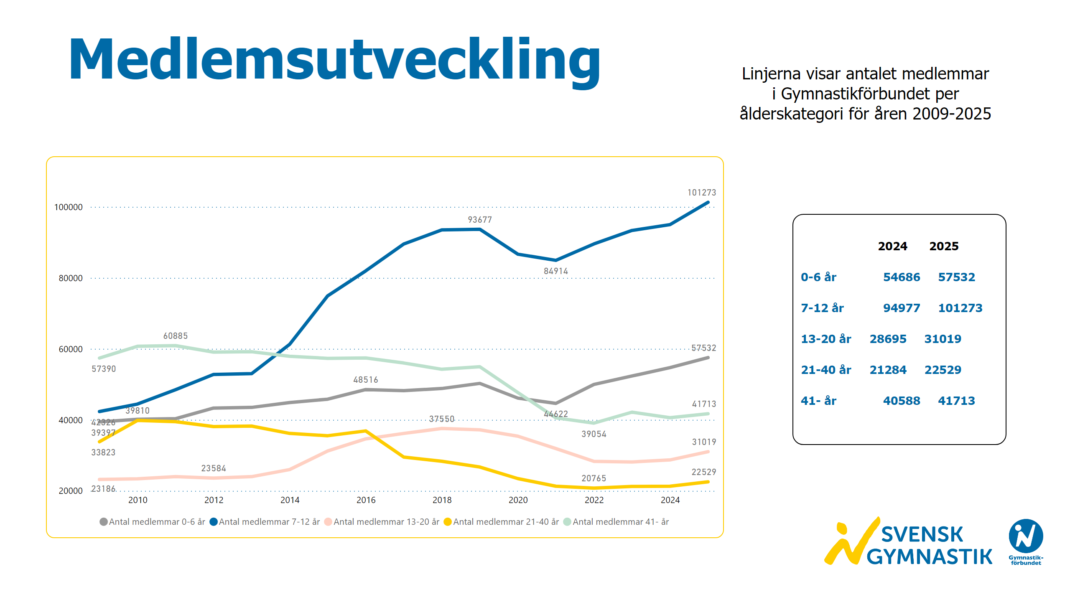
Medlemsutveckling ålder
Notes:
textbox
No alt text provided
textbox
No alt text provided
lineChart
No alt text provided
image
No alt text provided
textbox
No alt text provided

Slide 8
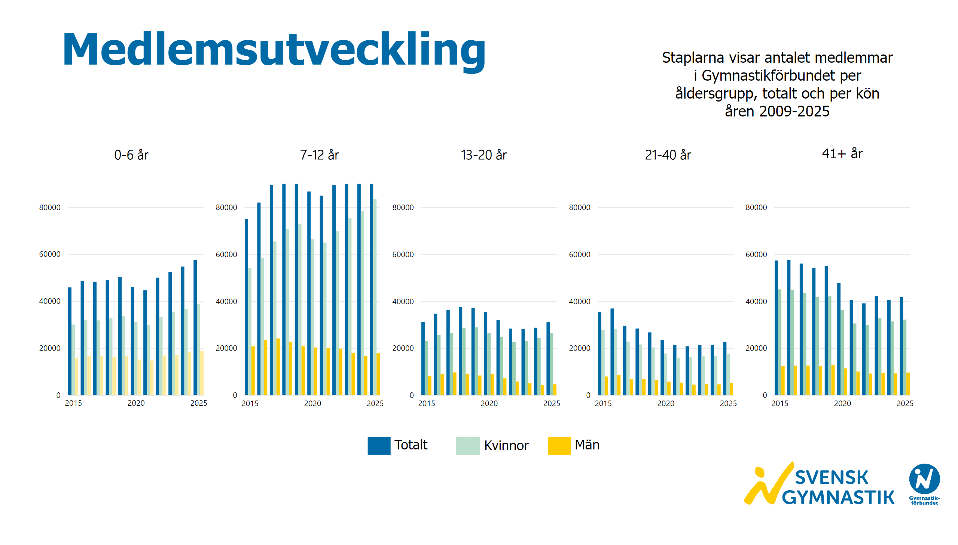
Medlemsutveckling ålder och kön
Notes:
textbox
No alt text provided
textbox
No alt text provided
textbox
No alt text provided
textbox
No alt text provided
textbox
No alt text provided
textbox
No alt text provided
textbox
No alt text provided
basicShape
No alt text provided
textbox
No alt text provided
basicShape
No alt text provided
textbox
No alt text provided
basicShape
No alt text provided
textbox
No alt text provided
clusteredColumnChart
No alt text provided
clusteredColumnChart
No alt text provided
clusteredColumnChart
No alt text provided
clusteredColumnChart
No alt text provided
clusteredColumnChart
No alt text provided
image
No alt text provided

Slide 9
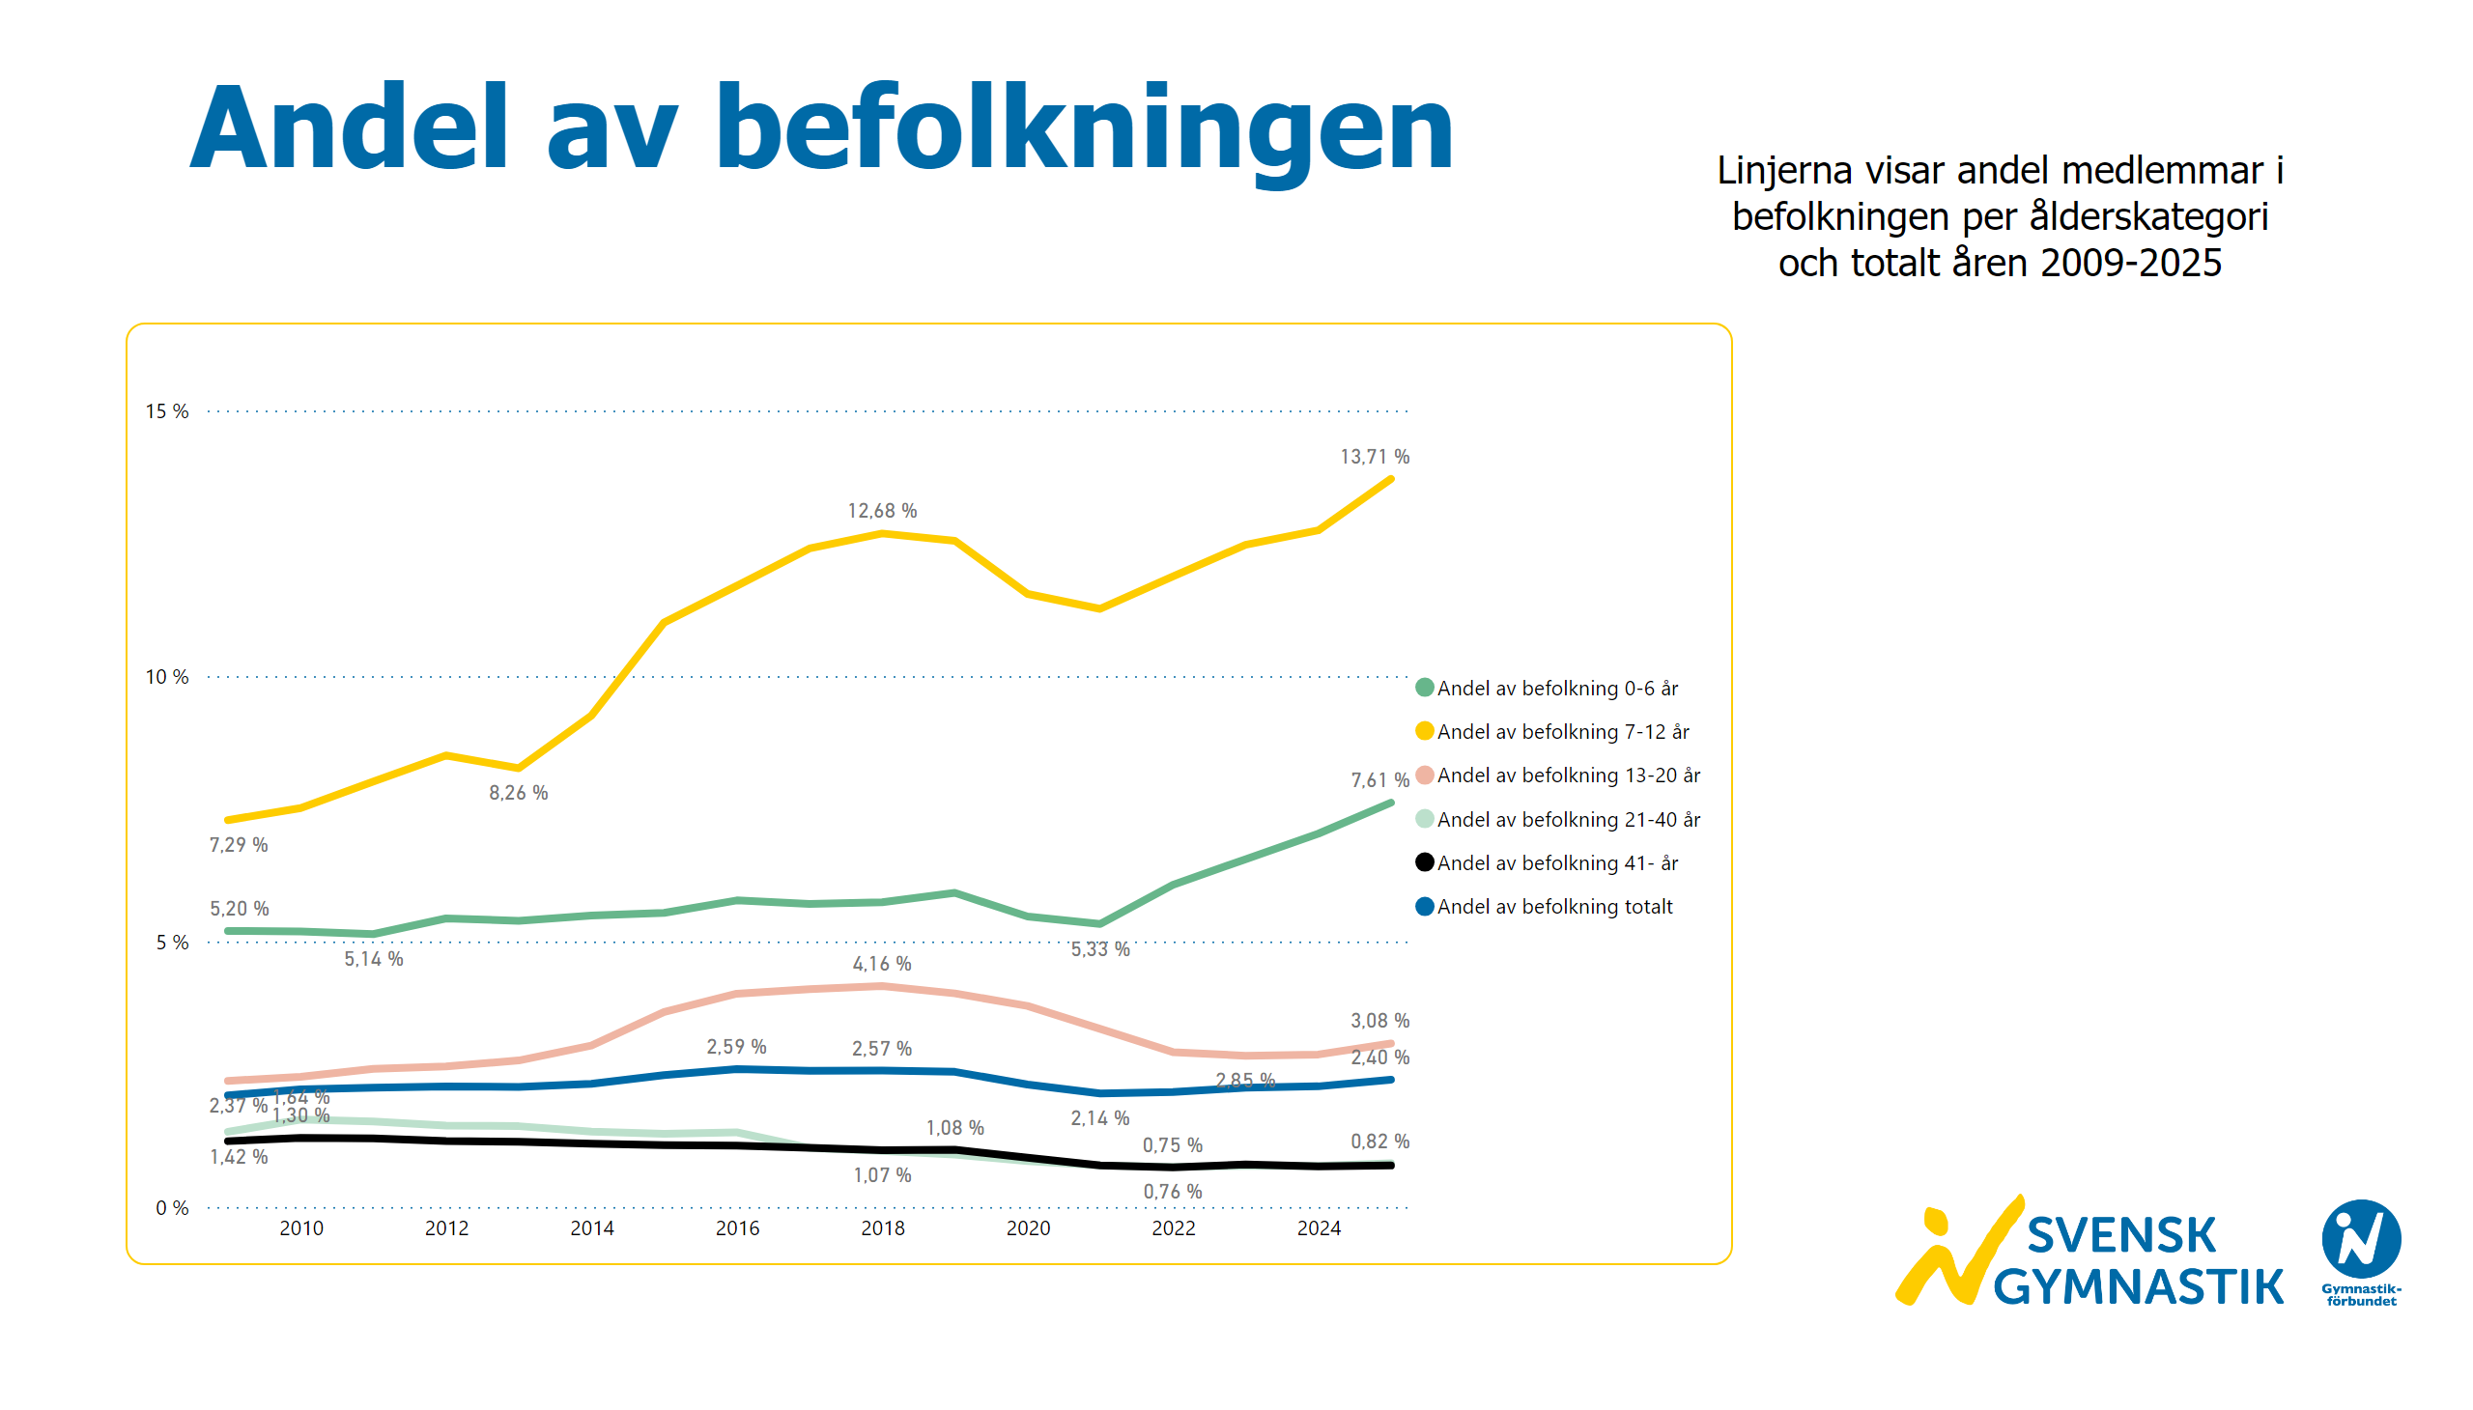
Andel av befolkningen
Notes:
textbox
No alt text provided
textbox
No alt text provided
lineChart
No alt text provided
image
No alt text provided

Slide 10
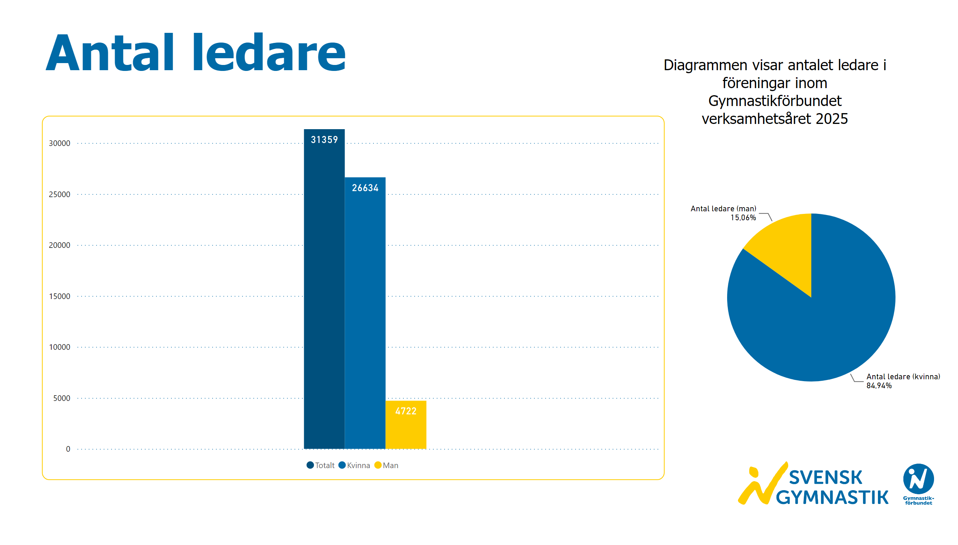
Antal ledare
Notes:
textbox
No alt text provided
textbox
No alt text provided
clusteredColumnChart
No alt text provided
pieChart
No alt text provided
image
No alt text provided

Slide 11
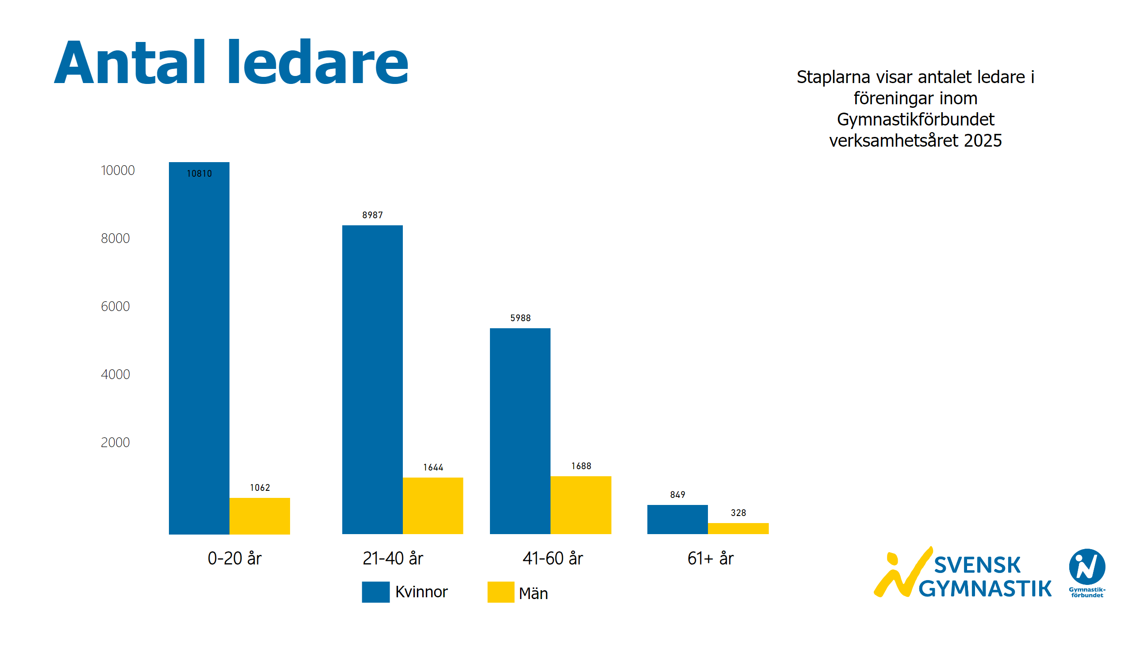
Antal ledare kön och ålder
Notes:
textbox
No alt text provided
textbox
No alt text provided
textbox
No alt text provided
clusteredColumnChart
No alt text provided
clusteredColumnChart
No alt text provided
clusteredColumnChart
No alt text provided
clusteredColumnChart
No alt text provided
textbox
No alt text provided
basicShape
No alt text provided
textbox
No alt text provided
basicShape
No alt text provided
textbox
No alt text provided
image
No alt text provided
textbox
No alt text provided

Slide 12
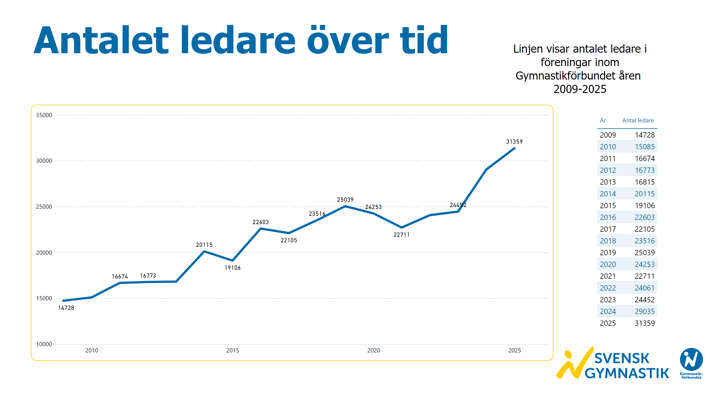
Ledarutveckling
Notes:
textbox
No alt text provided
textbox
No alt text provided
lineChart
No alt text provided
image
No alt text provided
tableEx
No alt text provided

Slide 13
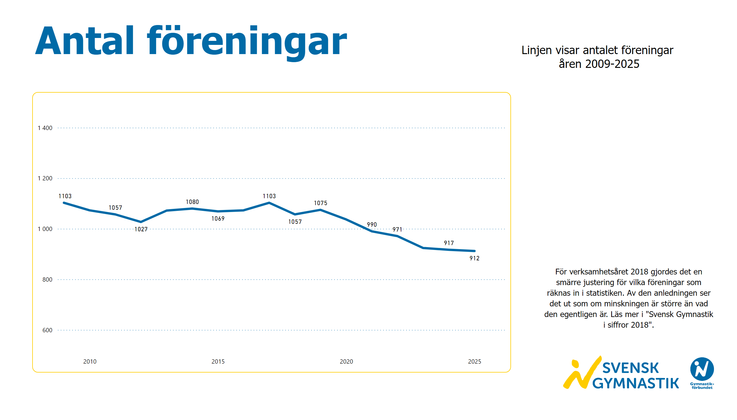
Antal föreningar
Notes:
textbox
No alt text provided
textbox
No alt text provided
textbox
No alt text provided
lineChart
No alt text provided
image
No alt text provided

Slide 14
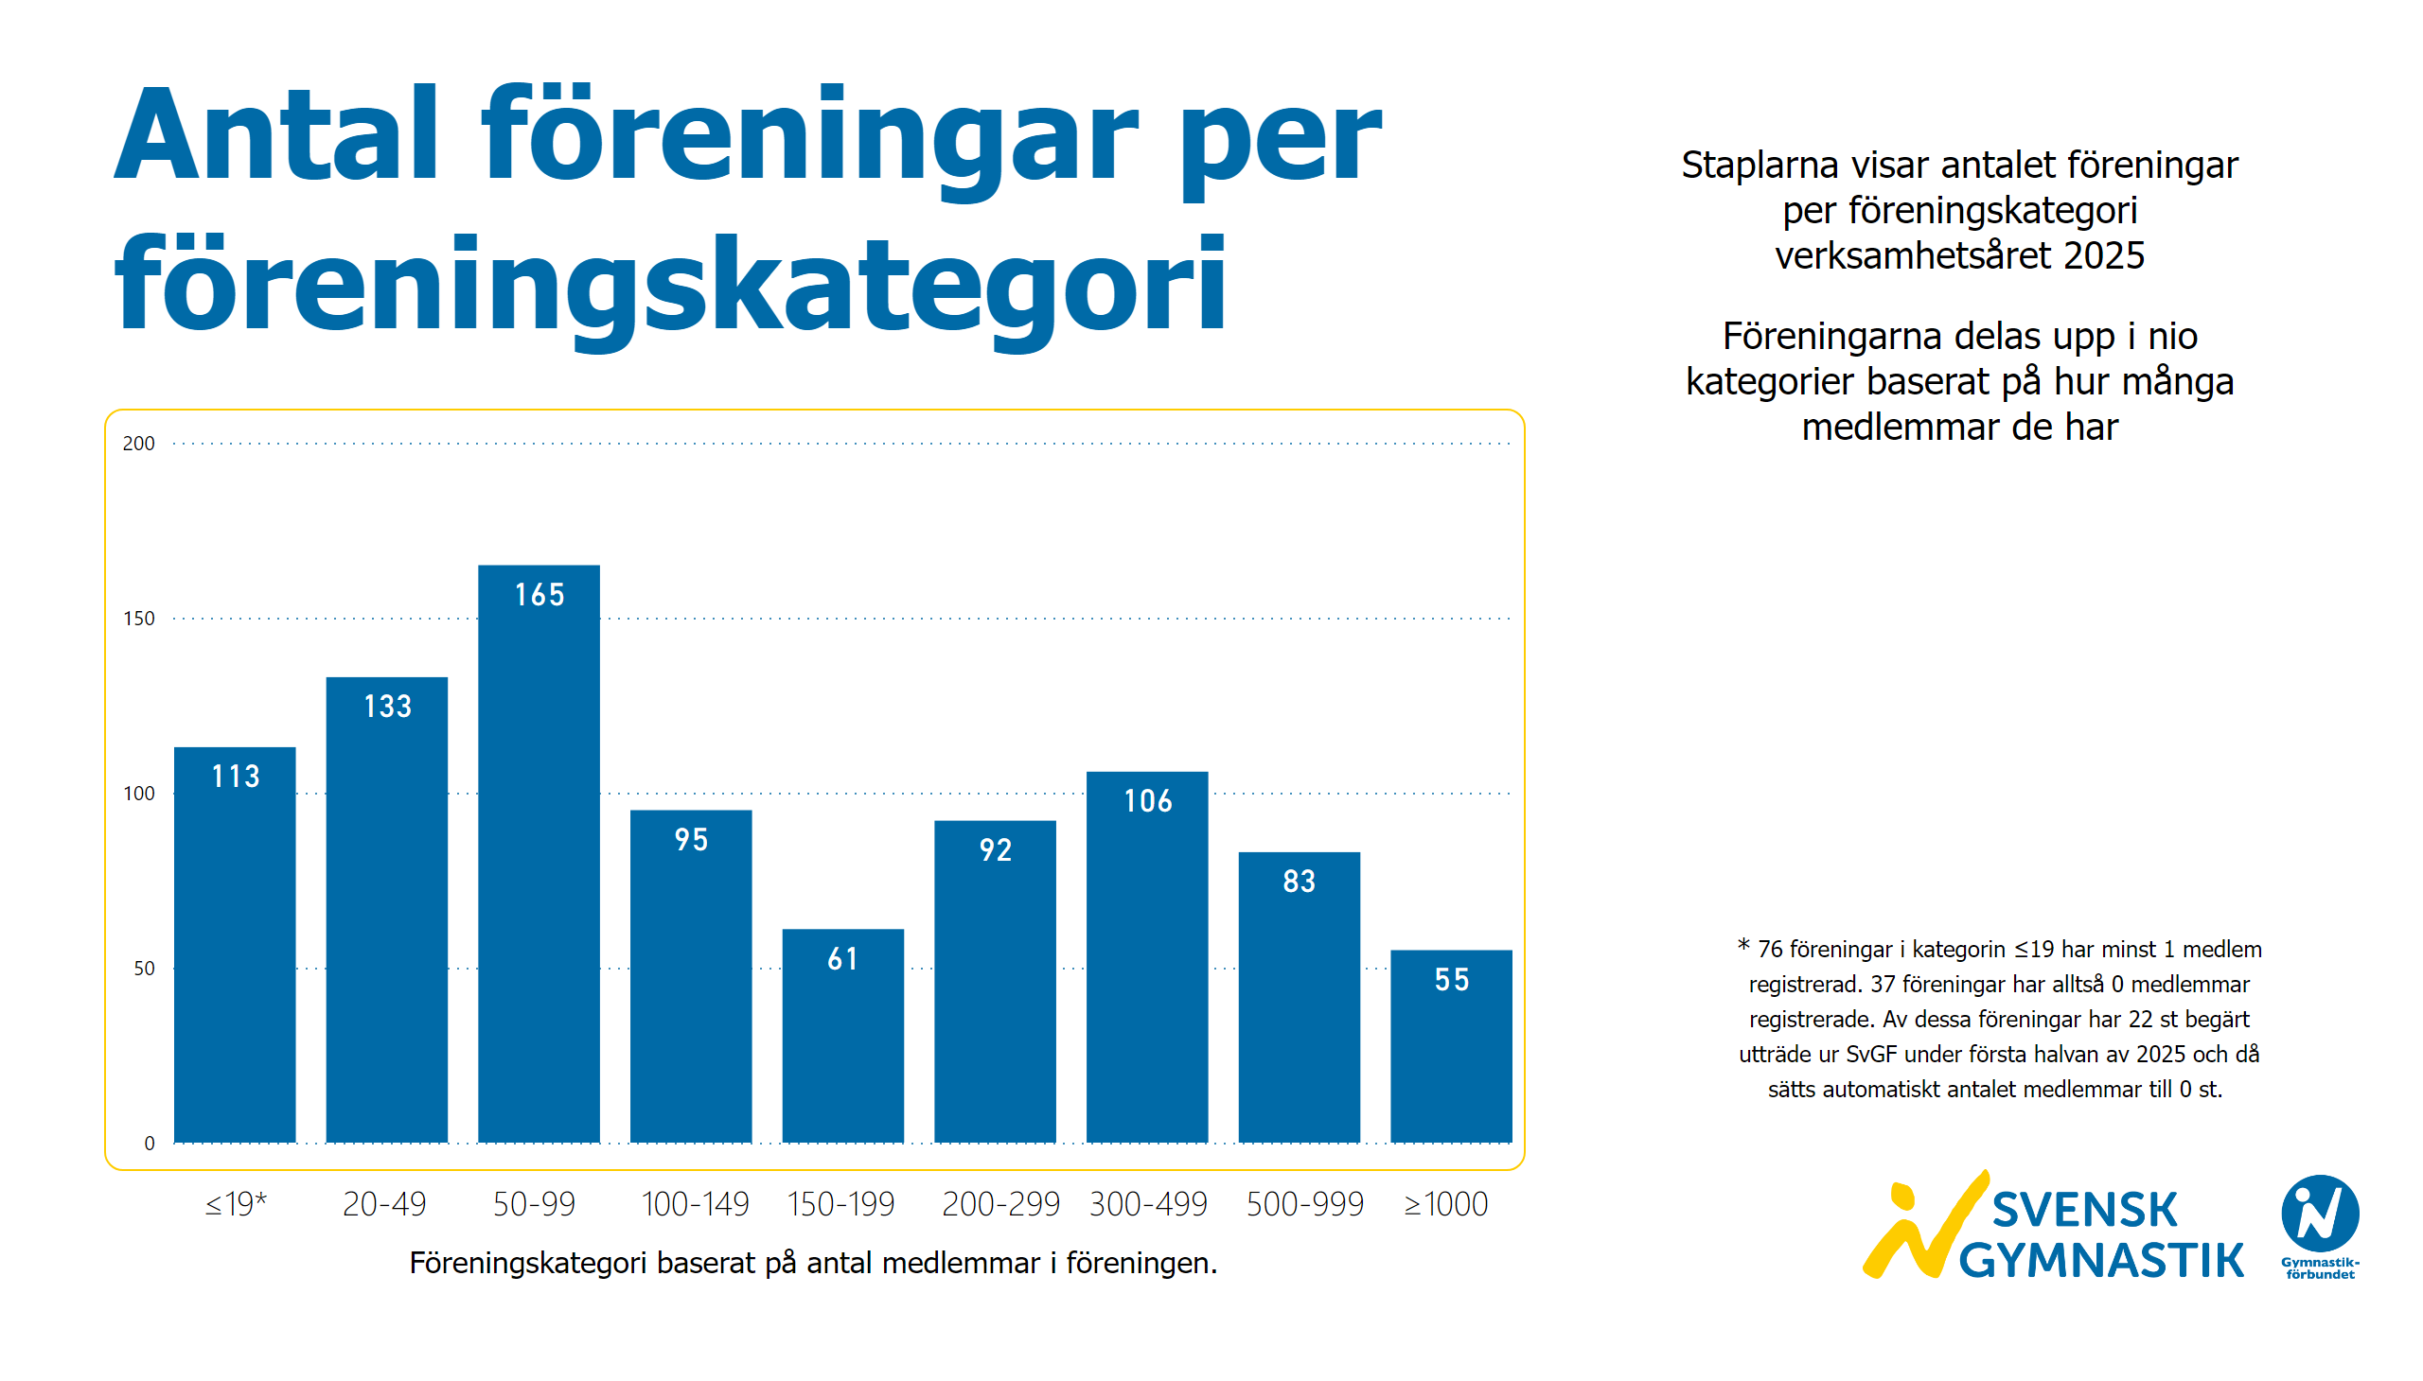
Föreningar per föreningskategori
Notes:
textbox
No alt text provided
textbox
No alt text provided
textbox
No alt text provided
clusteredColumnChart
No alt text provided
textbox
No alt text provided
textbox
No alt text provided
image
No alt text provided

Slide 15
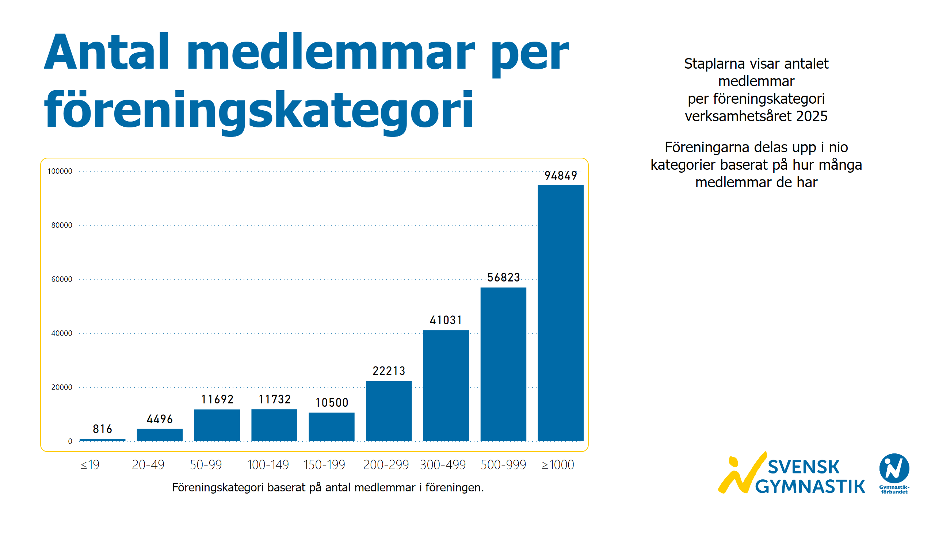
Medlemmar per föreningskategori
Notes:
textbox
No alt text provided
textbox
No alt text provided
textbox
No alt text provided
textbox
No alt text provided
clusteredColumnChart
No alt text provided
image
No alt text provided

Slide 16
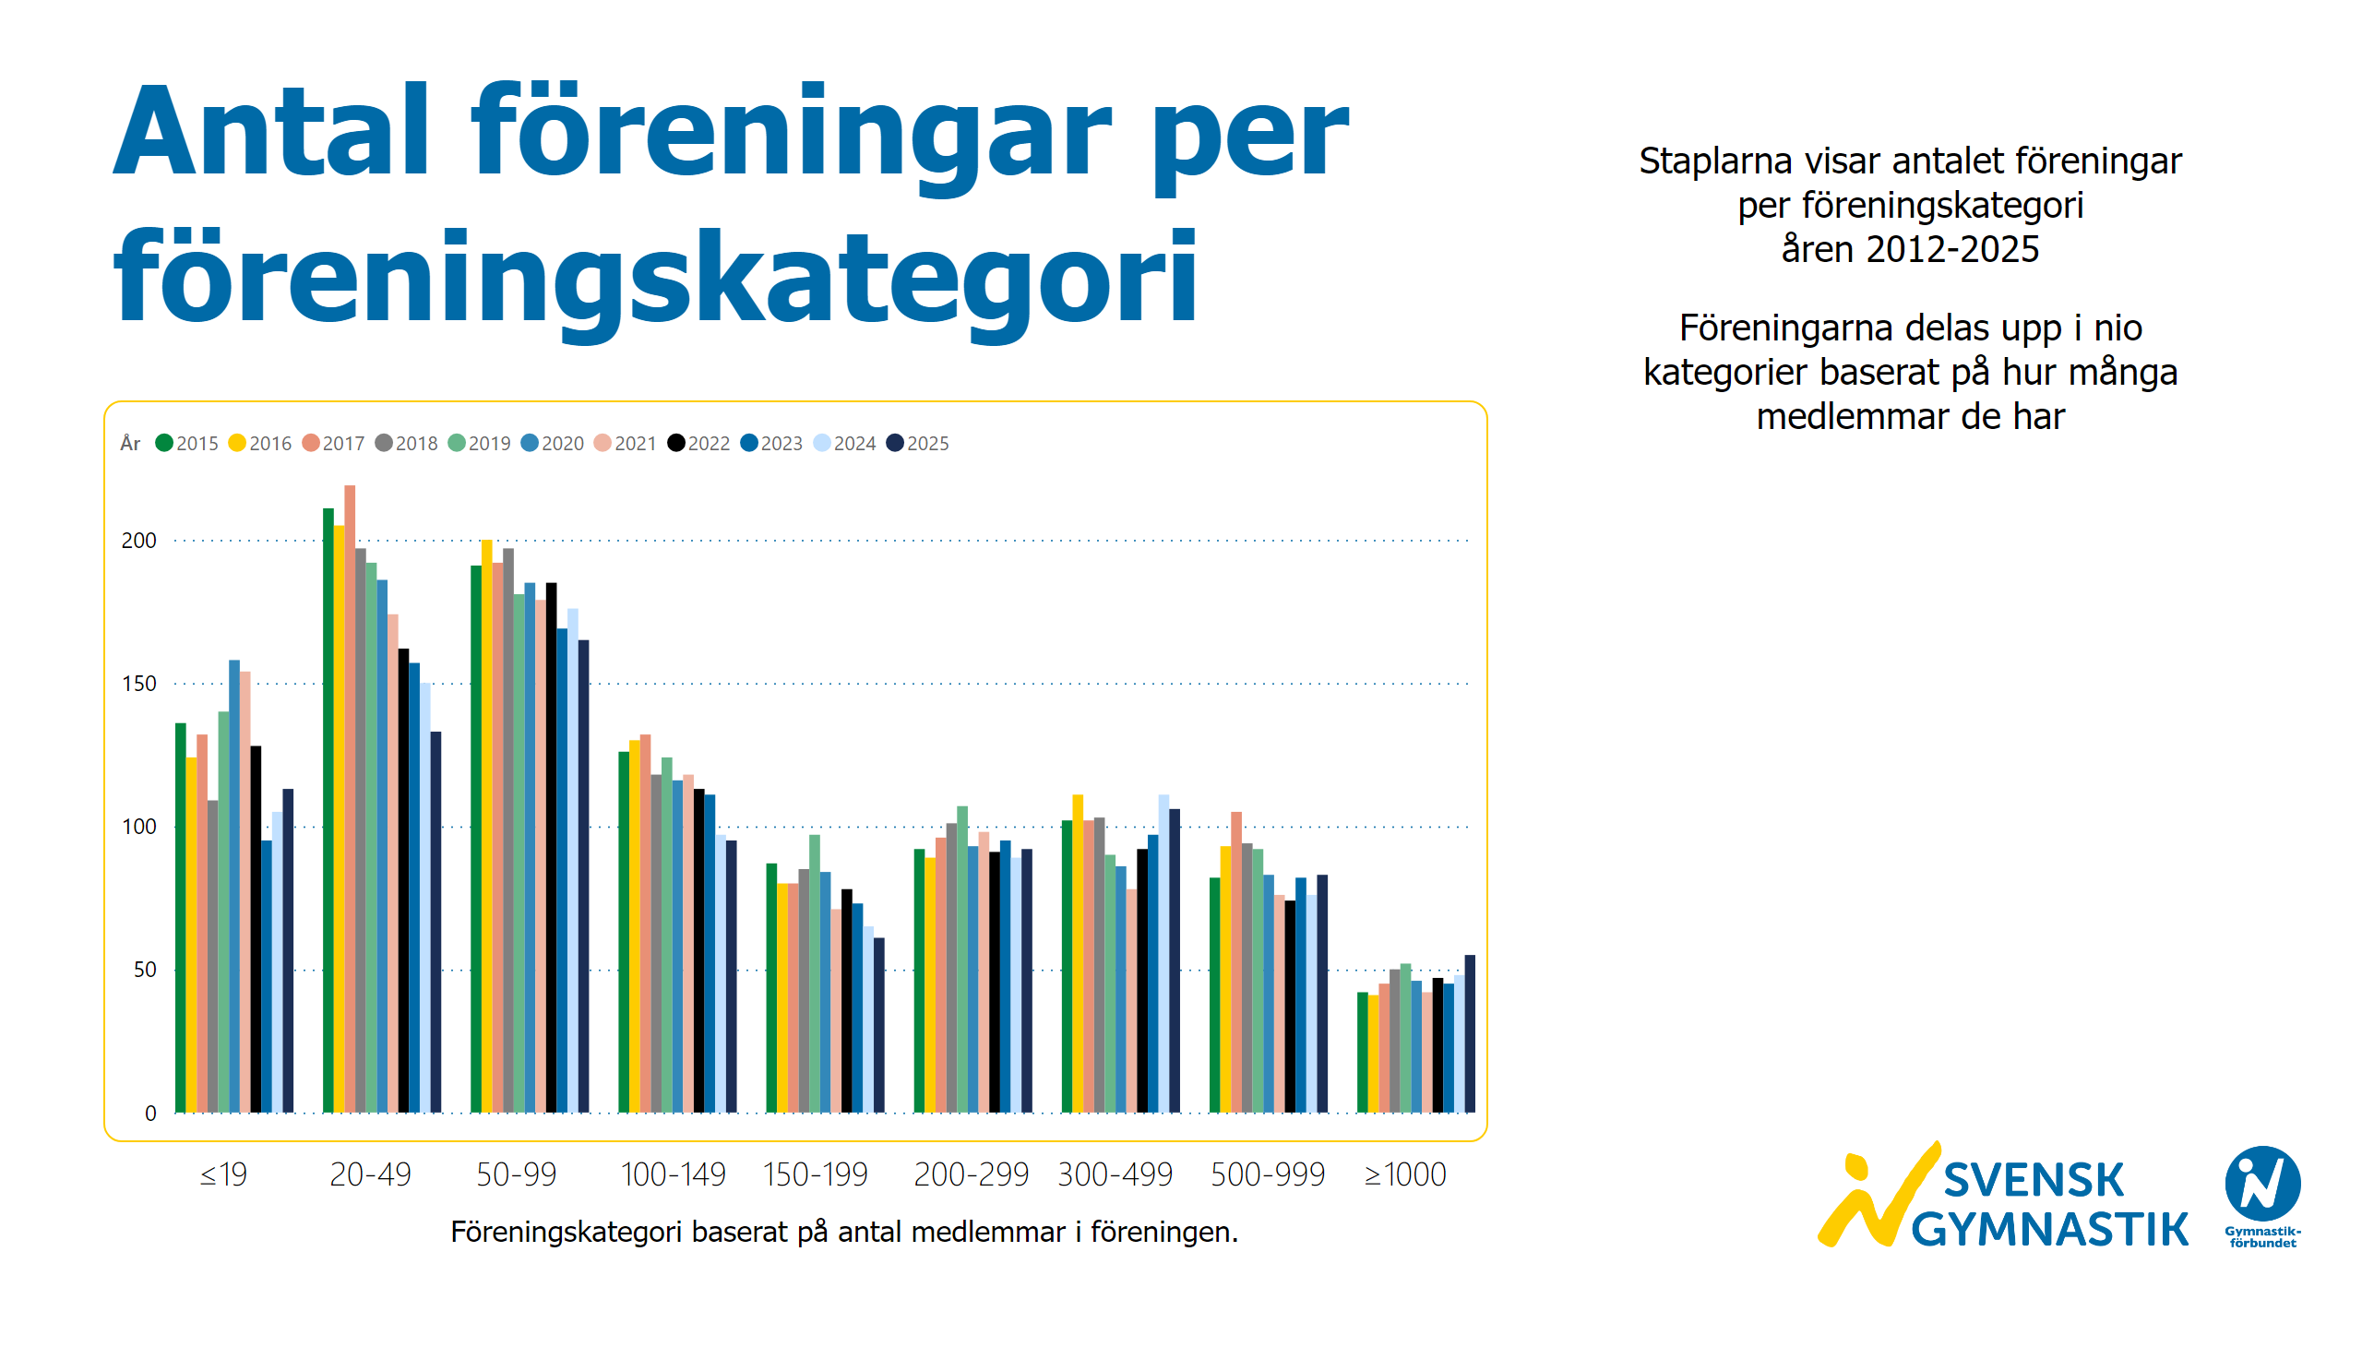
Föreningar per föreningskategori och år
Notes:
textbox
No alt text provided
textbox
No alt text provided
textbox
No alt text provided
textbox
No alt text provided
clusteredColumnChart
No alt text provided
image
No alt text provided

Slide 17
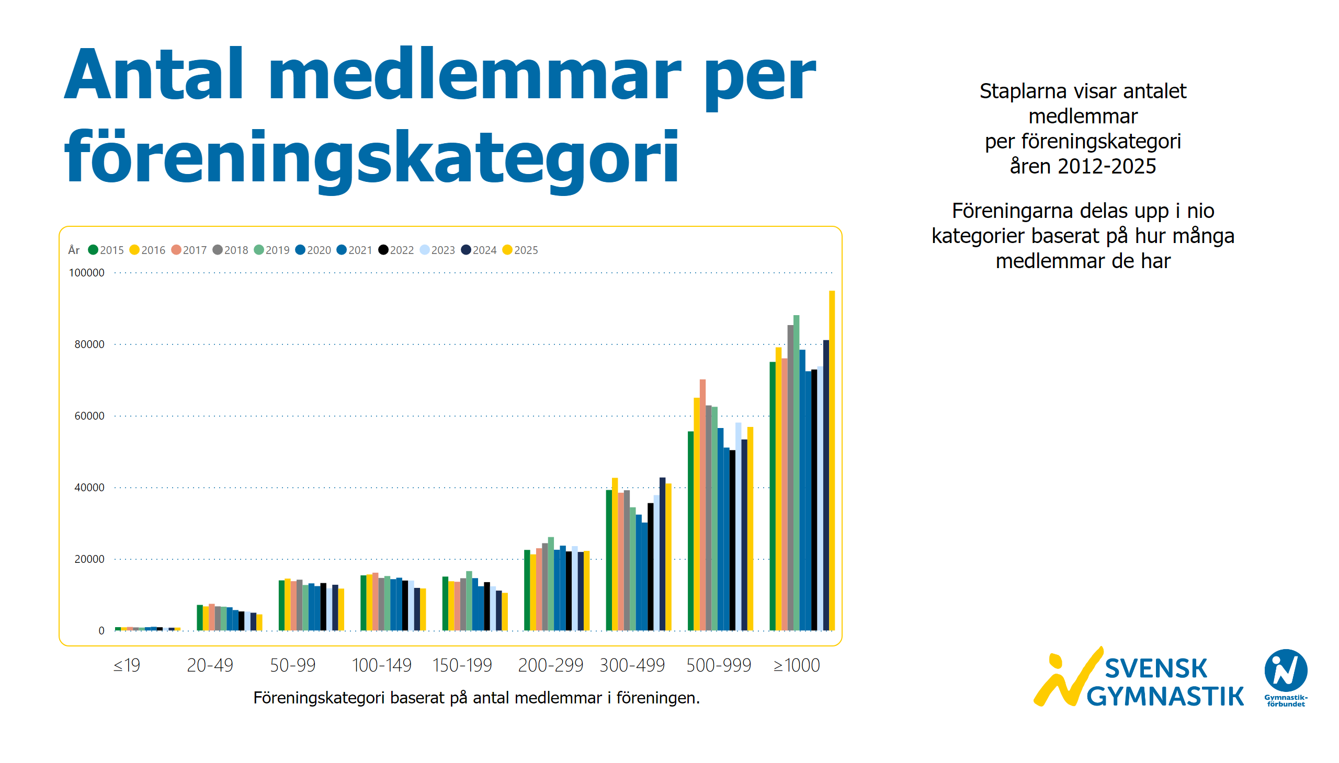
Medlemmar per föreningskategori och år
Notes:
textbox
No alt text provided
textbox
No alt text provided
textbox
No alt text provided
textbox
No alt text provided
clusteredColumnChart
No alt text provided
image
No alt text provided

Slide 18
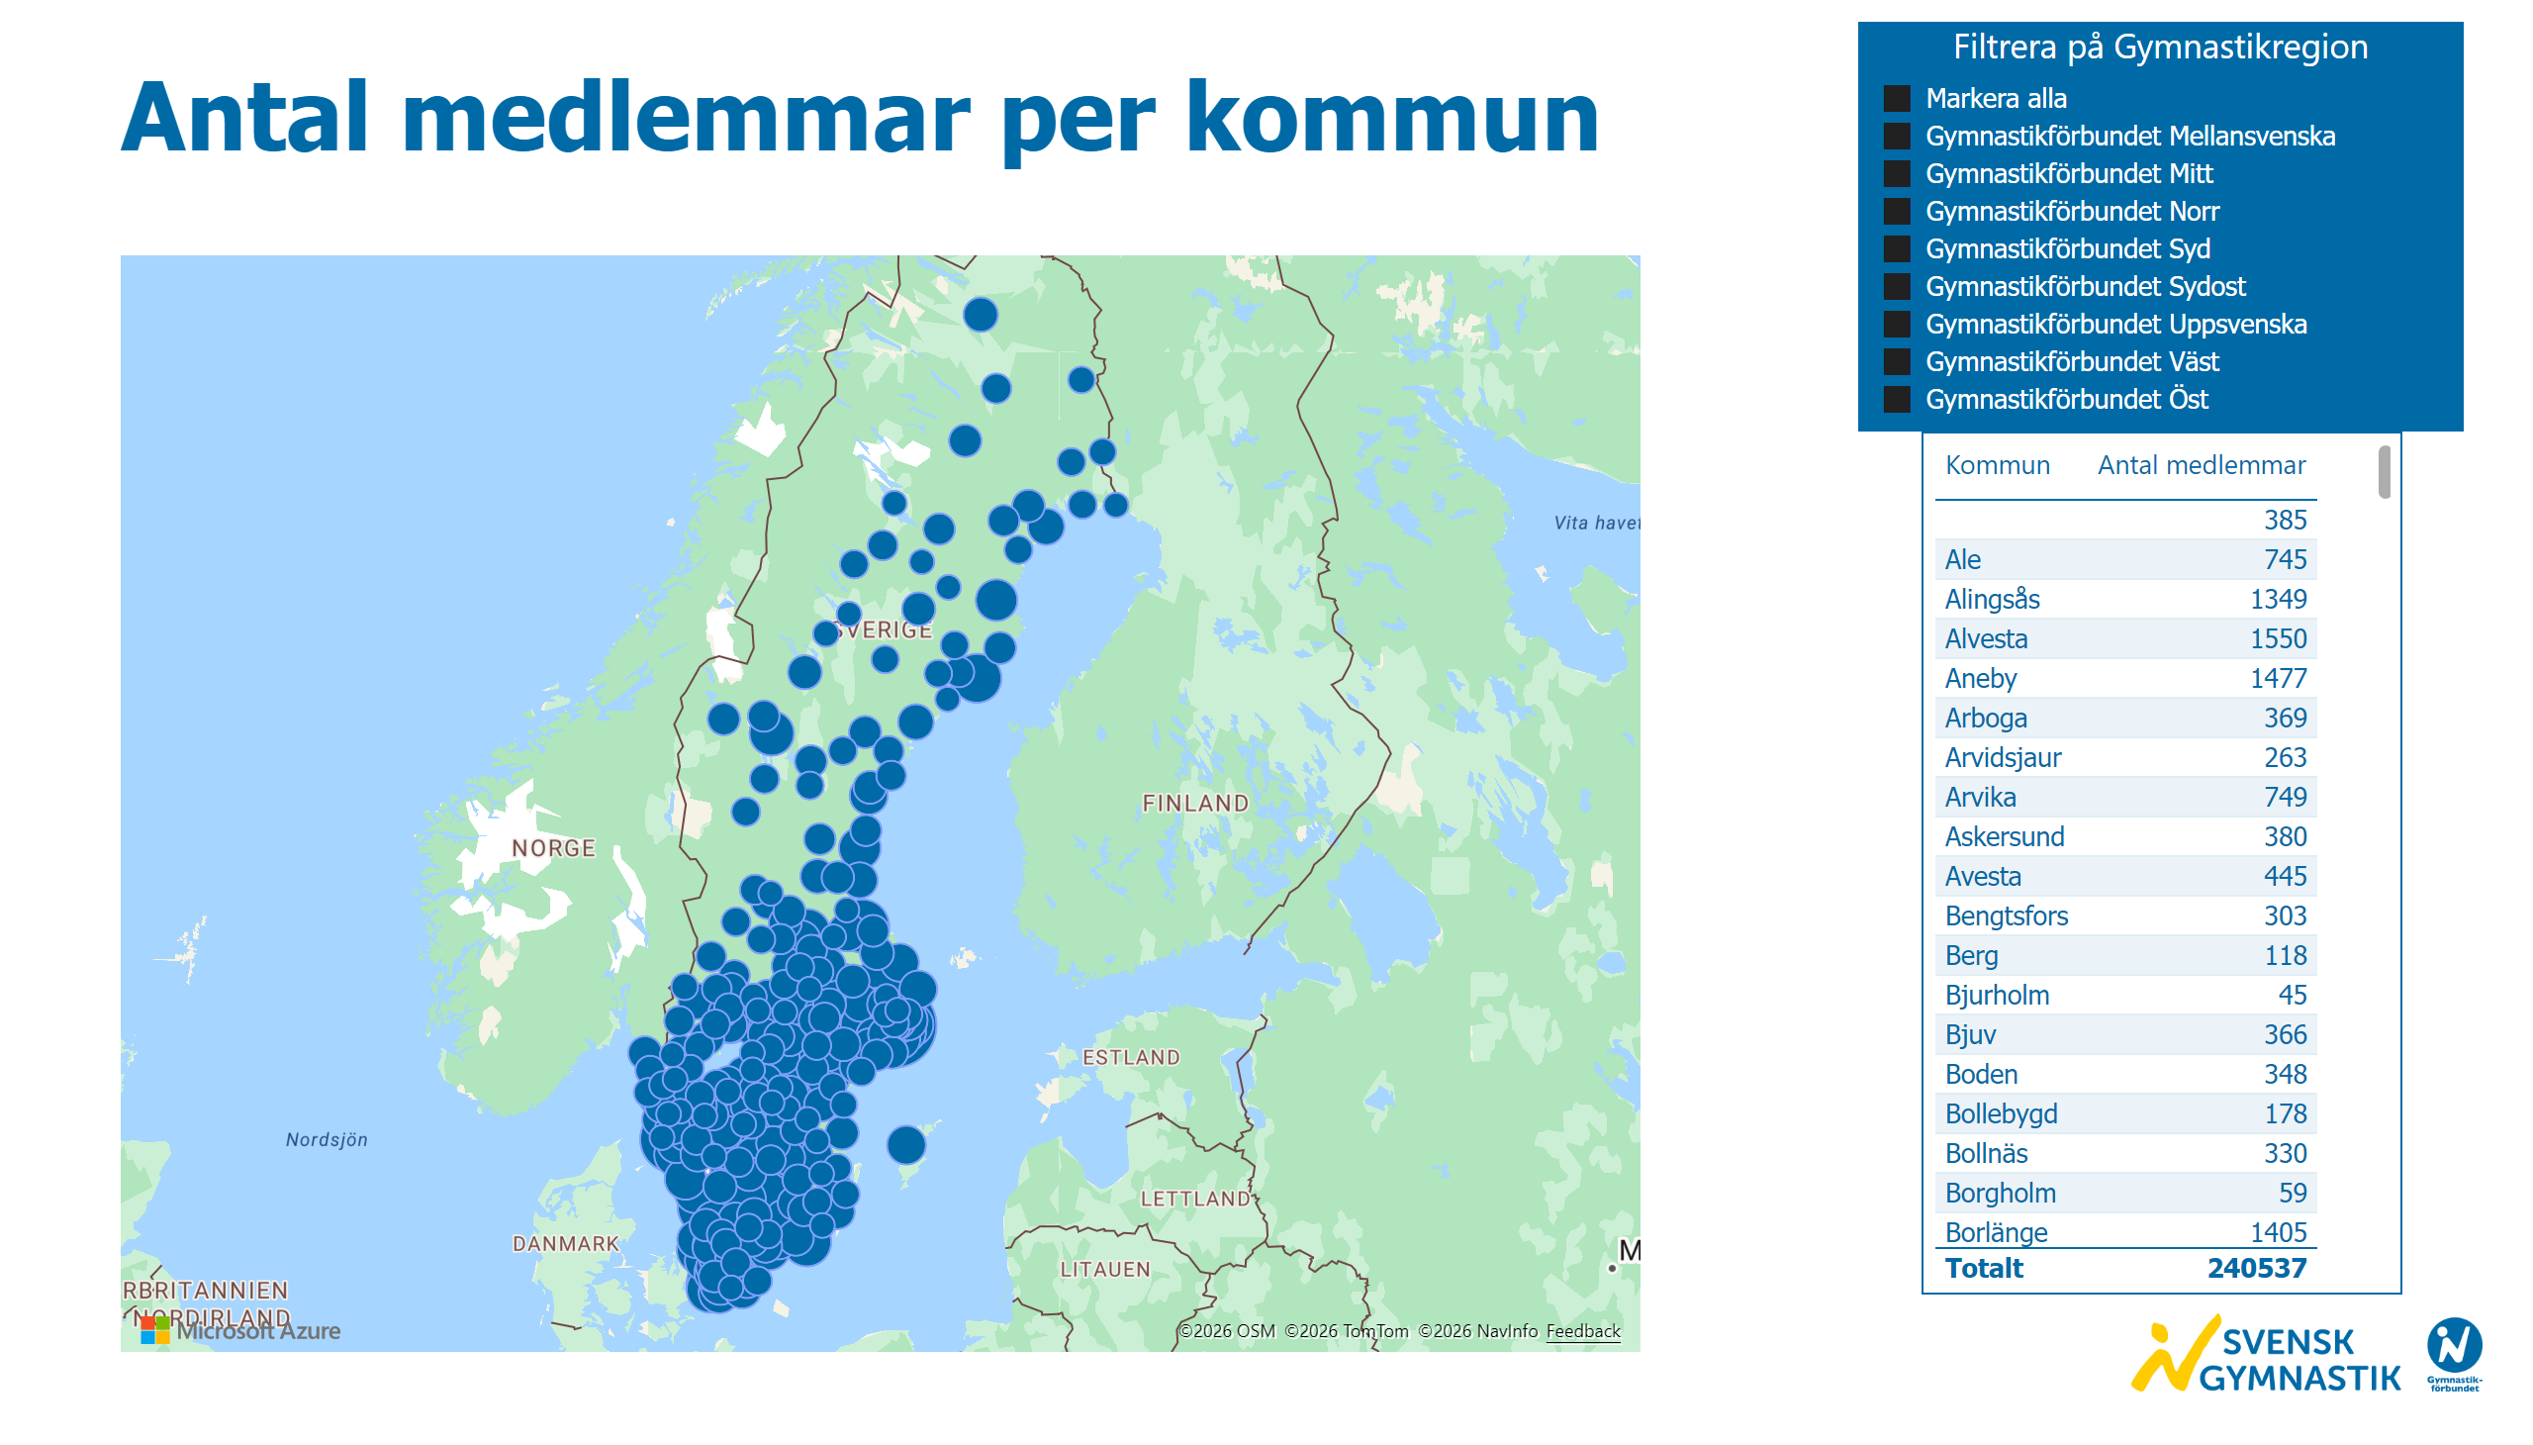
Medlemmar per kommun
Notes:
textbox
No alt text provided
azureMap
No alt text provided
Filtrera på Gymnastikregion
No alt text provided
tableEx
No alt text provided
image
No alt text provided

Slide 19
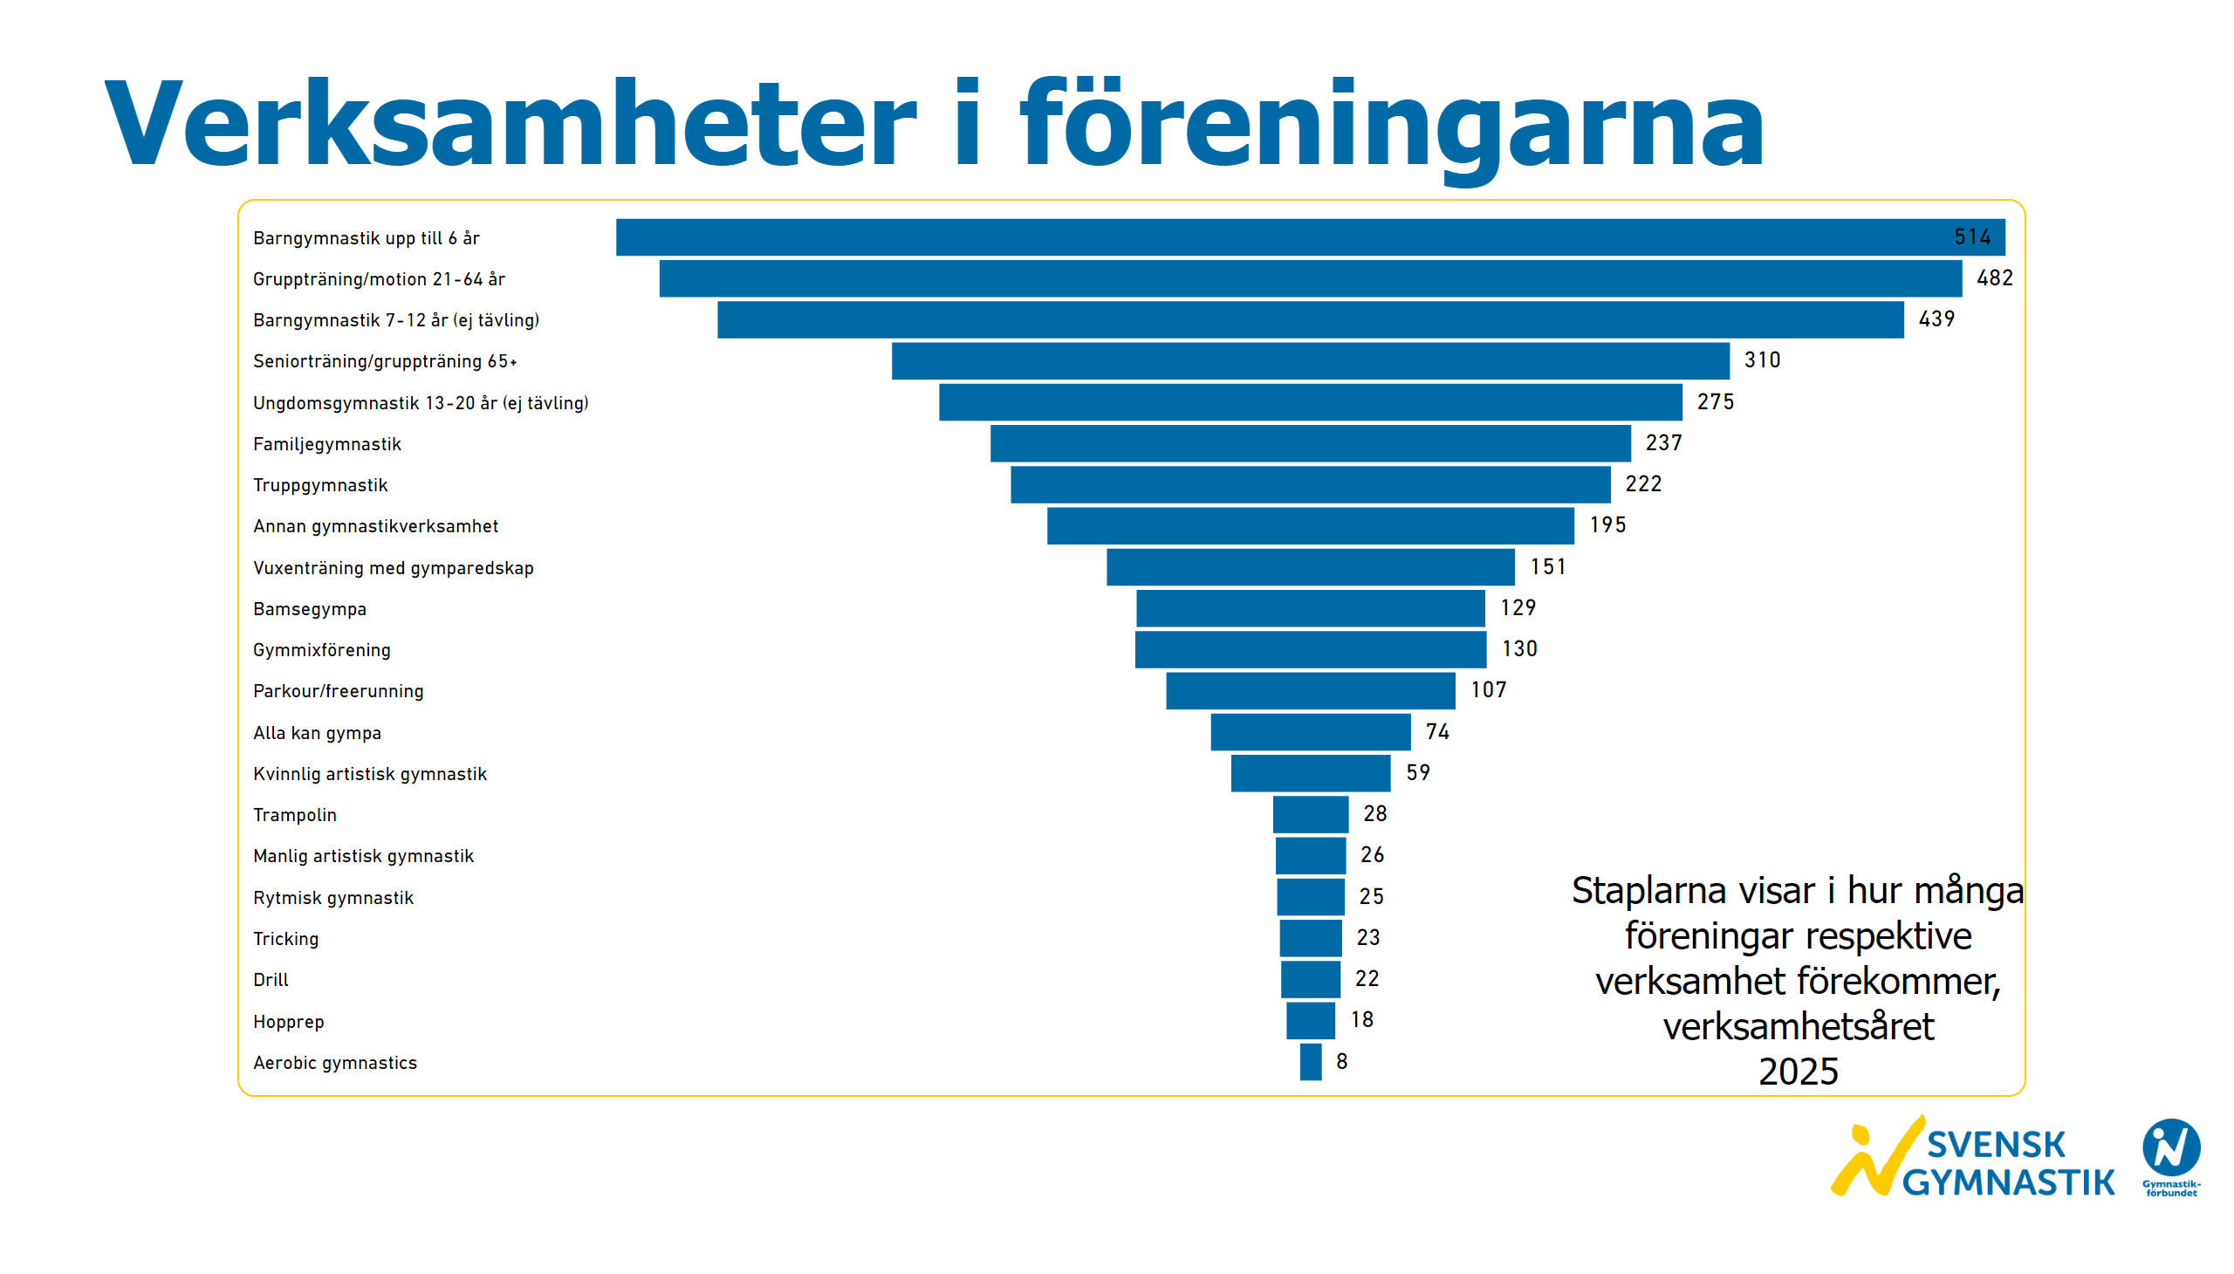
Verksamheter i föreningarna
Notes:
textbox
No alt text provided
textbox
No alt text provided
funnel
No alt text provided
image
No alt text provided

Slide 20
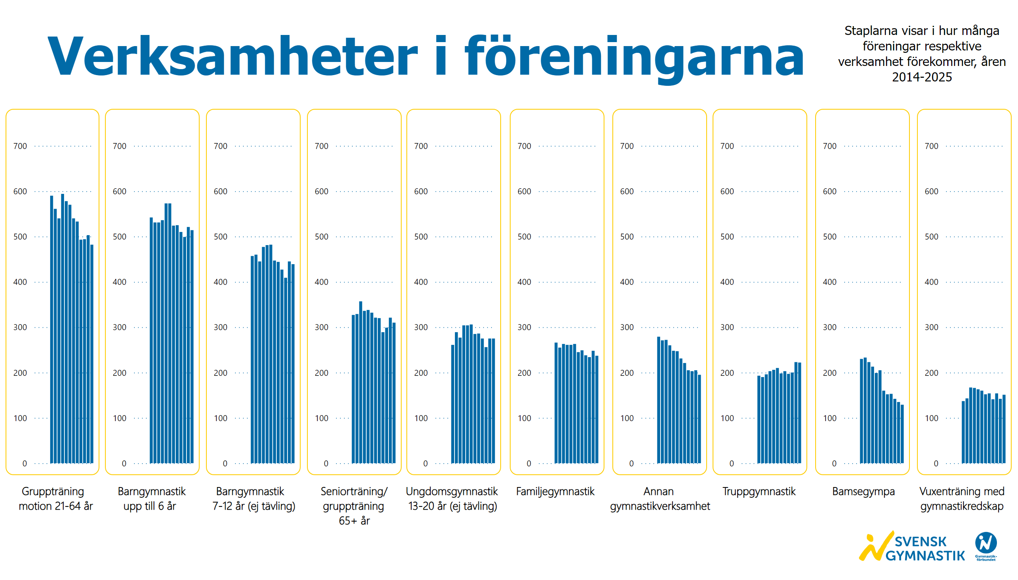
Verksamheter i föreningarna 2014-2025
Notes:
textbox
No alt text provided
textbox
No alt text provided
textbox
No alt text provided
clusteredColumnChart
No alt text provided
clusteredColumnChart
No alt text provided
clusteredColumnChart
No alt text provided
clusteredColumnChart
No alt text provided
clusteredColumnChart
No alt text provided
clusteredColumnChart
No alt text provided
clusteredColumnChart
No alt text provided
clusteredColumnChart
No alt text provided
clusteredColumnChart
No alt text provided
clusteredColumnChart
No alt text provided
image
No alt text provided

Slide 21
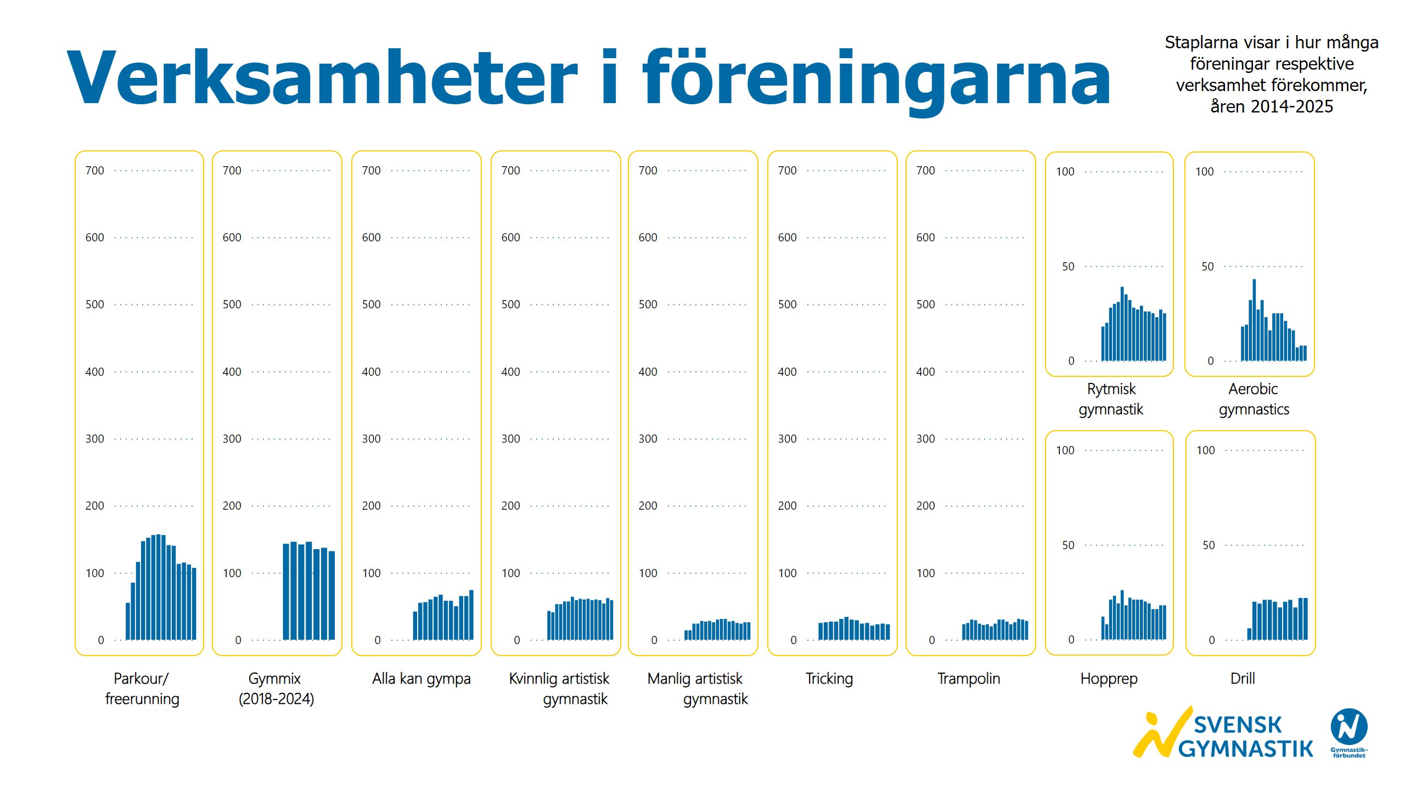
Verksamheter i föreningarna 2014-2025 2
Notes:
textbox
No alt text provided
textbox
No alt text provided
clusteredColumnChart
No alt text provided
clusteredColumnChart
No alt text provided
clusteredColumnChart
No alt text provided
clusteredColumnChart
No alt text provided
clusteredColumnChart
No alt text provided
clusteredColumnChart
No alt text provided
clusteredColumnChart
No alt text provided
clusteredColumnChart
No alt text provided
clusteredColumnChart
No alt text provided
textbox
No alt text provided
clusteredColumnChart
No alt text provided
clusteredColumnChart
No alt text provided
textbox
No alt text provided
image
No alt text provided

Slide 22
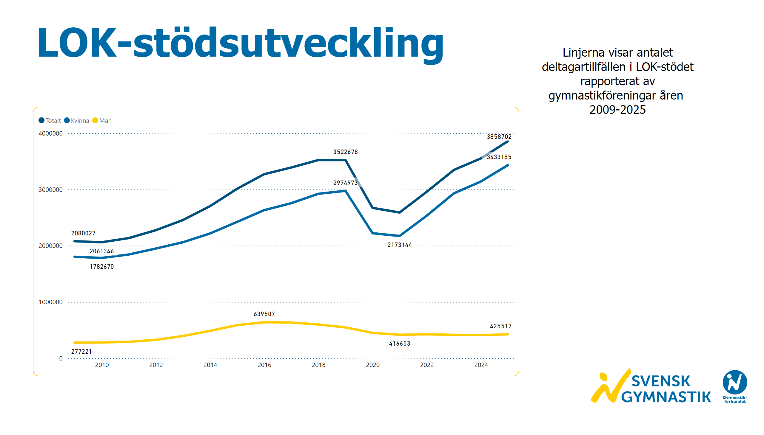
LOK-stödsutveckling
Notes:
textbox
No alt text provided
textbox
No alt text provided
lineChart
No alt text provided
image
No alt text provided

Slide 23
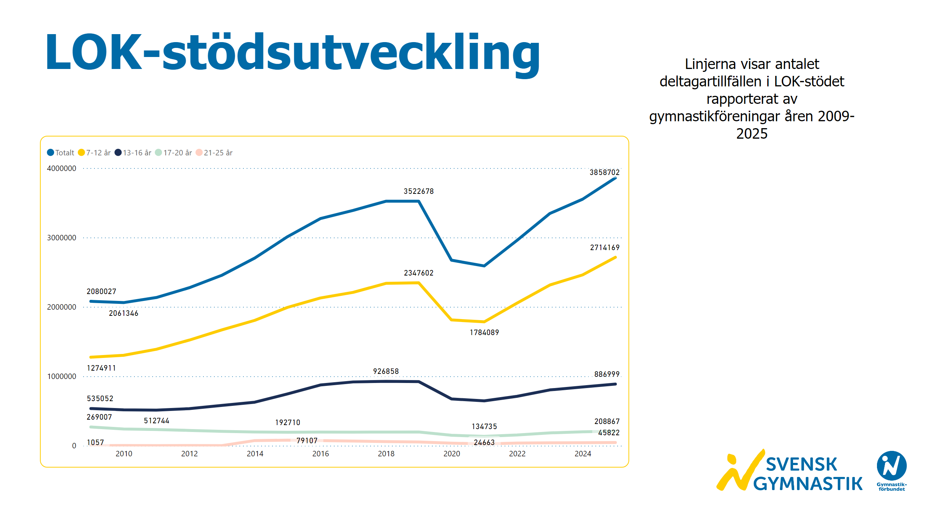
LOK-stödsutveckling åldersgrupper
Notes:
textbox
No alt text provided
lineChart
No alt text provided
textbox
No alt text provided
image
No alt text provided

Slide 24
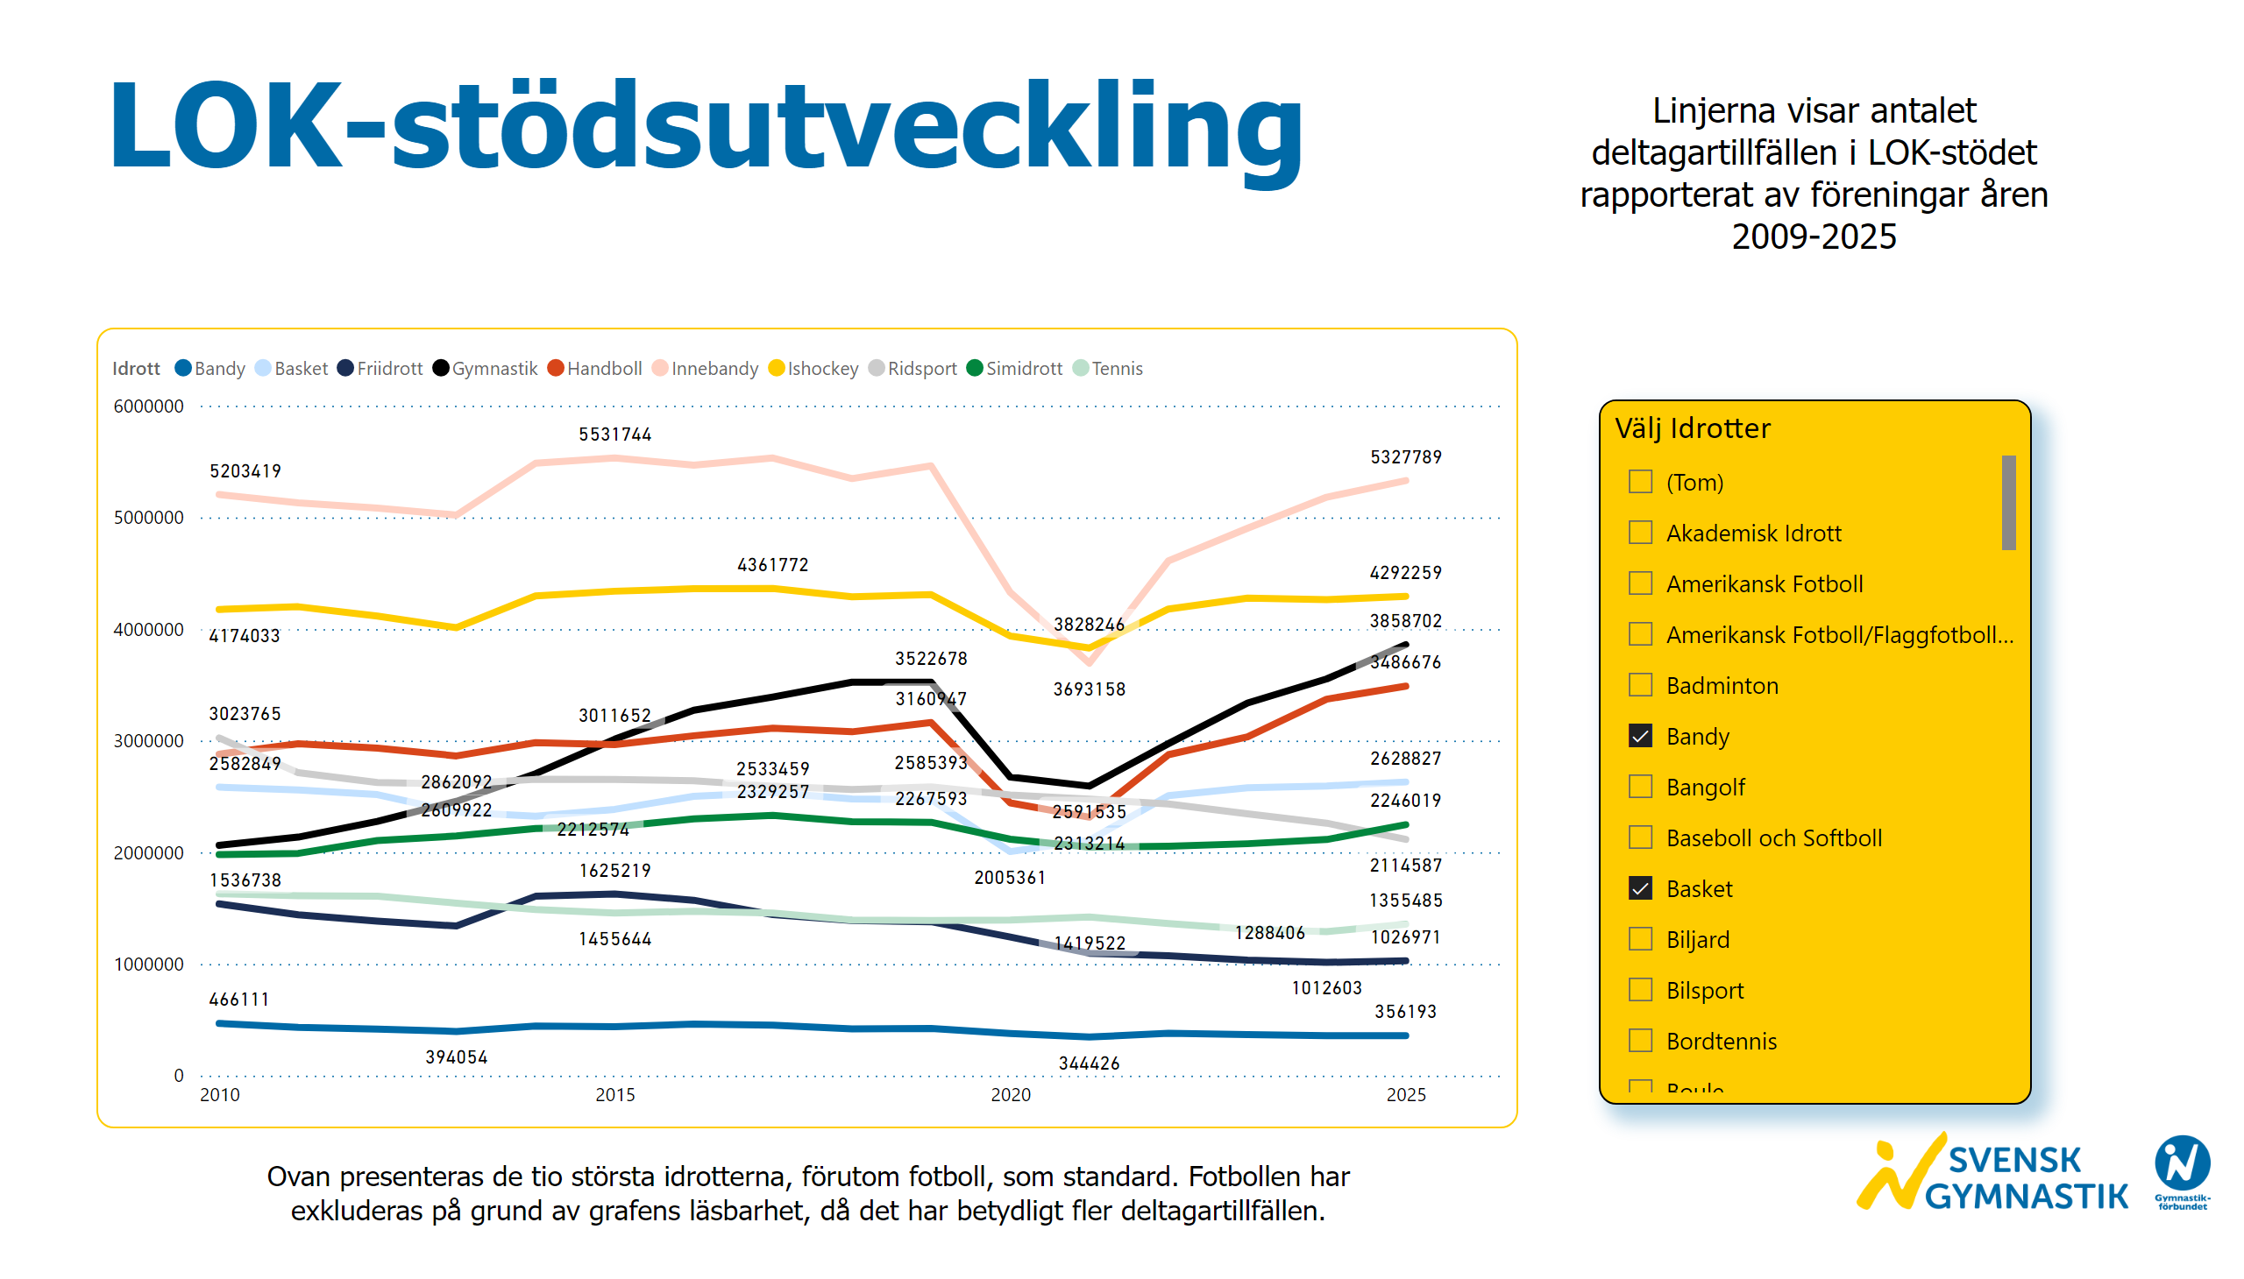
LOK-stödsutveckling - Jämföra idrotter
Notes:
textbox
No alt text provided
textbox
No alt text provided
lineChart
No alt text provided
Välj Idrotter
No alt text provided
textbox
No alt text provided
image
No alt text provided

Slide 25
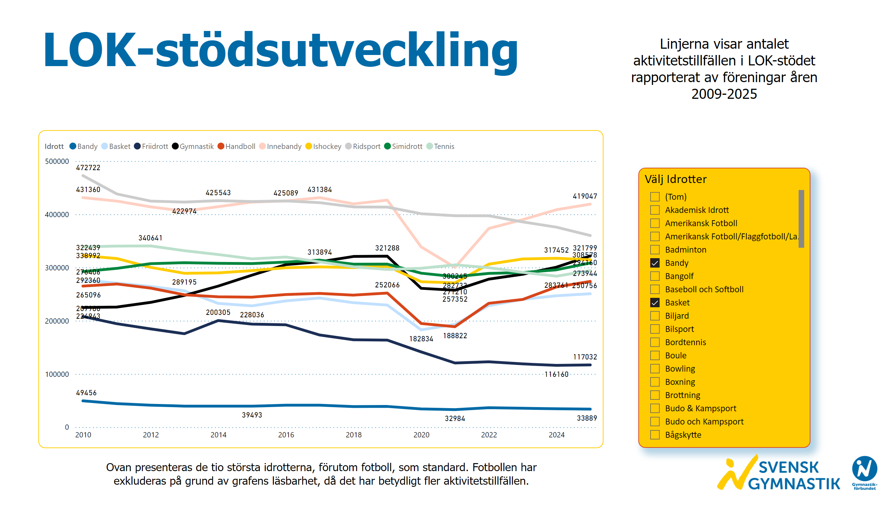
LOK-stödsutveckling - jämföra idrotter 2
Notes:
textbox
No alt text provided
lineChart
No alt text provided
Välj Idrotter
No alt text provided
textbox
No alt text provided
textbox
No alt text provided
image
No alt text provided

Slide 26
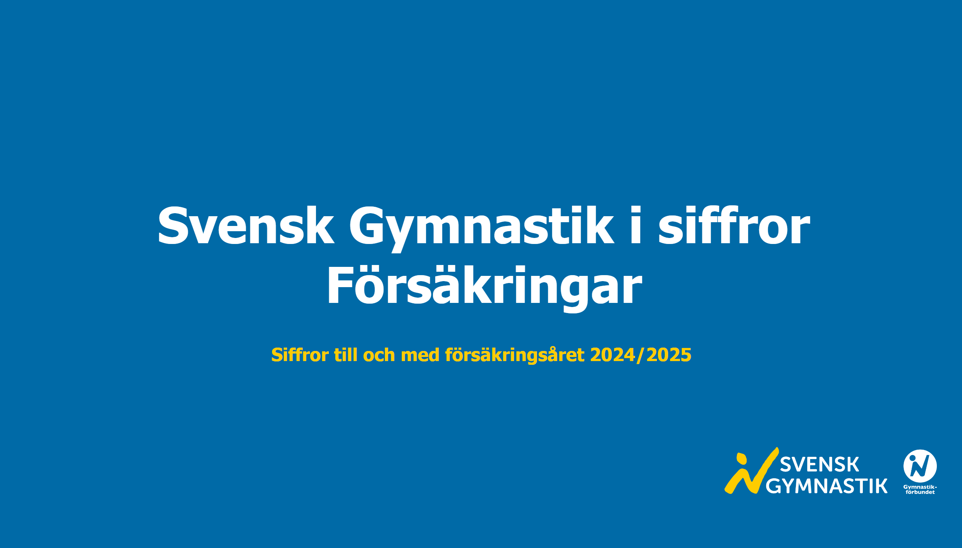
Startsida försäkringar
Notes:
textbox
No alt text provided
textbox
No alt text provided
image
No alt text provided

Slide 27
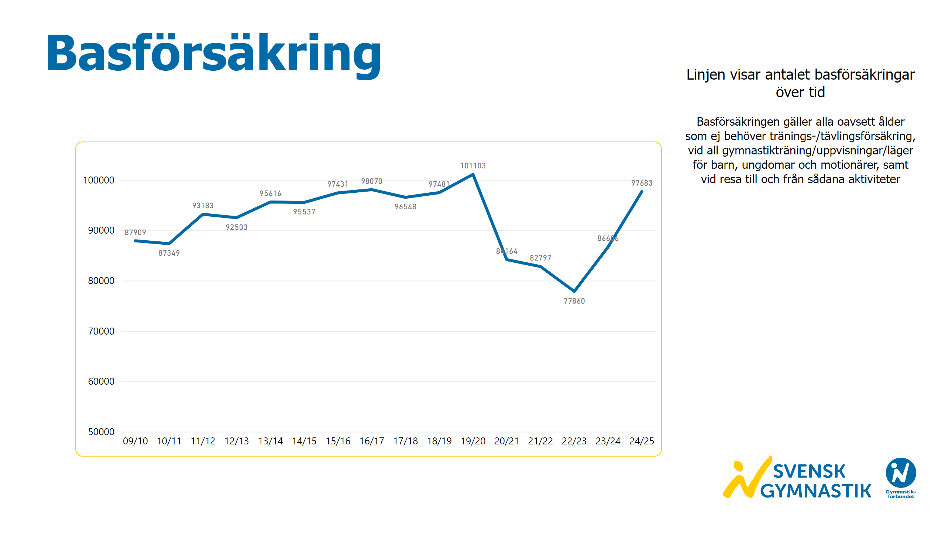
Basförsäkring
Notes:
textbox
No alt text provided
Basförsäkringar
No alt text provided
textbox
No alt text provided
image
No alt text provided

Slide 28
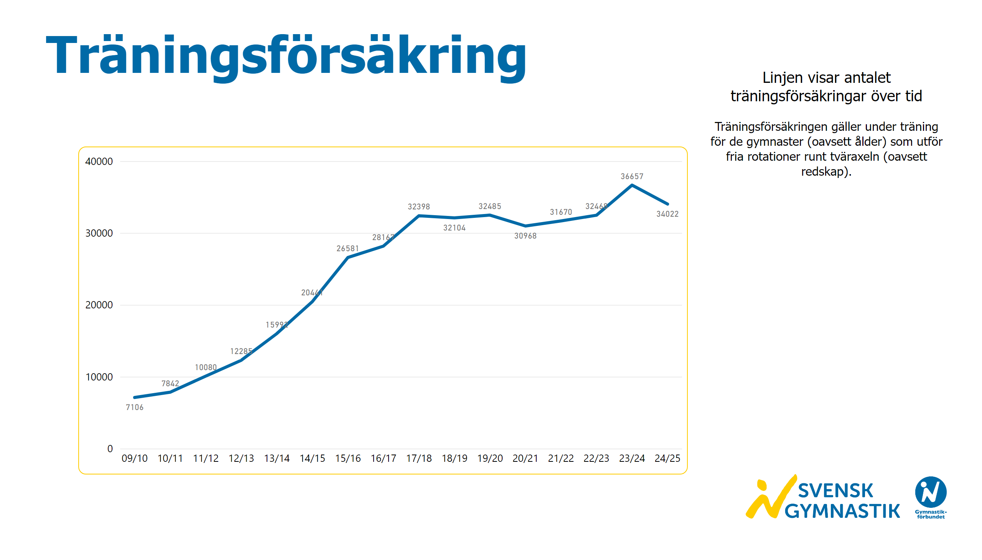
Träningsförsäkring
Notes:
textbox
No alt text provided
Basförsäkringar
No alt text provided
textbox
No alt text provided
image
No alt text provided

Slide 29
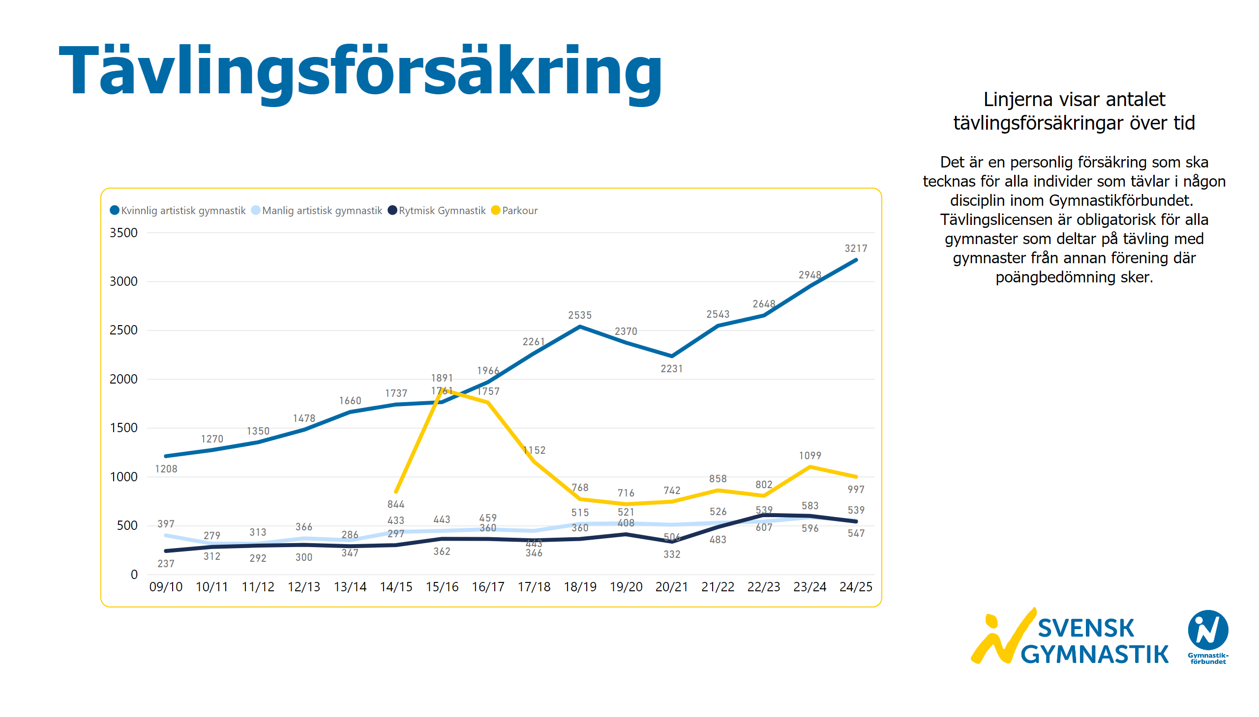
Tävlingsförsäkringar 1
Notes:
textbox
No alt text provided
Basförsäkringar
No alt text provided
textbox
No alt text provided
image
No alt text provided

Slide 30
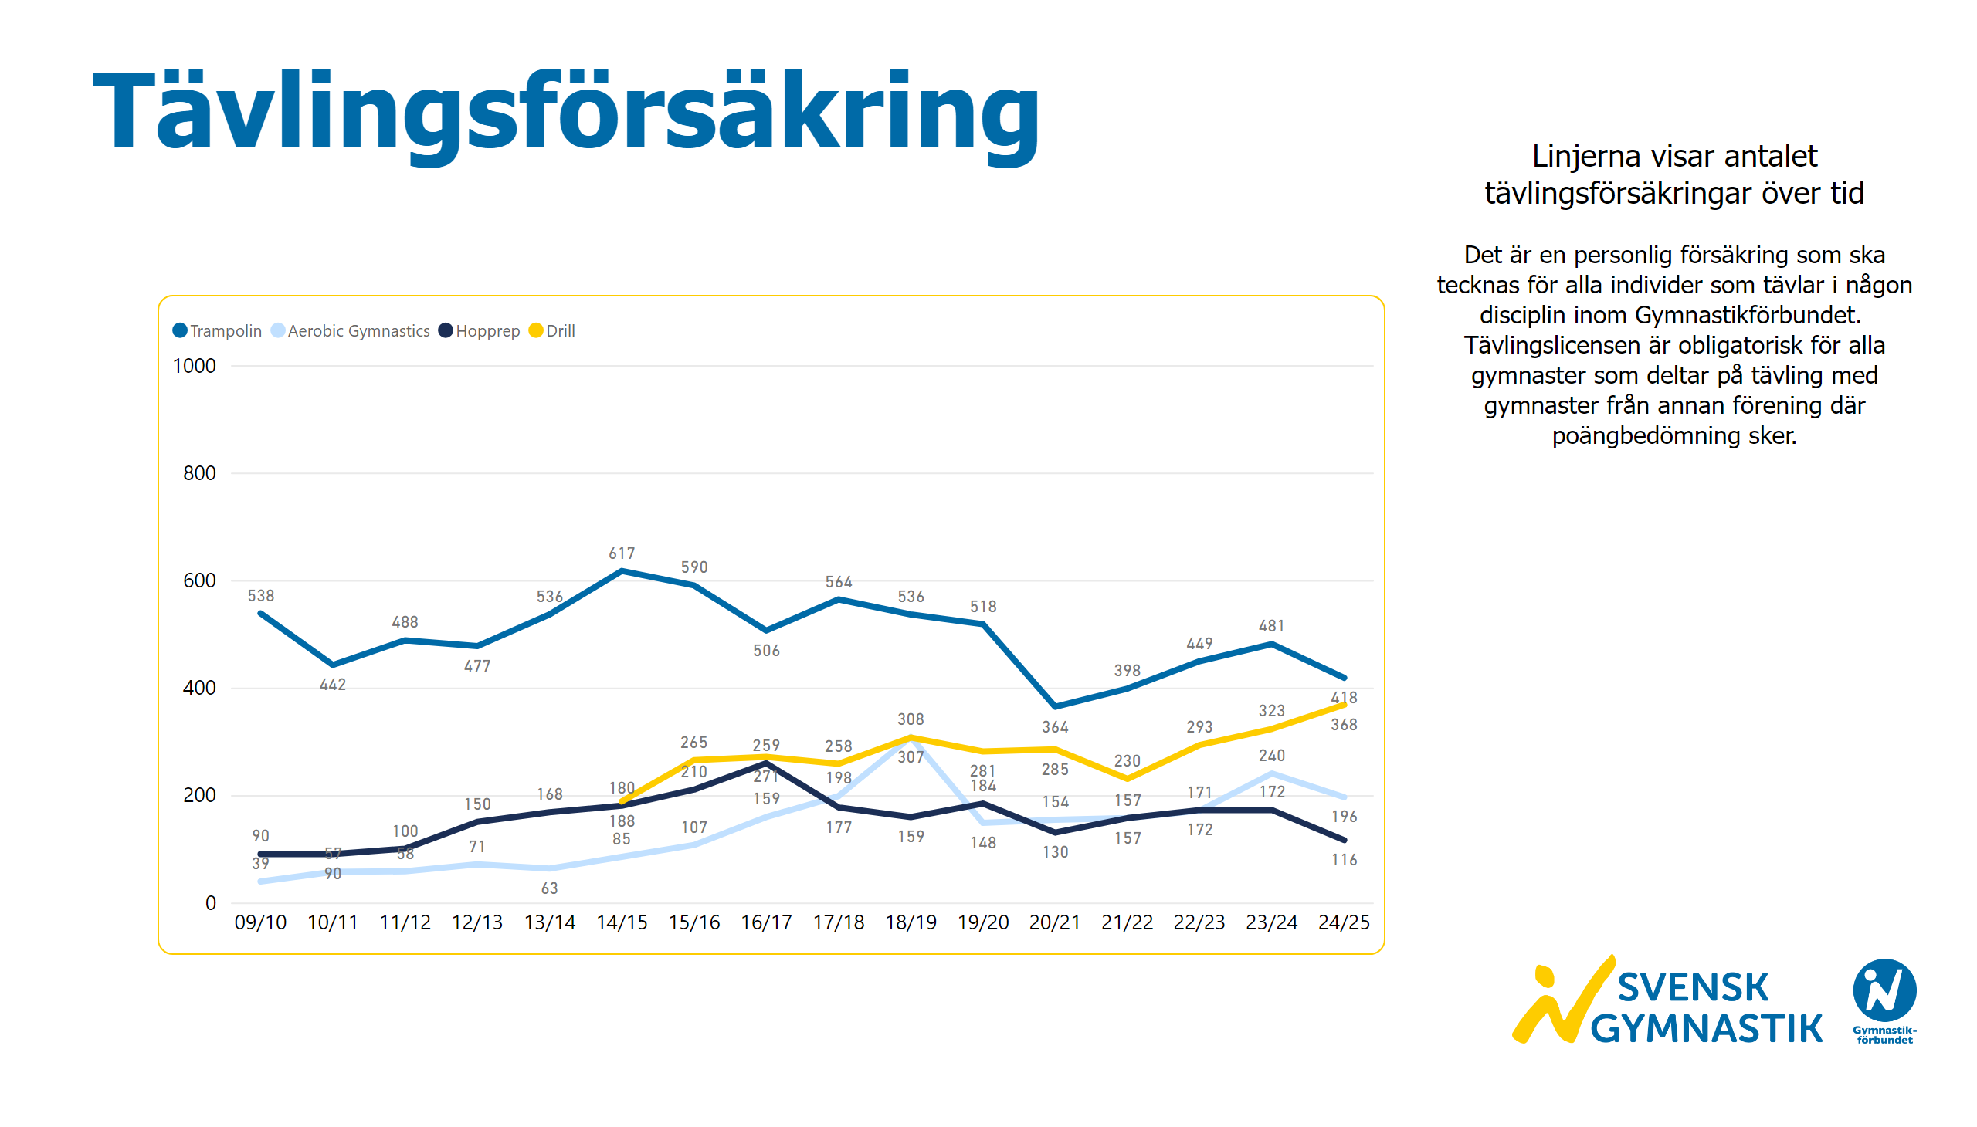
Tävlingsförsäkringar 2
Notes:
textbox
No alt text provided
Basförsäkringar
No alt text provided
textbox
No alt text provided
image
No alt text provided

Slide 31
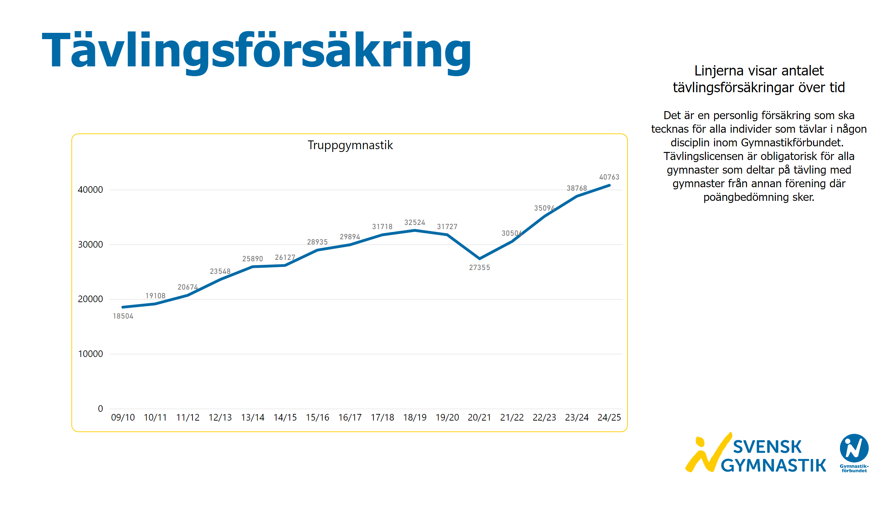
Tävlingsförsäkringar 3
Notes:
textbox
No alt text provided
Truppgymnastik
No alt text provided
textbox
No alt text provided
image
No alt text provided

Slide 32
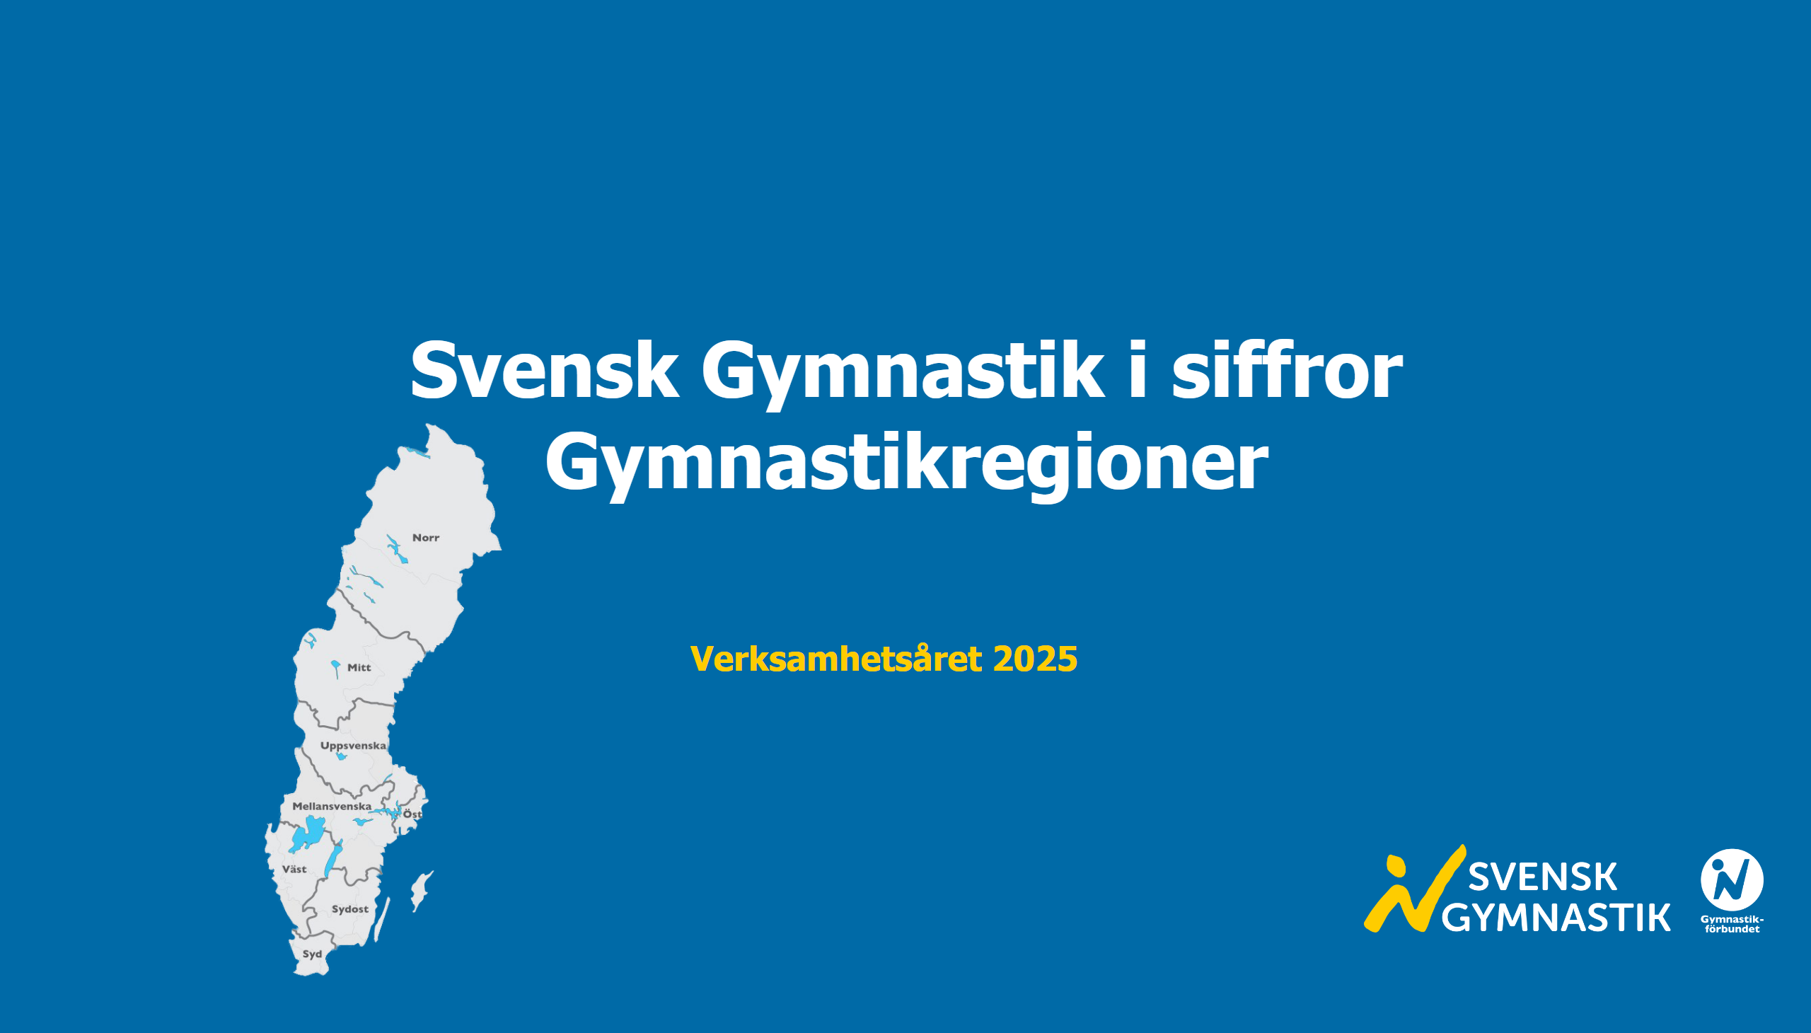
Startsida regioner
Notes:
textbox
No alt text provided
textbox
No alt text provided
image
No alt text provided
image
No alt text provided

Slide 33
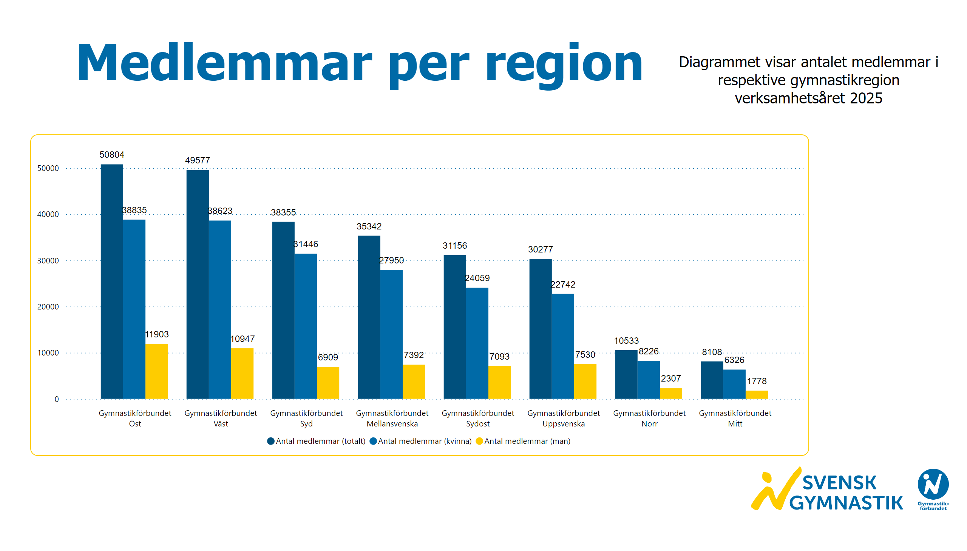
Medlemmar regioner
Notes:
textbox
No alt text provided
textbox
No alt text provided
clusteredColumnChart
No alt text provided
image
No alt text provided

Slide 34
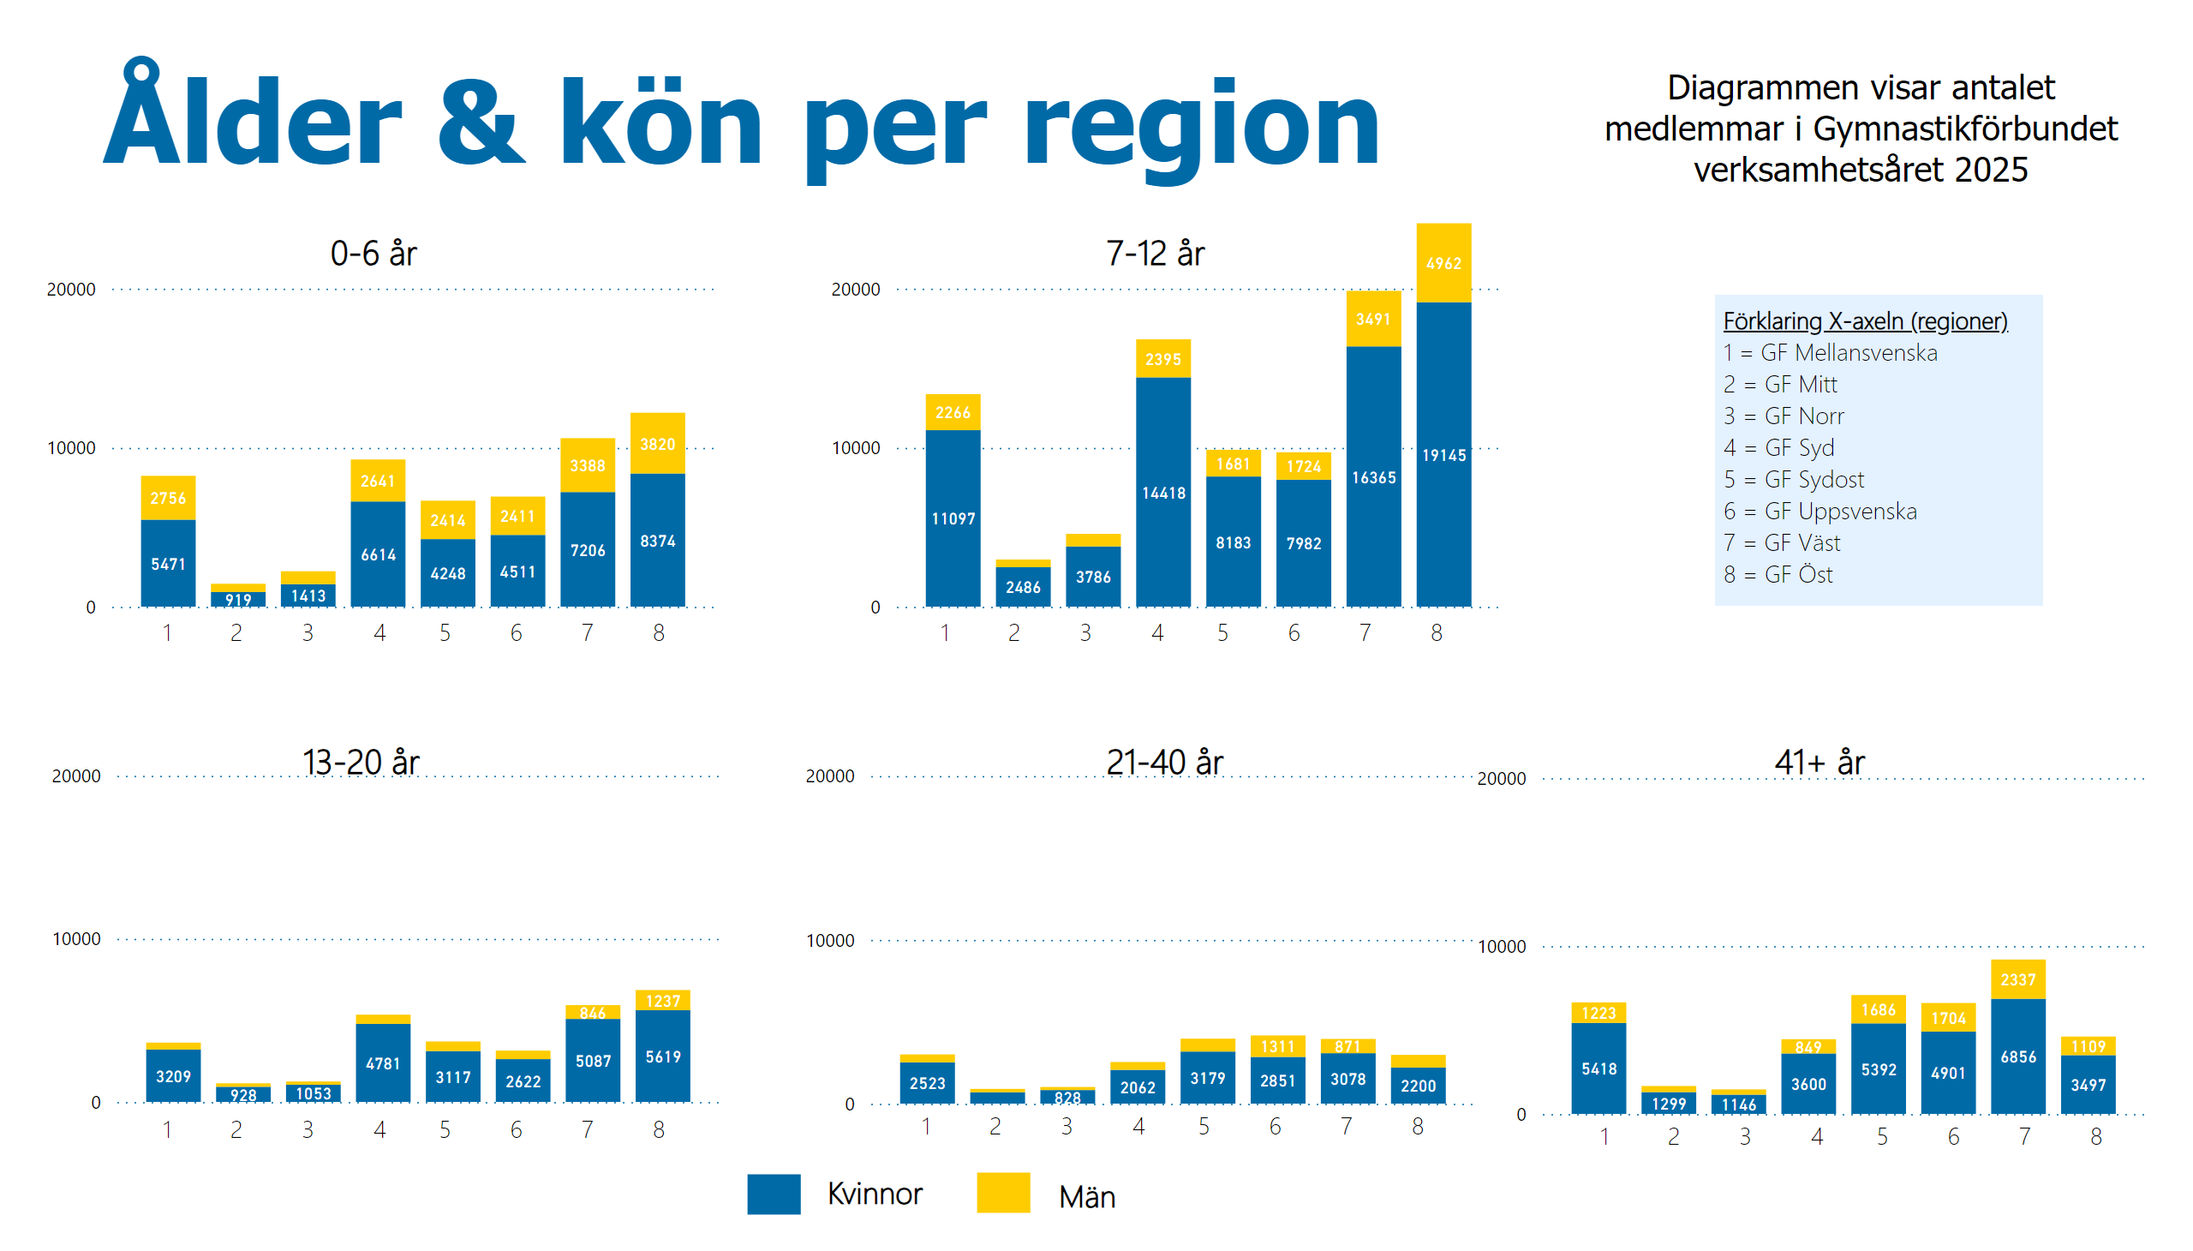
Ålder och kön regioner
Notes:
textbox
No alt text provided
textbox
No alt text provided
textbox
No alt text provided
basicShape
No alt text provided
textbox
No alt text provided
basicShape
No alt text provided
textbox
No alt text provided
textbox
No alt text provided
textbox
No alt text provided
textbox
No alt text provided
textbox
No alt text provided
textbox
No alt text provided
columnChart
No alt text provided
columnChart
No alt text provided
columnChart
No alt text provided
columnChart
No alt text provided
columnChart
No alt text provided
textbox
No alt text provided
textbox
No alt text provided
textbox
No alt text provided
textbox
No alt text provided
textbox
No alt text provided

Slide 35
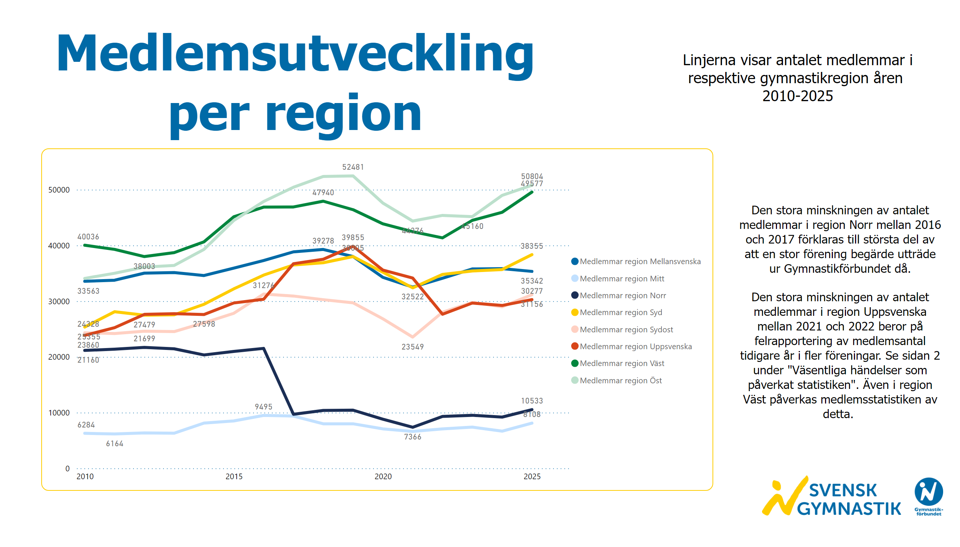
Medlemsutveckling regioner
Notes:
textbox
No alt text provided
textbox
No alt text provided
lineChart
No alt text provided
textbox
No alt text provided
image
No alt text provided

Slide 36
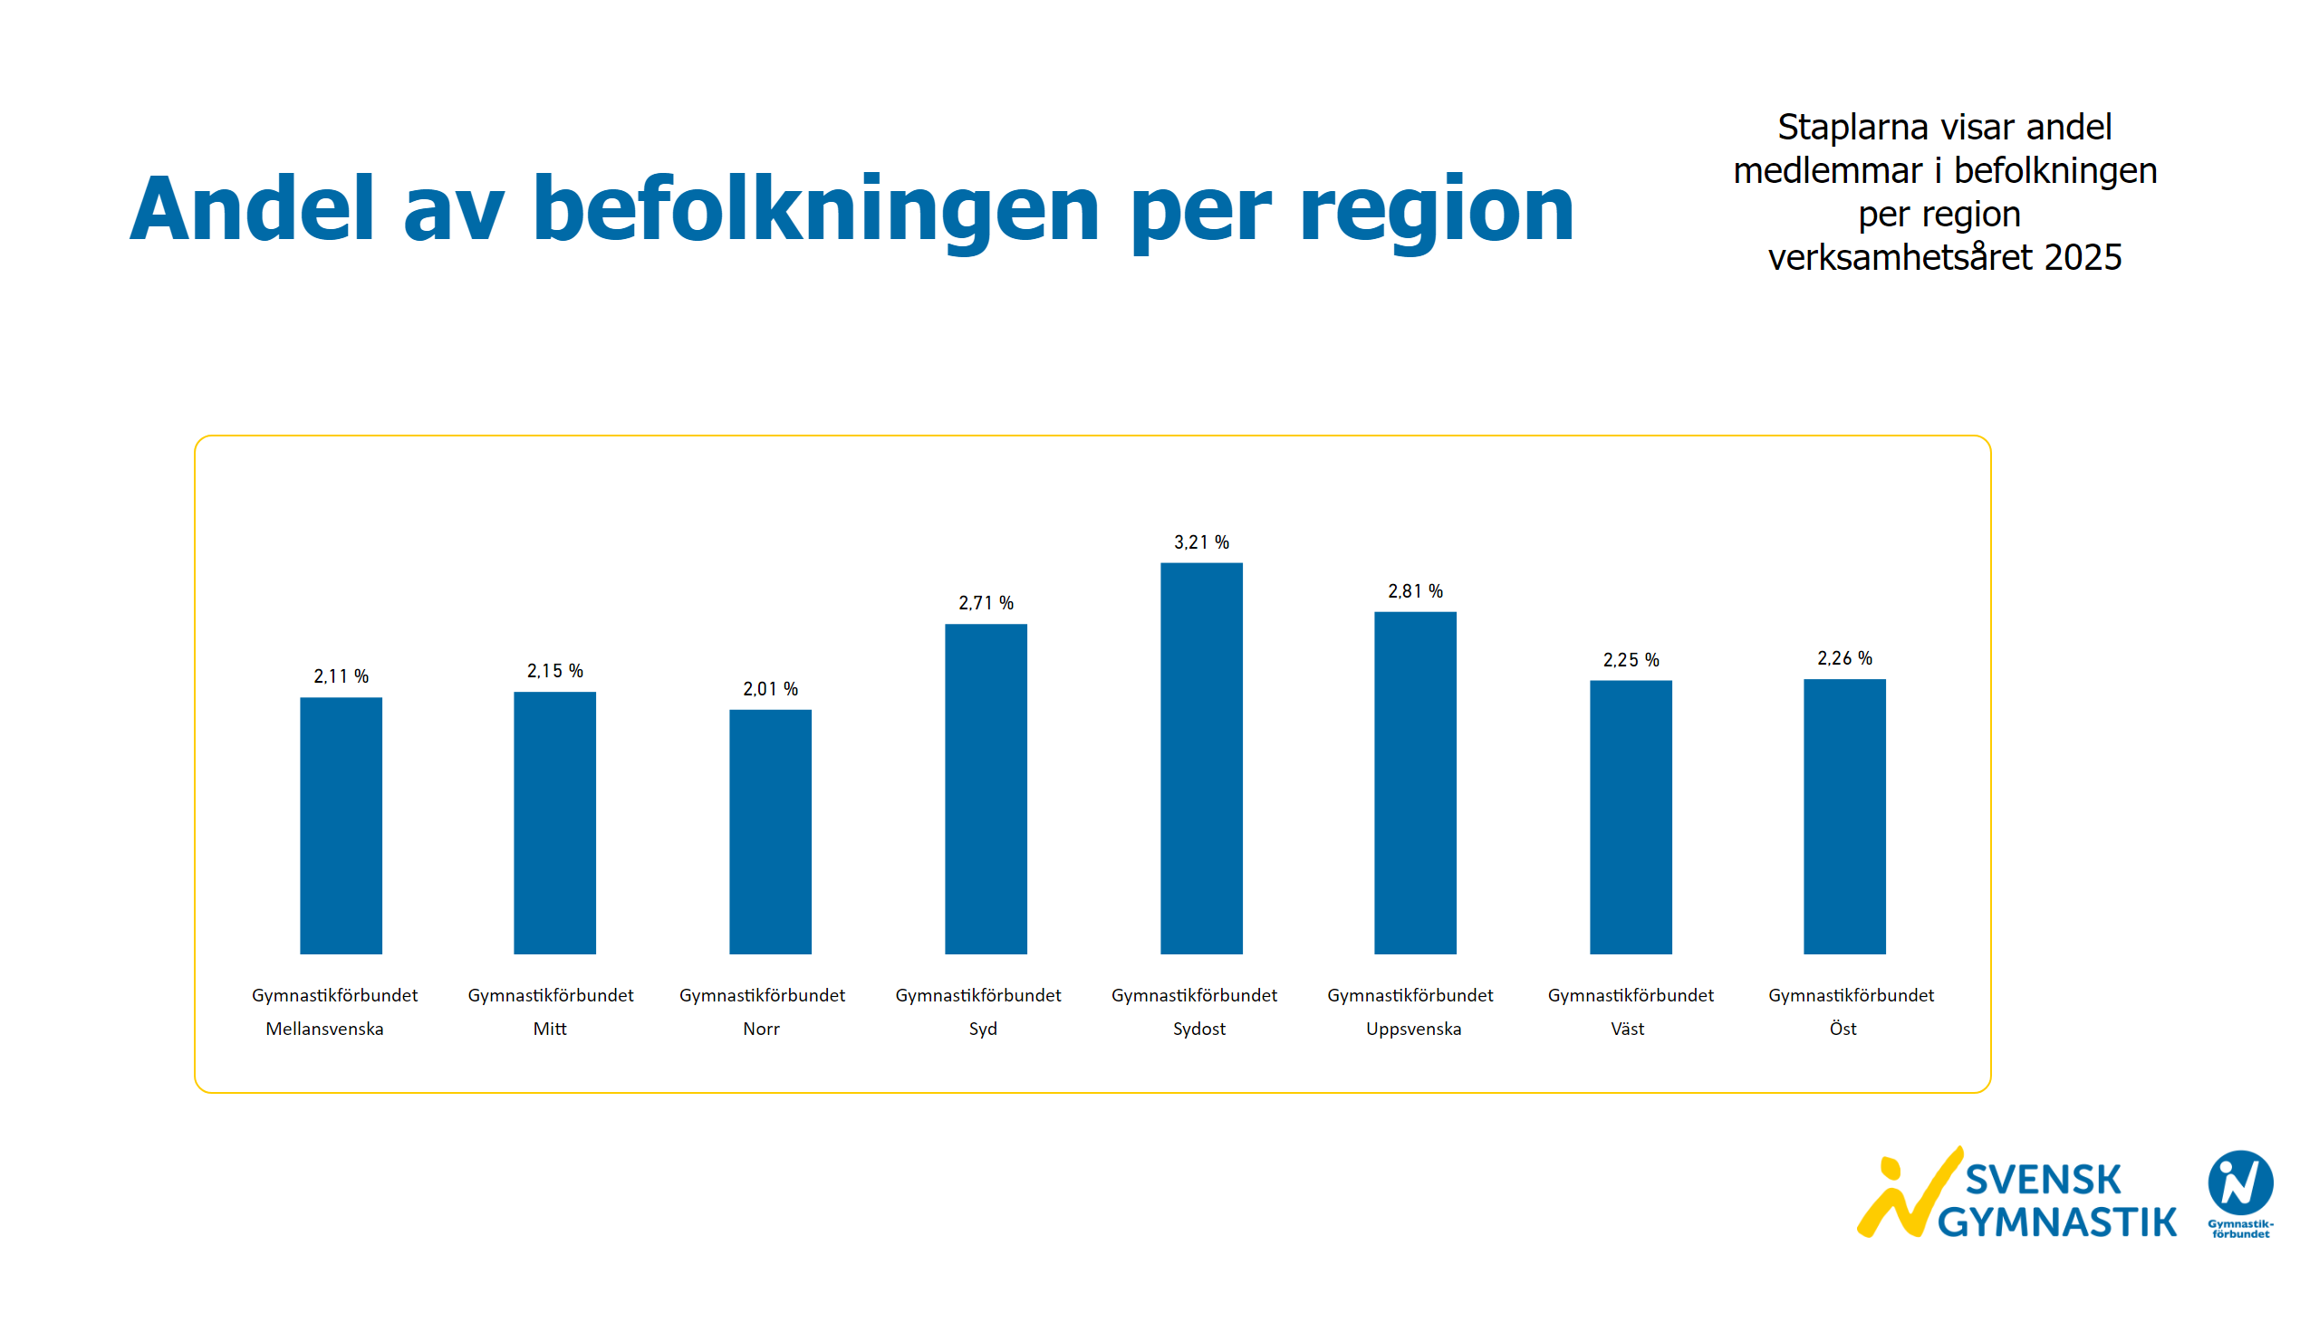
Andel av befolkningen regioner
Notes:
textbox
No alt text provided
textbox
No alt text provided
image
No alt text provided
textbox
No alt text provided
clusteredColumnChart
No alt text provided
clusteredColumnChart
No alt text provided
clusteredColumnChart
No alt text provided
clusteredColumnChart
No alt text provided
clusteredColumnChart
No alt text provided
clusteredColumnChart
No alt text provided
clusteredColumnChart
No alt text provided
clusteredColumnChart
No alt text provided
image
No alt text provided

Slide 37
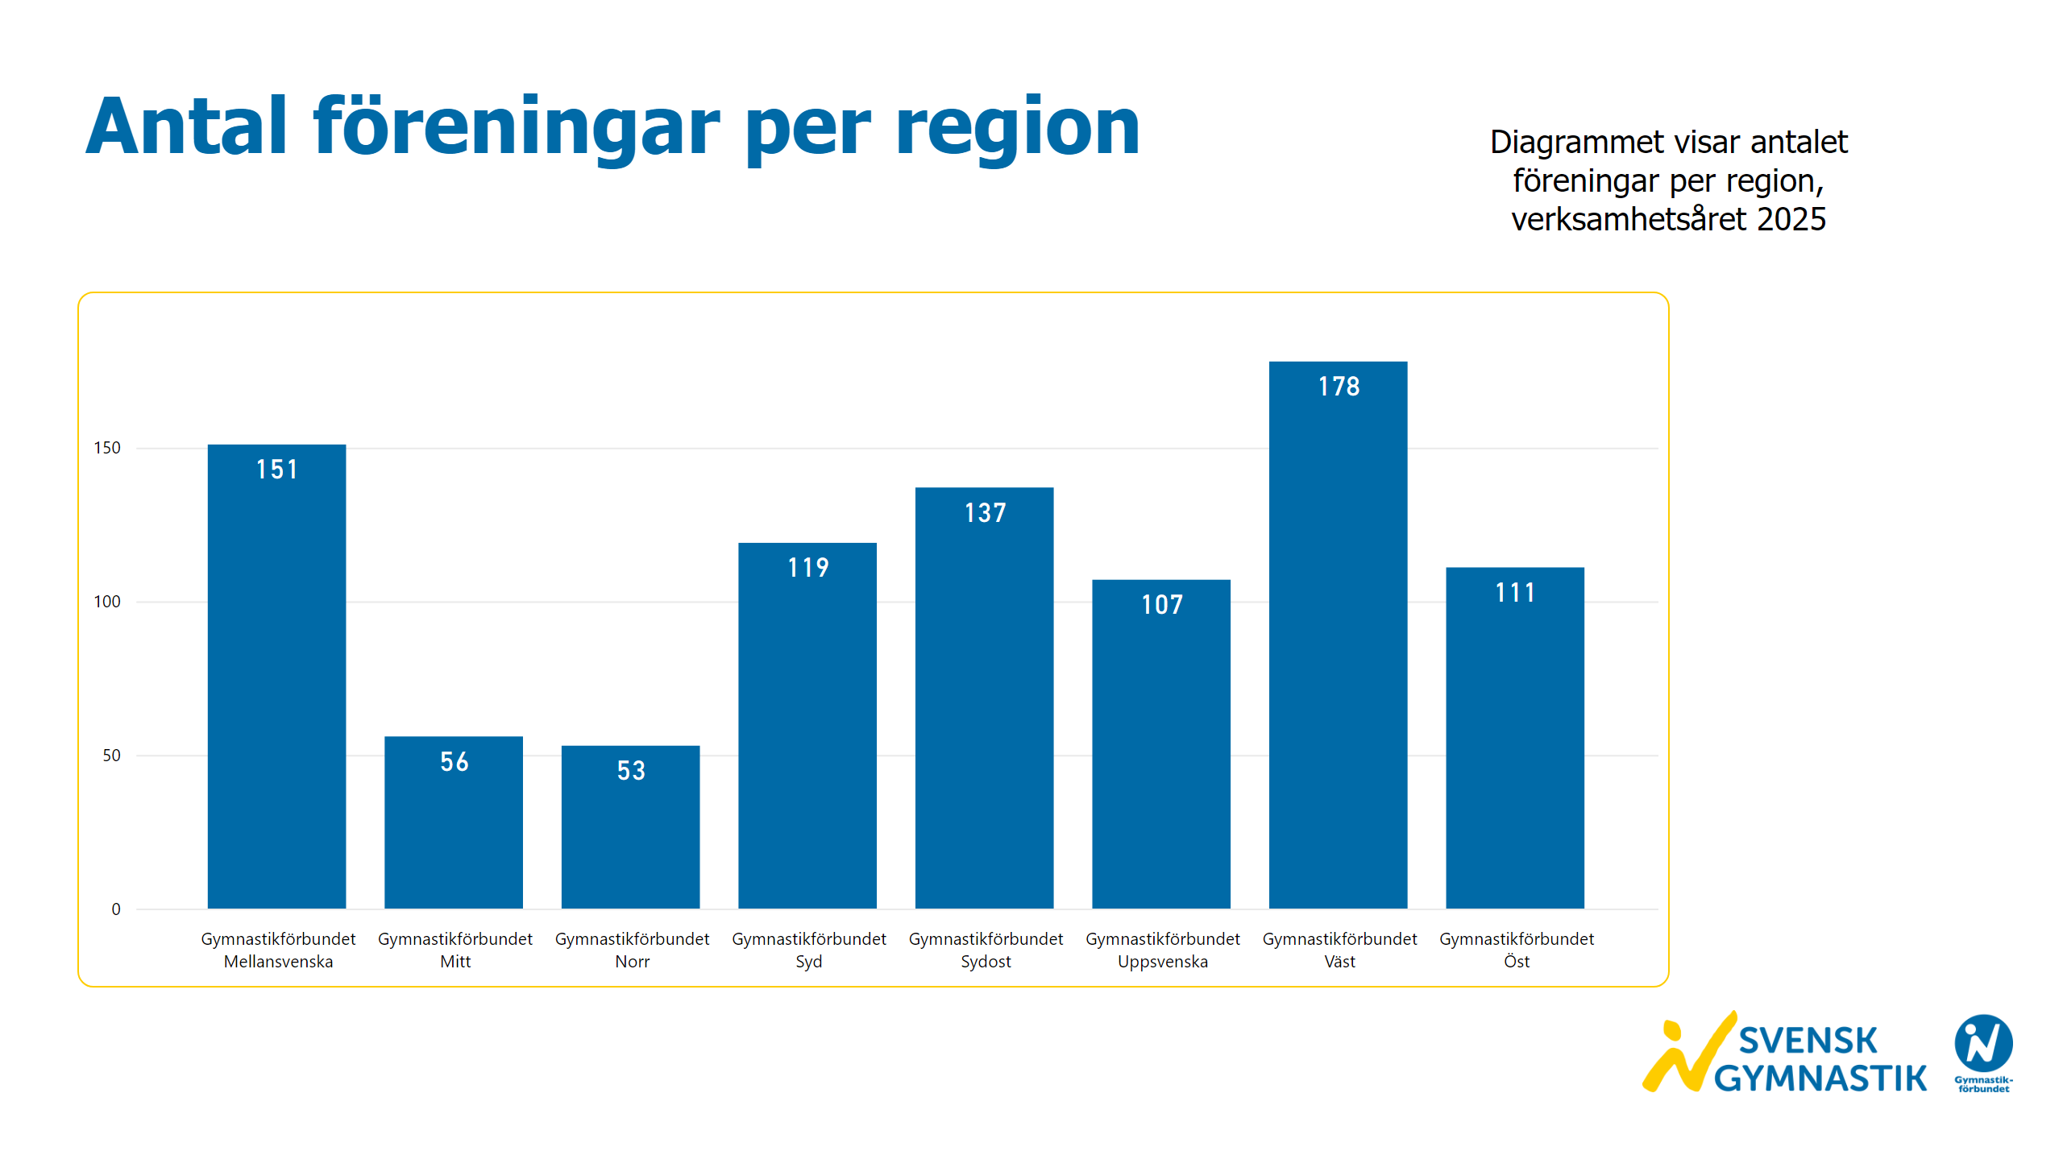
Antal föreningar regioner
Notes:
textbox
No alt text provided
textbox
No alt text provided
clusteredColumnChart
No alt text provided
image
No alt text provided

Slide 38
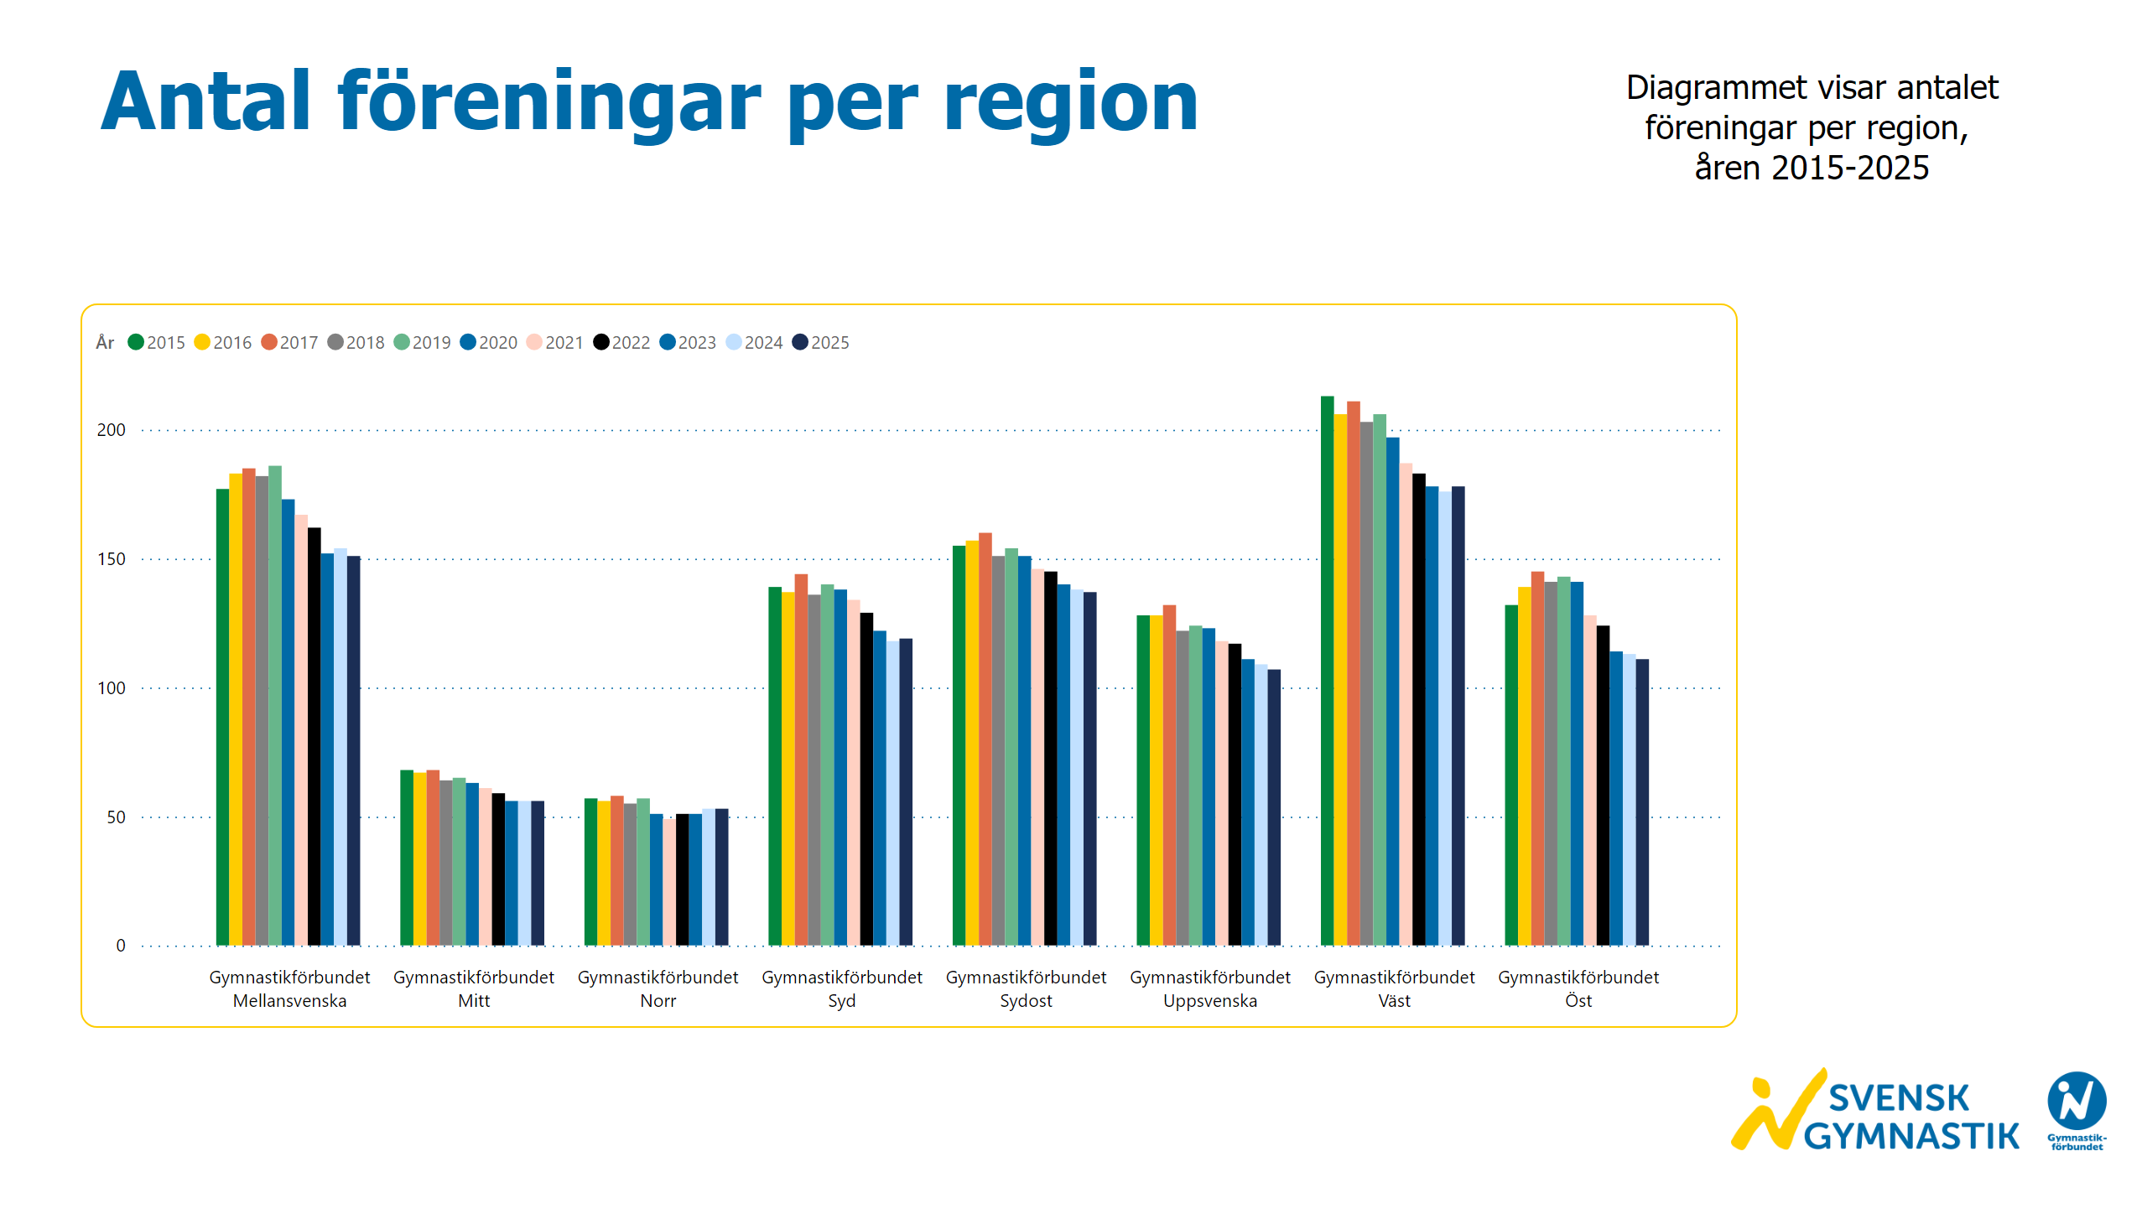
Antal föreningar 10 år regioner
Notes:
textbox
No alt text provided
textbox
No alt text provided
clusteredColumnChart
No alt text provided
image
No alt text provided

