Slide 1

Startsida
Notes:
textbox
No alt text provided
textbox
No alt text provided
image
No alt text provided

Slide 2
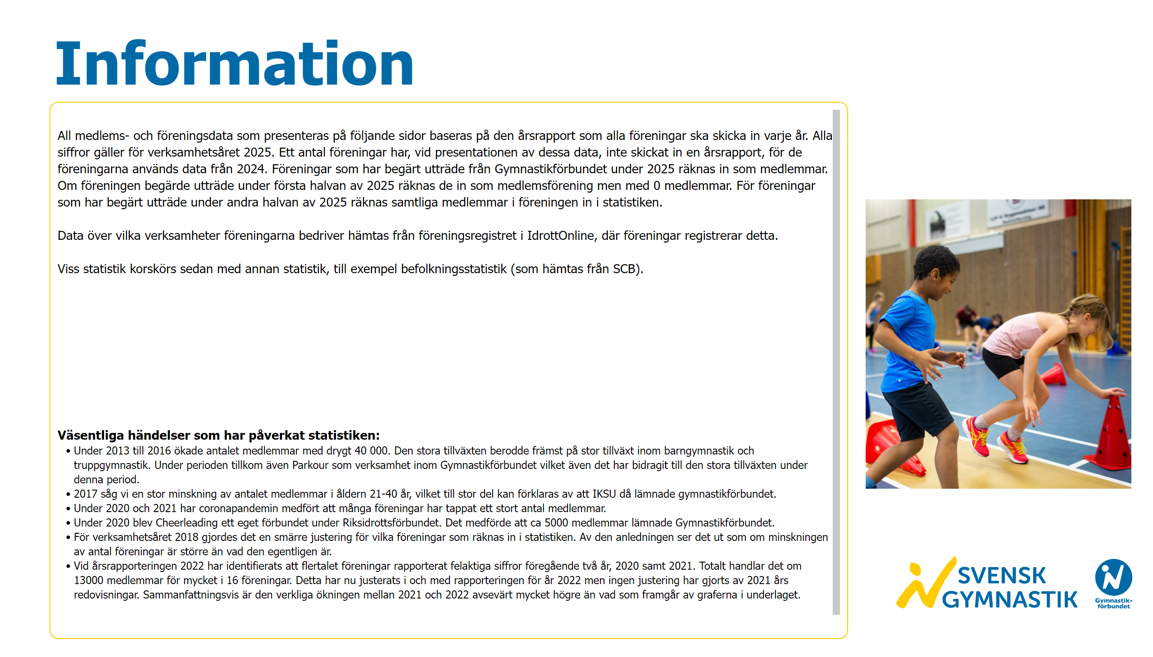
Information
Notes:
textbox
No alt text provided
textbox
No alt text provided
image
No alt text provided
slicer
No alt text provided
image
No alt text provided

Slide 3
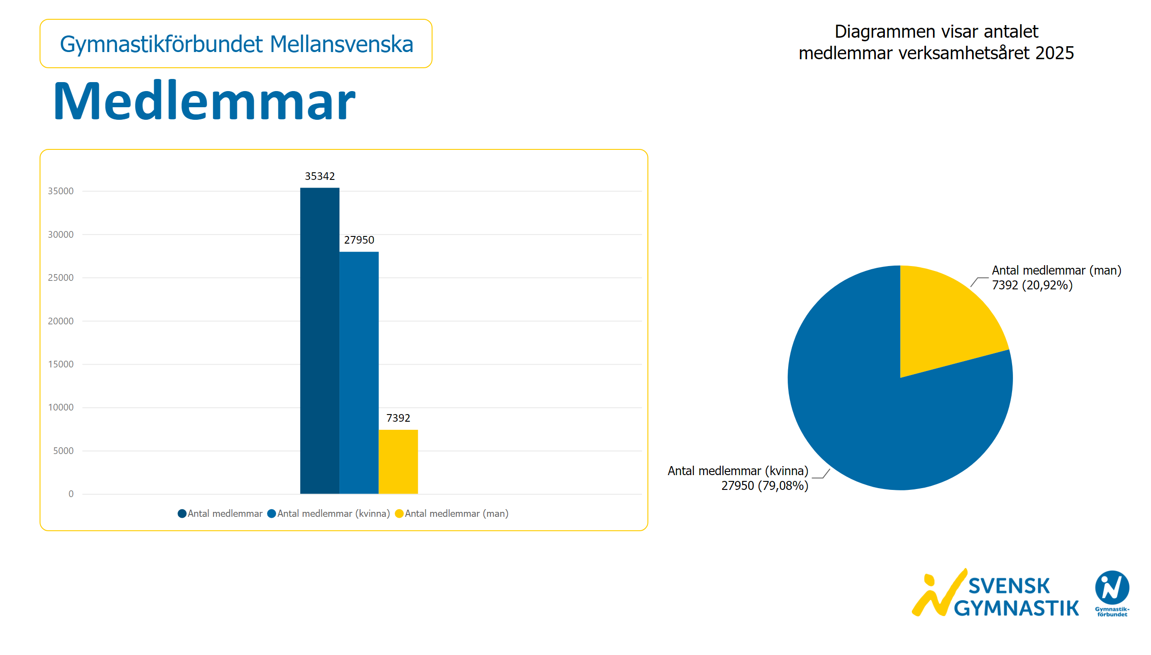
Medlemmar
Notes:
textbox
No alt text provided
textbox
No alt text provided
clusteredColumnChart
No alt text provided
pieChart
No alt text provided
card
No alt text provided
slicer
No alt text provided
image
No alt text provided

Slide 4
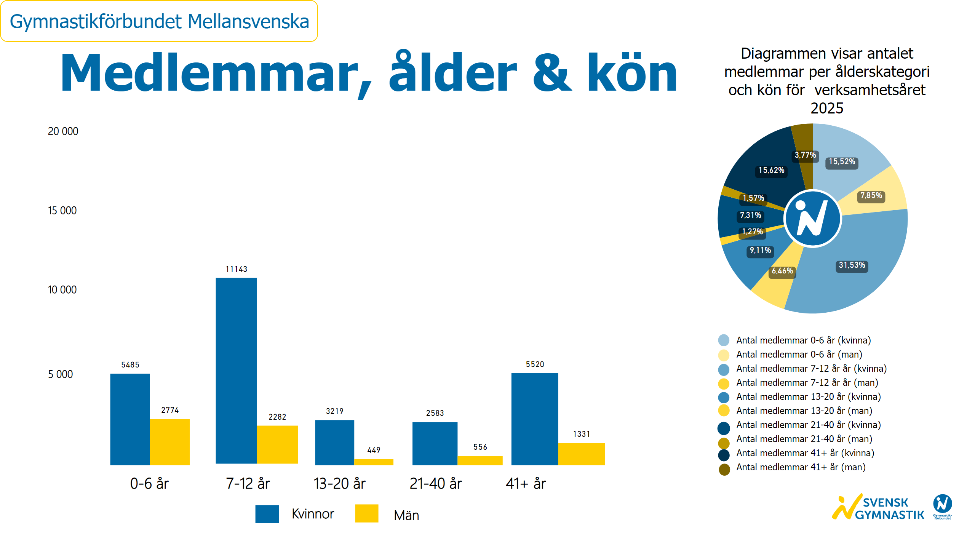
Ålder och kön
Notes:
textbox
No alt text provided
textbox
No alt text provided
image
No alt text provided
textbox
No alt text provided
textbox
No alt text provided
basicShape
No alt text provided
textbox
No alt text provided
basicShape
No alt text provided
textbox
No alt text provided
clusteredColumnChart
No alt text provided
clusteredColumnChart
No alt text provided
clusteredColumnChart
No alt text provided
clusteredColumnChart
No alt text provided
clusteredColumnChart
No alt text provided
donutChart
No alt text provided
textbox
No alt text provided
basicShape
No alt text provided
basicShape
No alt text provided
basicShape
No alt text provided
basicShape
No alt text provided
basicShape
No alt text provided
basicShape
No alt text provided
basicShape
No alt text provided
card
No alt text provided
slicer
No alt text provided
basicShape
No alt text provided
basicShape
No alt text provided
basicShape
No alt text provided
image
No alt text provided

Slide 5
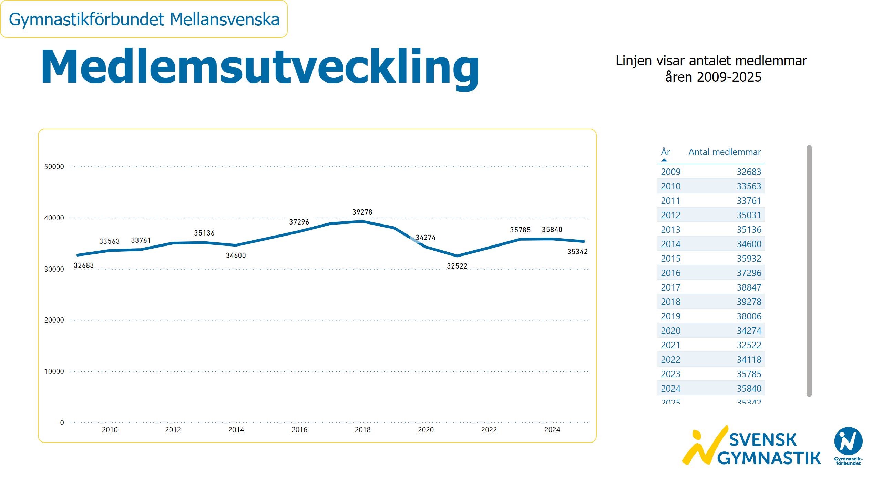
Medlemsutveckling
Notes:
textbox
No alt text provided
textbox
No alt text provided
lineChart
No alt text provided
card
No alt text provided
slicer
No alt text provided
image
No alt text provided
tableEx
No alt text provided

Slide 6
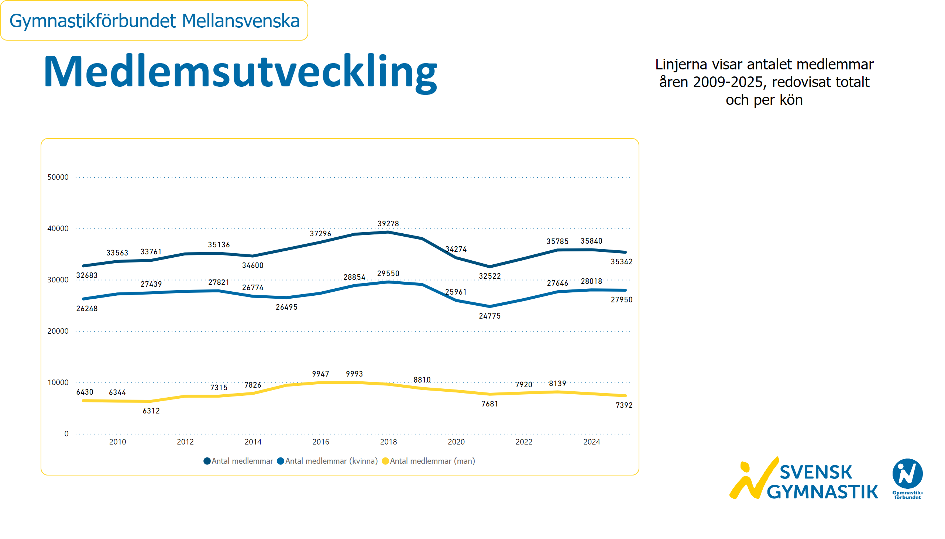
Medlemsutveckling kön
Notes:
textbox
No alt text provided
textbox
No alt text provided
lineChart
No alt text provided
card
No alt text provided
slicer
No alt text provided
image
No alt text provided

Slide 7
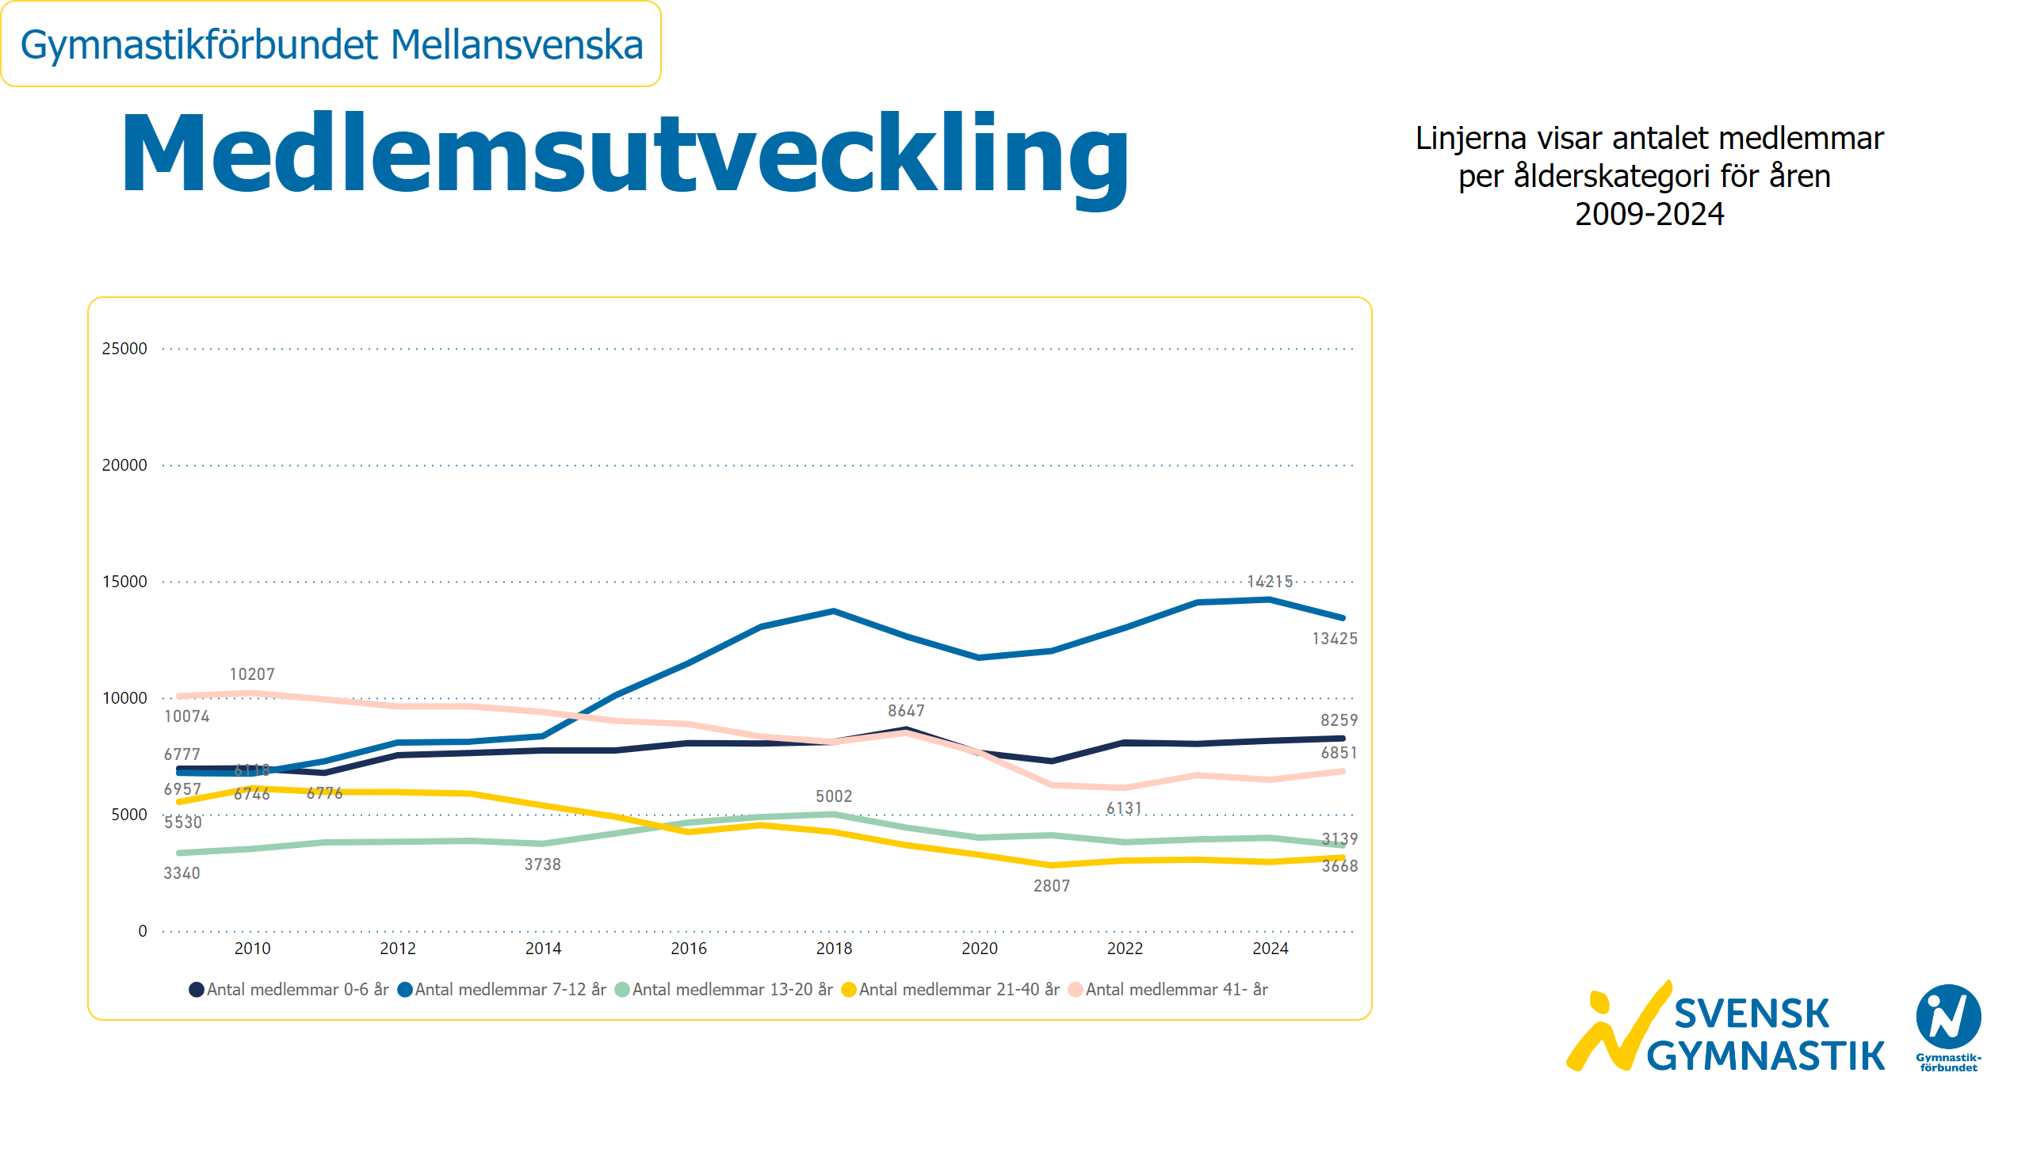
Medlemsutveckling ålder
Notes:
textbox
No alt text provided
textbox
No alt text provided
lineChart
No alt text provided
card
No alt text provided
slicer
No alt text provided
image
No alt text provided

Slide 8
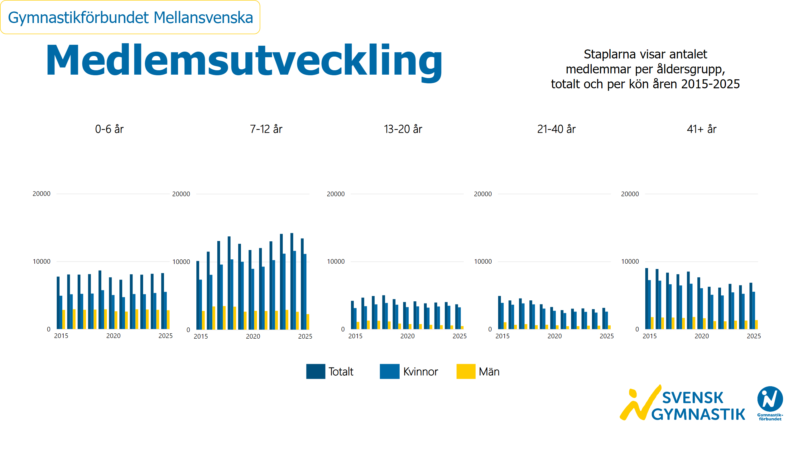
Medlemsutveckling ålder och kön
Notes:
textbox
No alt text provided
textbox
No alt text provided
textbox
No alt text provided
textbox
No alt text provided
textbox
No alt text provided
textbox
No alt text provided
textbox
No alt text provided
basicShape
No alt text provided
textbox
No alt text provided
basicShape
No alt text provided
textbox
No alt text provided
basicShape
No alt text provided
textbox
No alt text provided
clusteredColumnChart
No alt text provided
clusteredColumnChart
No alt text provided
clusteredColumnChart
No alt text provided
clusteredColumnChart
No alt text provided
clusteredColumnChart
No alt text provided
card
No alt text provided
slicer
No alt text provided
image
No alt text provided

Slide 9
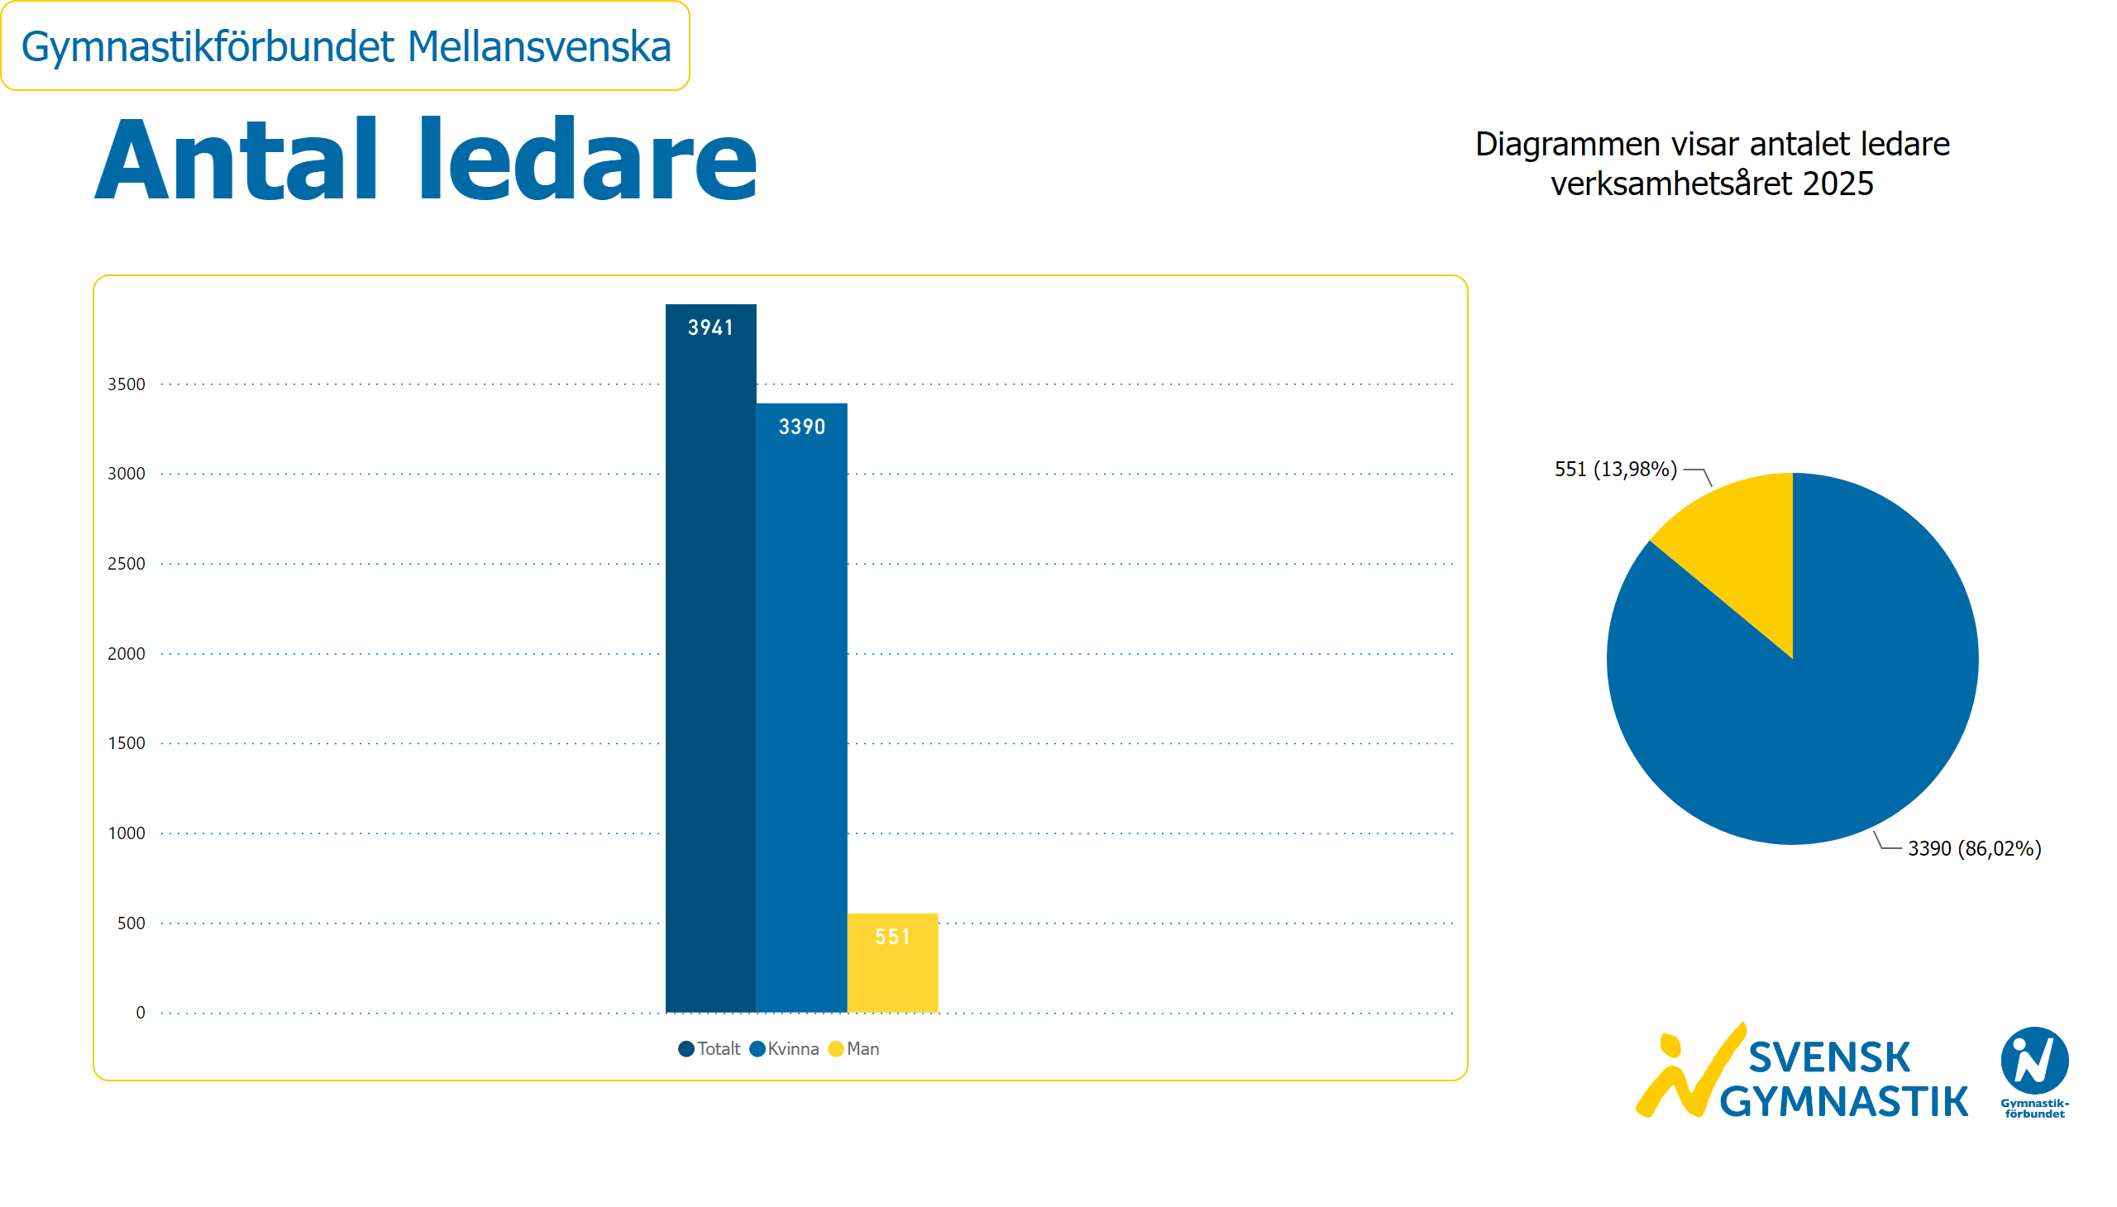
Antal ledare
Notes:
textbox
No alt text provided
textbox
No alt text provided
clusteredColumnChart
No alt text provided
pieChart
No alt text provided
card
No alt text provided
slicer
No alt text provided
image
No alt text provided

Slide 10
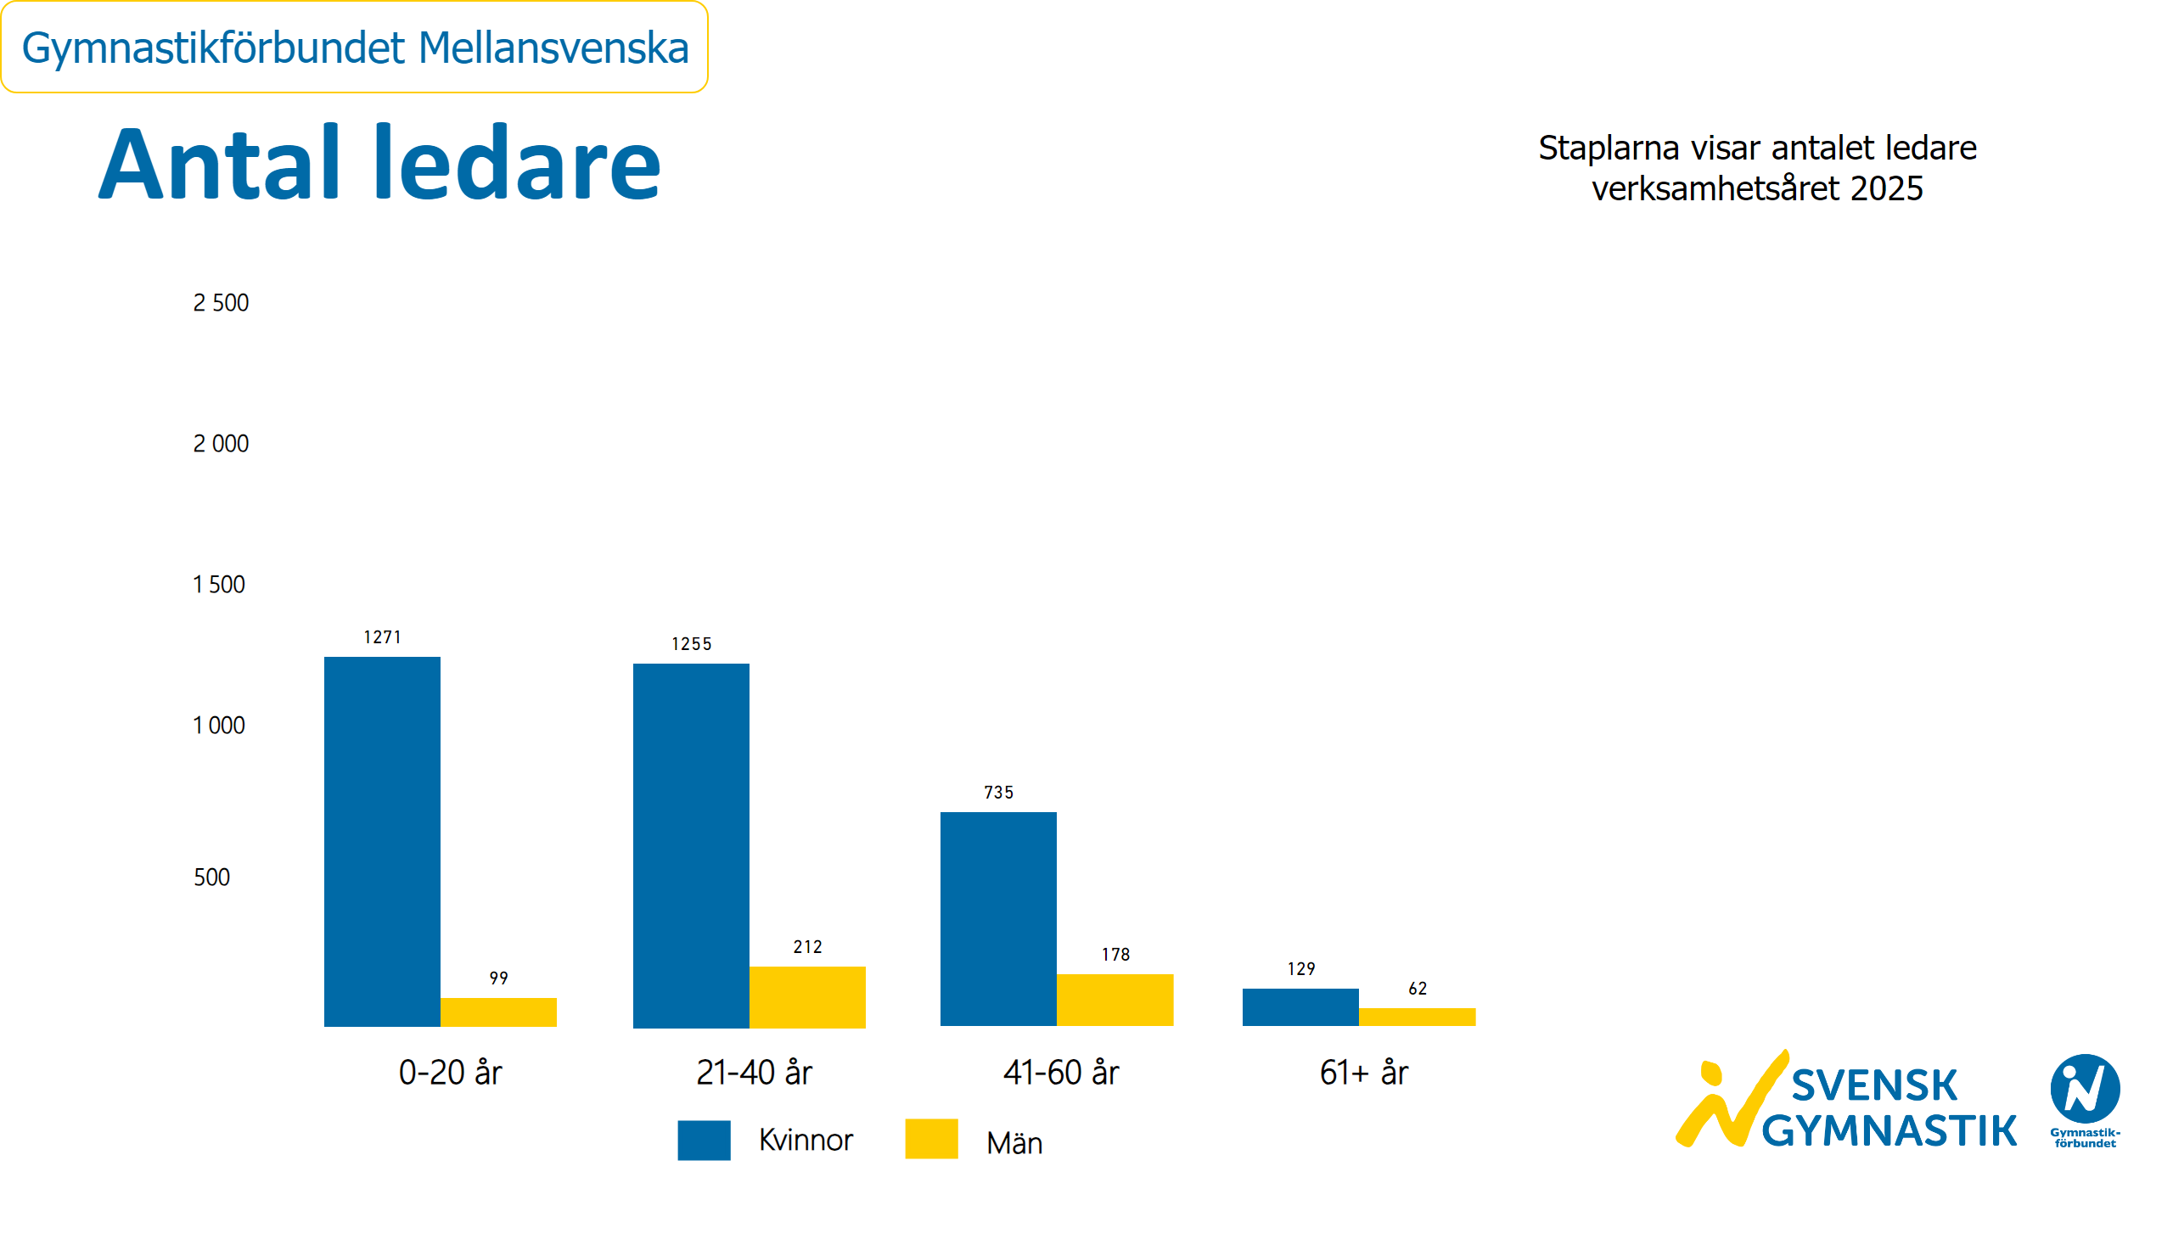
Antal ledare kön och ålder
Notes:
textbox
No alt text provided
textbox
No alt text provided
textbox
No alt text provided
clusteredColumnChart
No alt text provided
clusteredColumnChart
No alt text provided
clusteredColumnChart
No alt text provided
clusteredColumnChart
No alt text provided
textbox
No alt text provided
basicShape
No alt text provided
textbox
No alt text provided
basicShape
No alt text provided
textbox
No alt text provided
card
No alt text provided
slicer
No alt text provided
image
No alt text provided

Slide 11
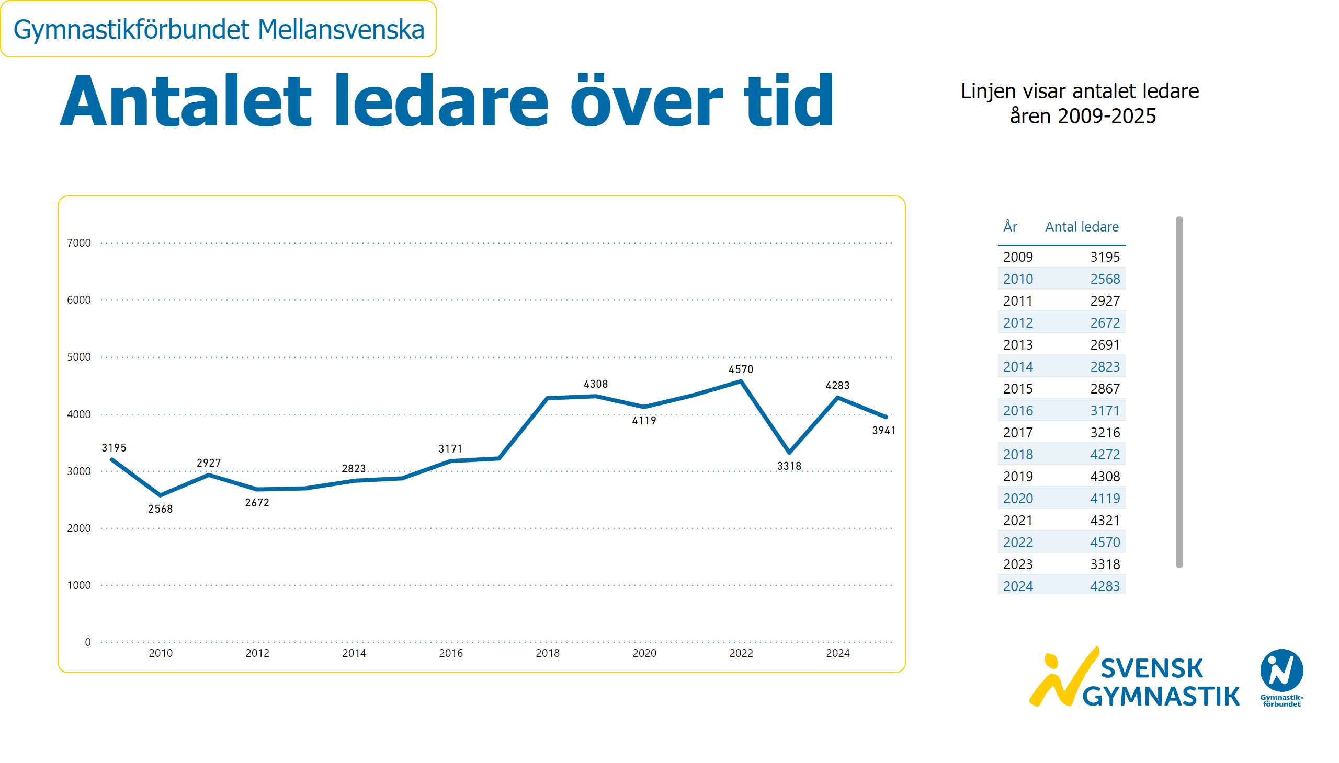
Ledarutveckling
Notes:
textbox
No alt text provided
textbox
No alt text provided
lineChart
No alt text provided
card
No alt text provided
slicer
No alt text provided
image
No alt text provided
tableEx
No alt text provided

Slide 12
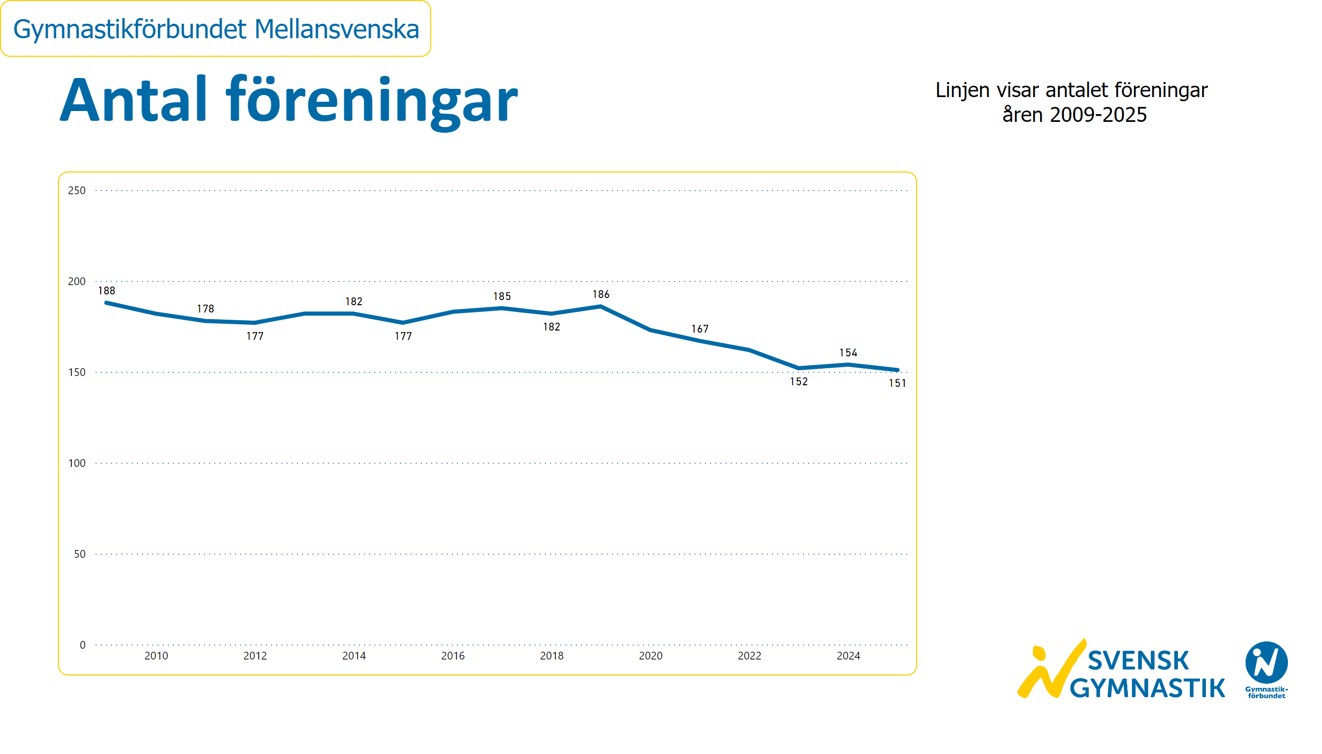
Antal föreningar
Notes:
textbox
No alt text provided
textbox
No alt text provided
lineChart
No alt text provided
card
No alt text provided
slicer
No alt text provided
image
No alt text provided

Slide 13
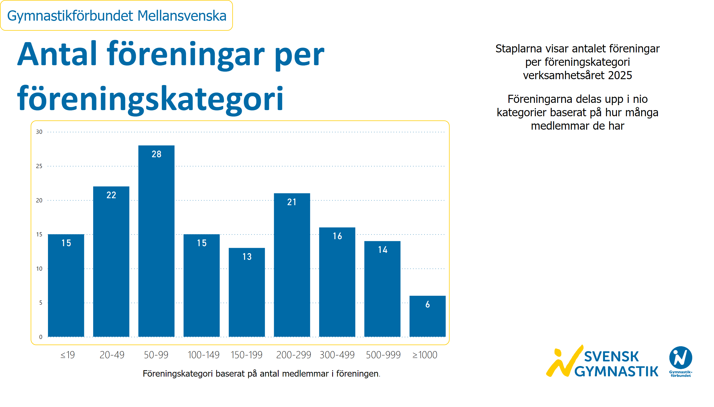
Föreningar per föreningskategori
Notes:
textbox
No alt text provided
textbox
No alt text provided
textbox
No alt text provided
clusteredColumnChart
No alt text provided
textbox
No alt text provided
slicer
No alt text provided
card
No alt text provided
image
No alt text provided

Slide 14
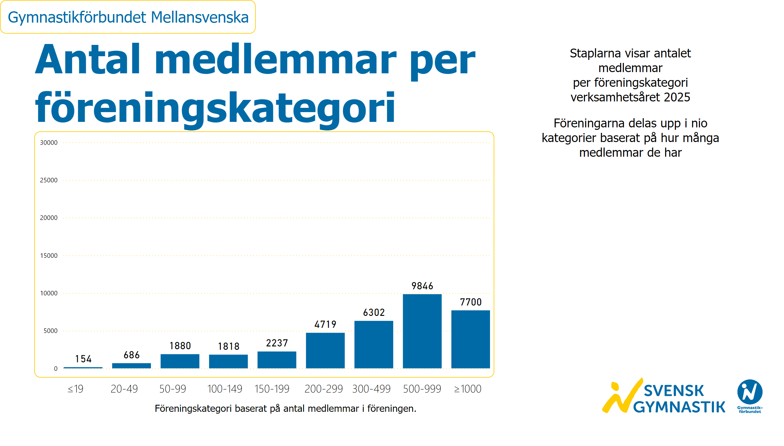
Medlemmar per föreningskategori
Notes:
textbox
No alt text provided
textbox
No alt text provided
textbox
No alt text provided
textbox
No alt text provided
clusteredColumnChart
No alt text provided
slicer
No alt text provided
card
No alt text provided
image
No alt text provided

Slide 15
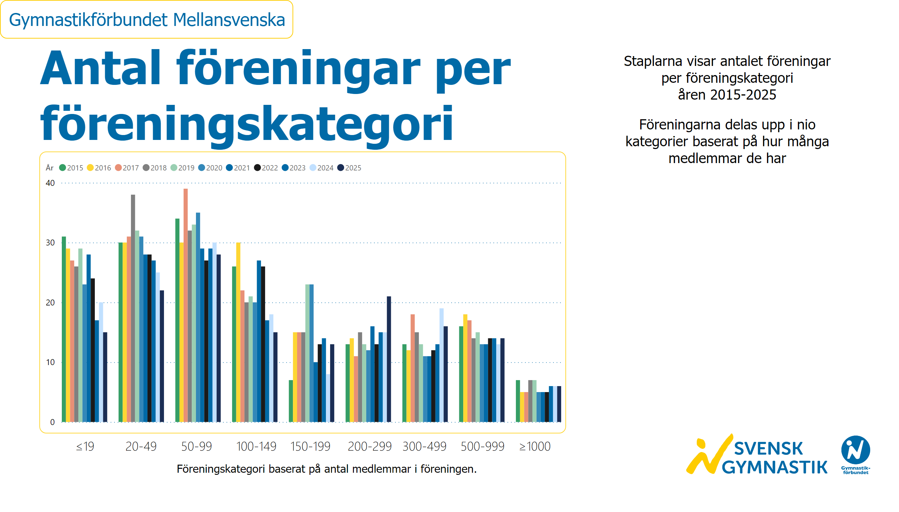
Föreningar per föreningskategori och år
Notes:
textbox
No alt text provided
textbox
No alt text provided
textbox
No alt text provided
textbox
No alt text provided
clusteredColumnChart
No alt text provided
slicer
No alt text provided
card
No alt text provided
image
No alt text provided

Slide 16
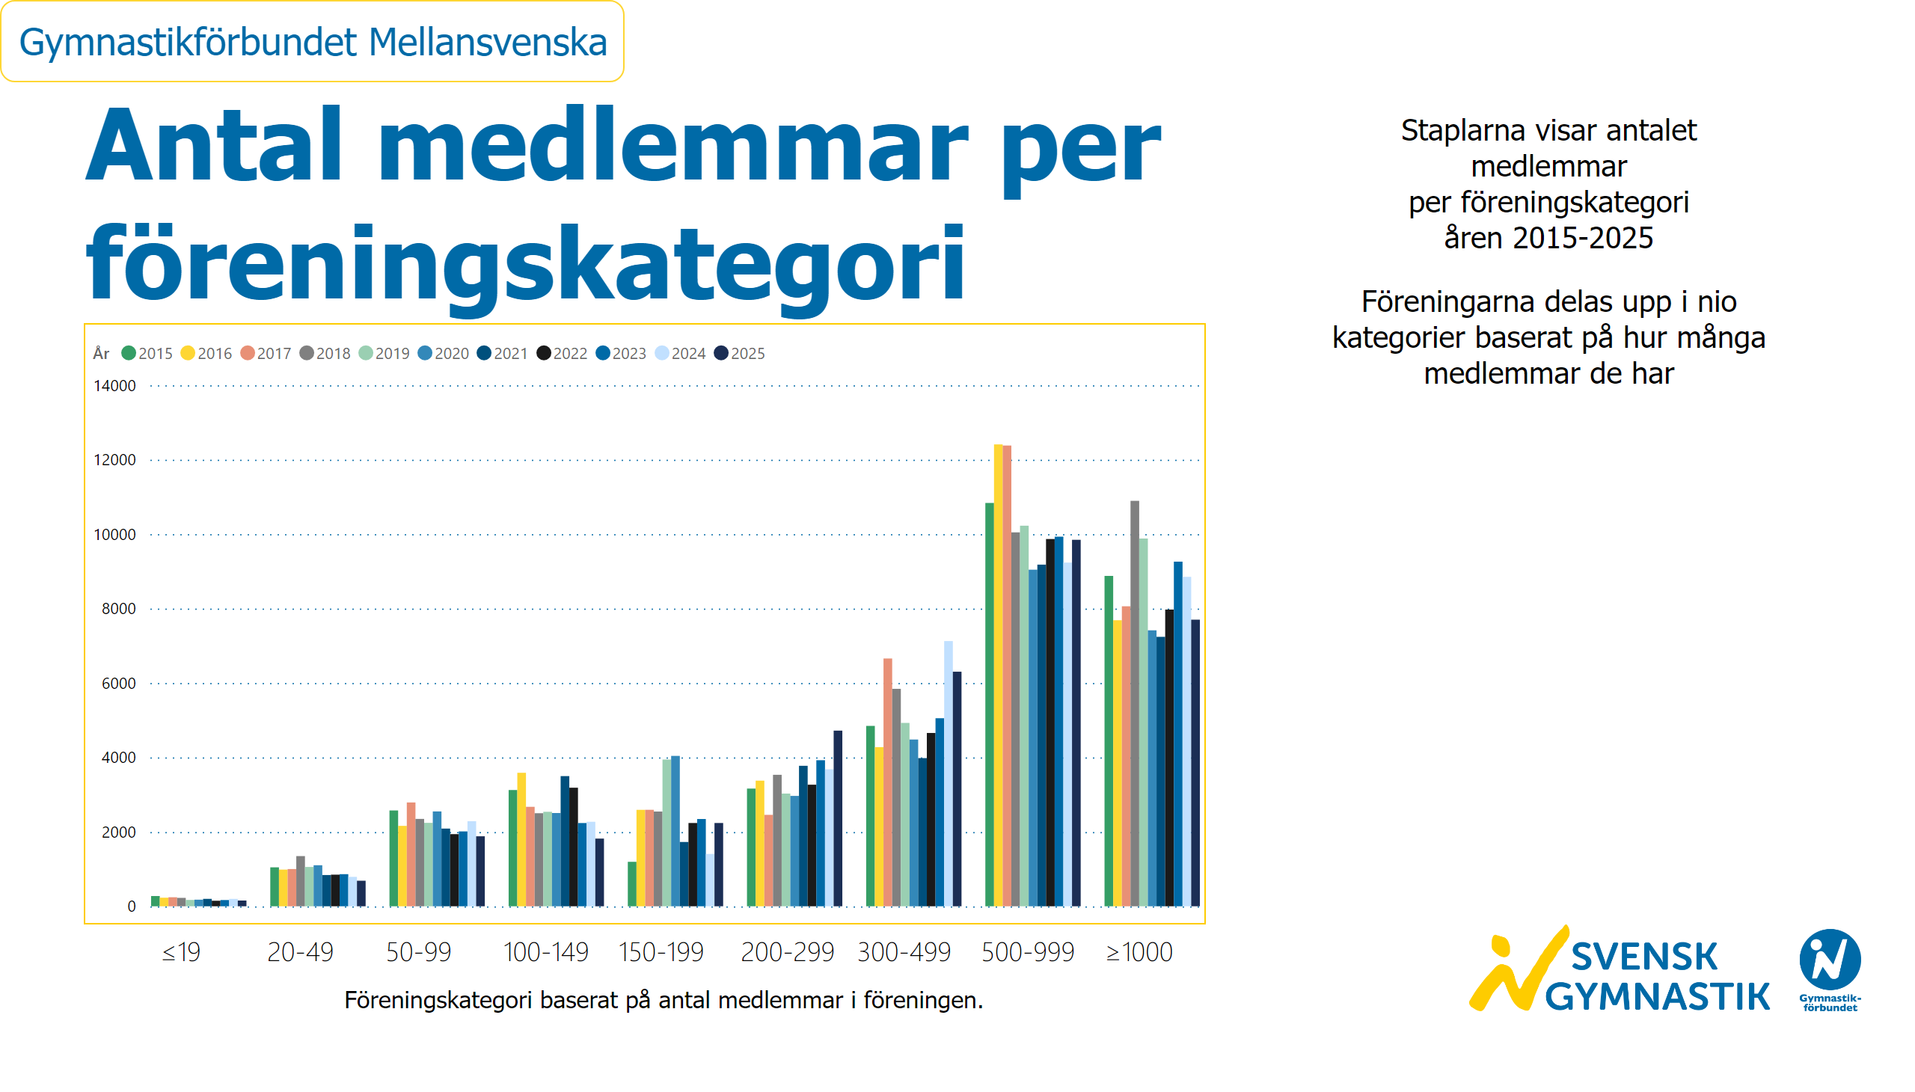
Medlemmar per föreningskategori och år
Notes:
textbox
No alt text provided
textbox
No alt text provided
textbox
No alt text provided
textbox
No alt text provided
clusteredColumnChart
No alt text provided
slicer
No alt text provided
card
No alt text provided
image
No alt text provided

Slide 17
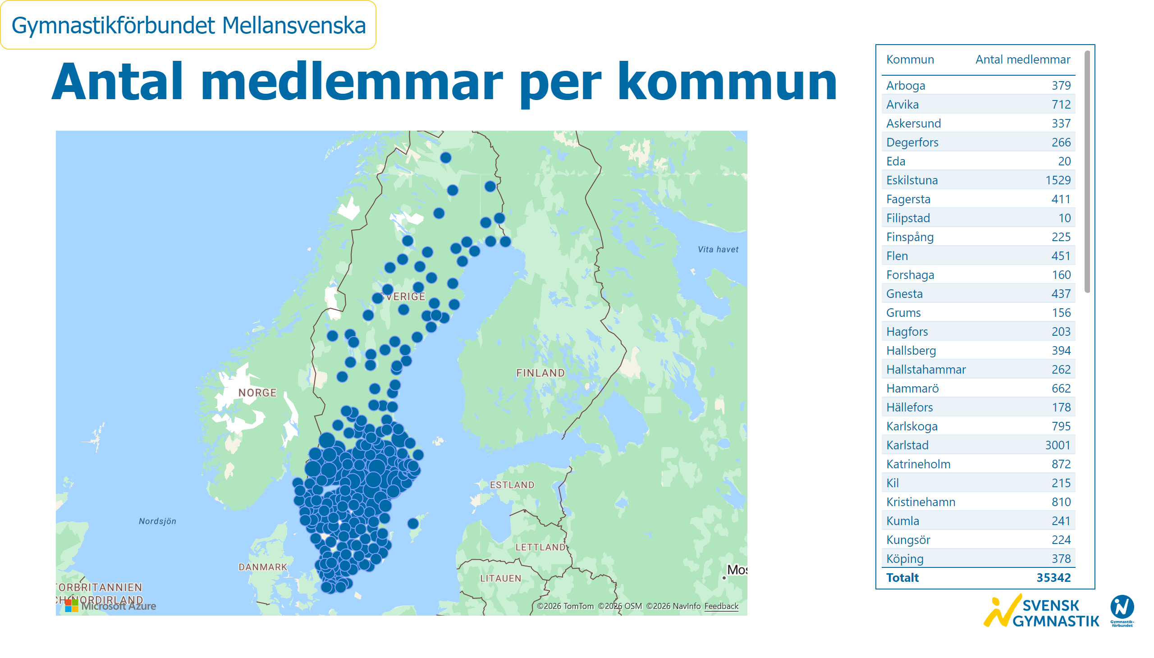
Medlemmar per kommun
Notes:
textbox
No alt text provided
azureMap
No alt text provided
tableEx
No alt text provided
slicer
No alt text provided
card
No alt text provided
image
No alt text provided

Slide 18
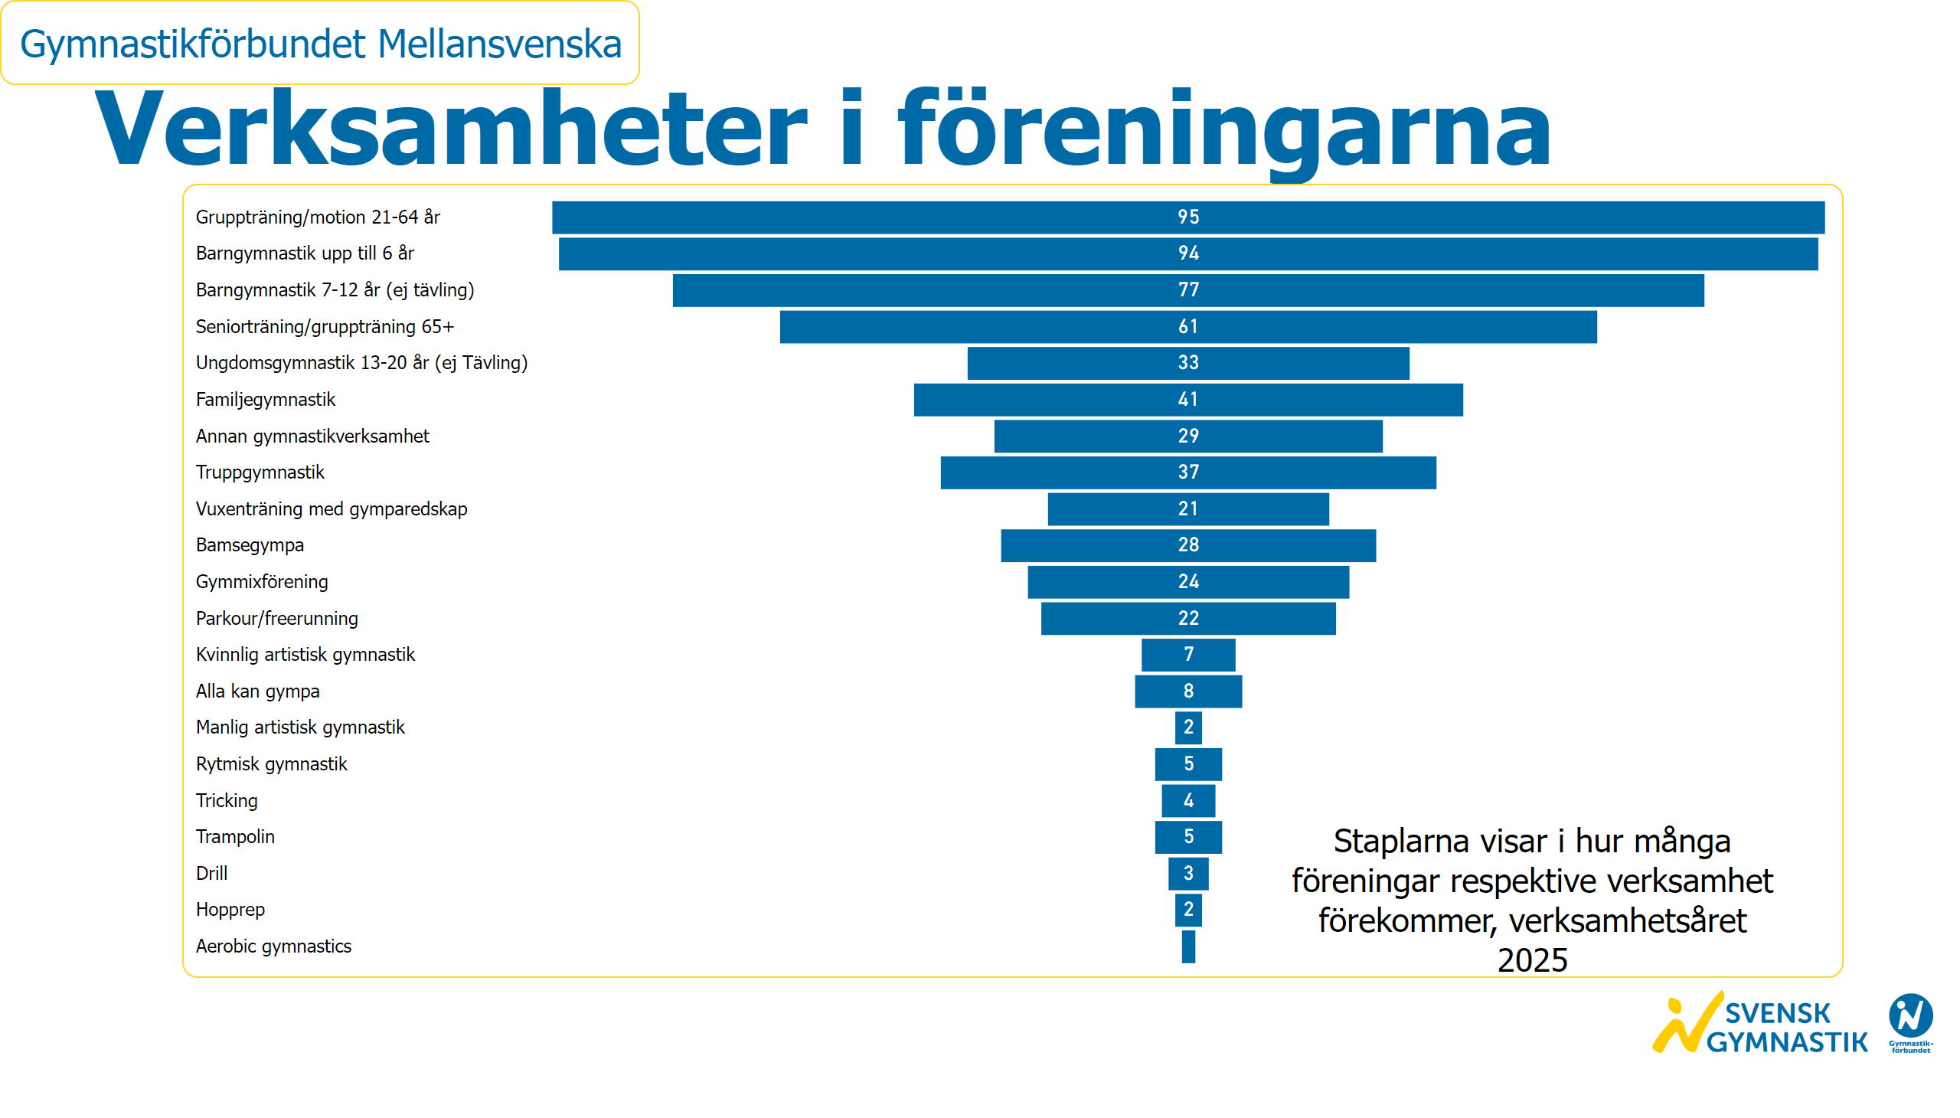
Verksamheter i föreningarna
Notes:
textbox
No alt text provided
textbox
No alt text provided
funnel
No alt text provided
slicer
No alt text provided
card
No alt text provided
image
No alt text provided

Slide 19
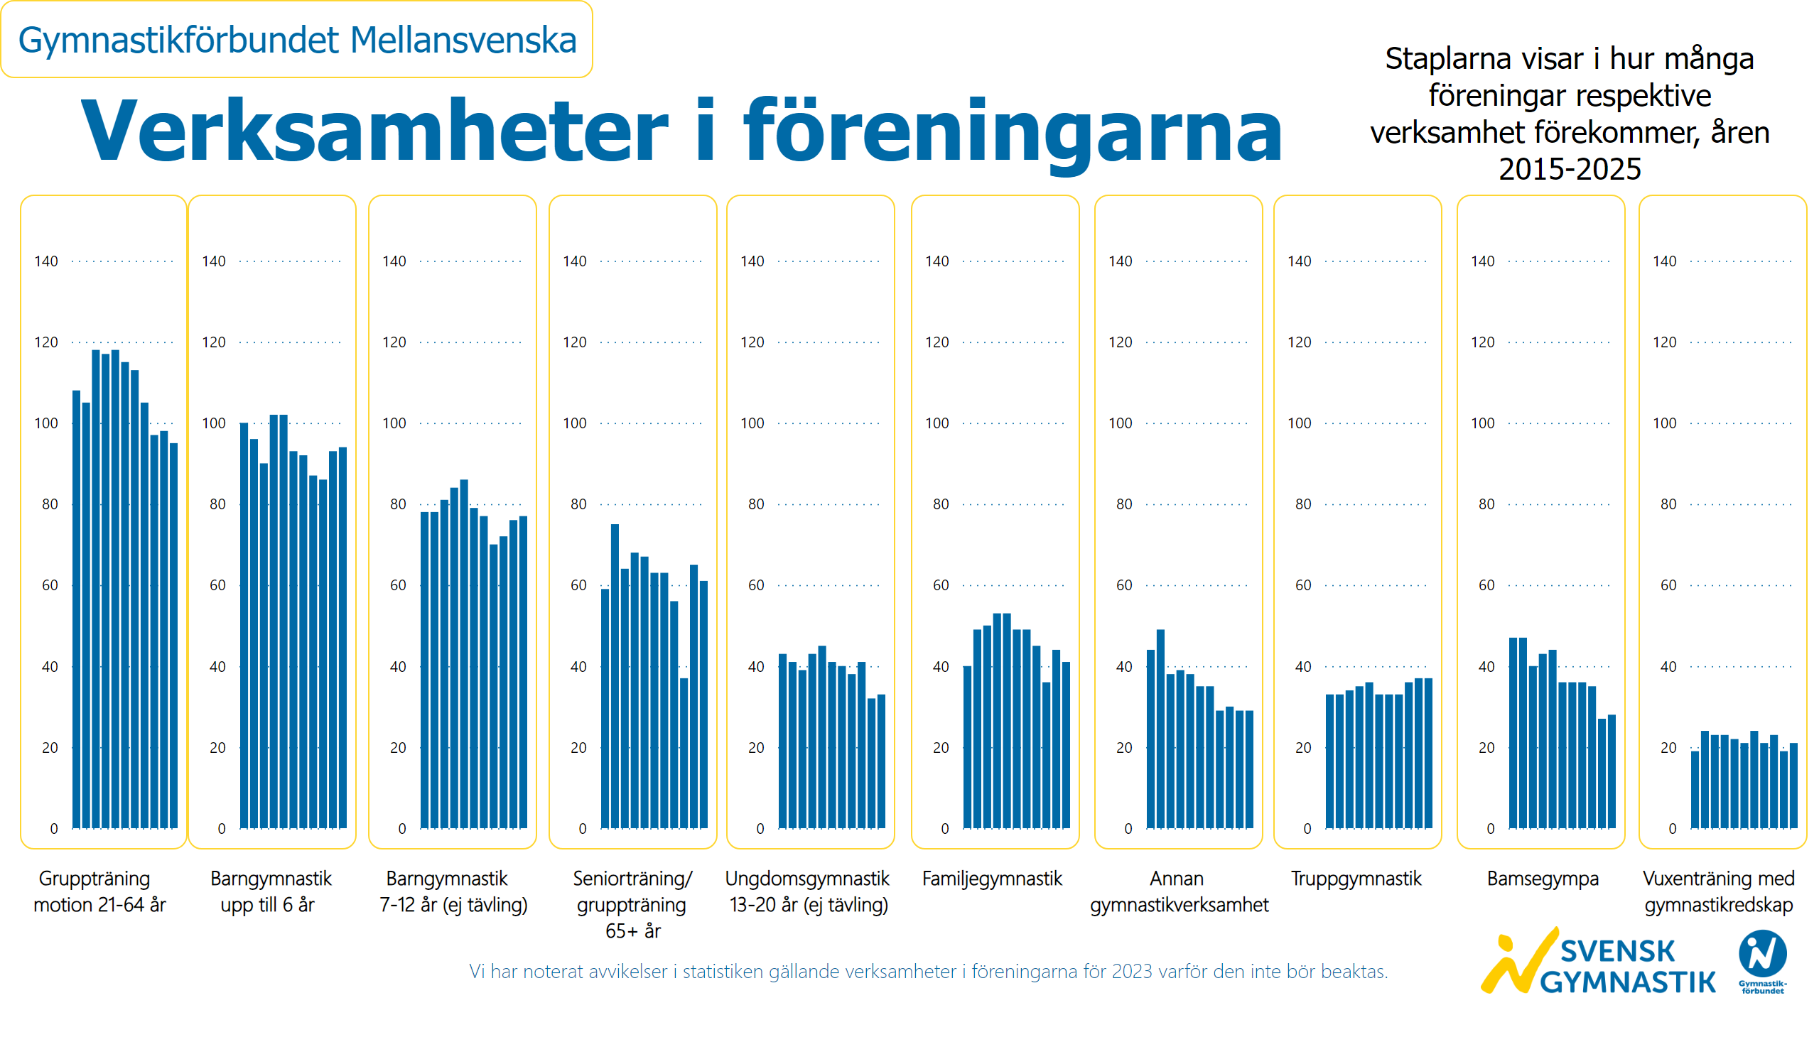
Verksamheter i föreningarna 2015-2025
Notes:
textbox
No alt text provided
textbox
No alt text provided
textbox
No alt text provided
clusteredColumnChart
No alt text provided
clusteredColumnChart
No alt text provided
clusteredColumnChart
No alt text provided
clusteredColumnChart
No alt text provided
clusteredColumnChart
No alt text provided
clusteredColumnChart
No alt text provided
clusteredColumnChart
No alt text provided
clusteredColumnChart
No alt text provided
clusteredColumnChart
No alt text provided
clusteredColumnChart
No alt text provided
slicer
No alt text provided
card
No alt text provided
image
No alt text provided
textbox
No alt text provided
textbox
No alt text provided

Slide 20
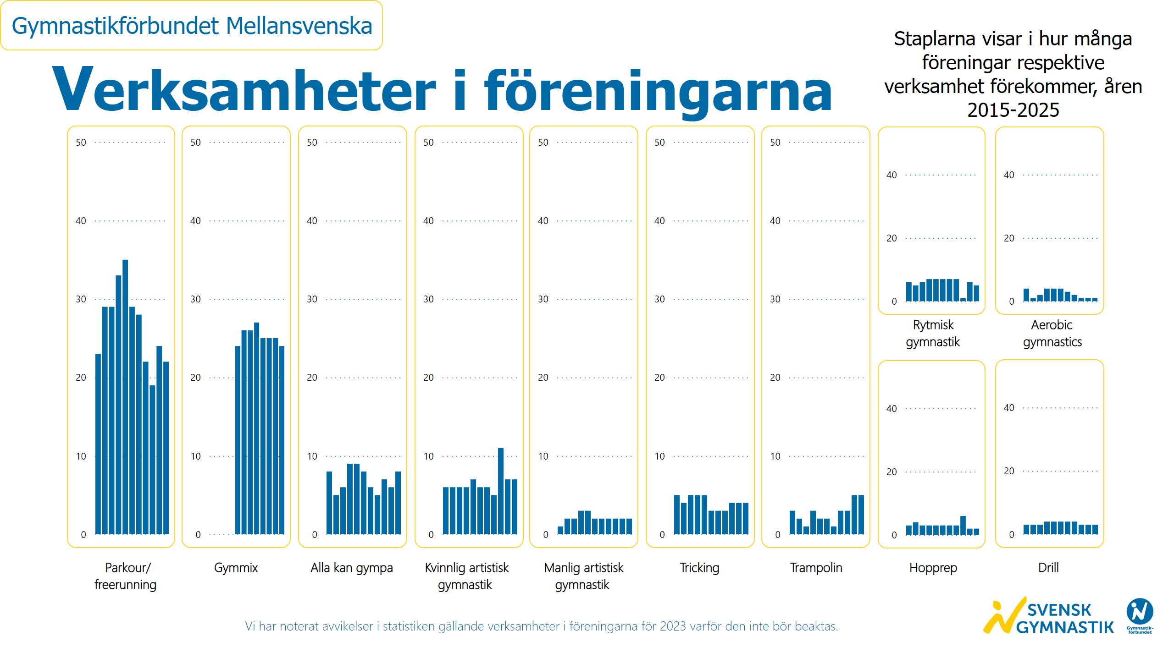
Verksamheter i föreningarna 2015-2025 2
Notes:
textbox
No alt text provided
textbox
No alt text provided
clusteredColumnChart
No alt text provided
clusteredColumnChart
No alt text provided
clusteredColumnChart
No alt text provided
clusteredColumnChart
No alt text provided
clusteredColumnChart
No alt text provided
clusteredColumnChart
No alt text provided
clusteredColumnChart
No alt text provided
clusteredColumnChart
No alt text provided
clusteredColumnChart
No alt text provided
textbox
No alt text provided
clusteredColumnChart
No alt text provided
clusteredColumnChart
No alt text provided
textbox
No alt text provided
textbox
No alt text provided
slicer
No alt text provided
card
No alt text provided
image
No alt text provided

Slide 22
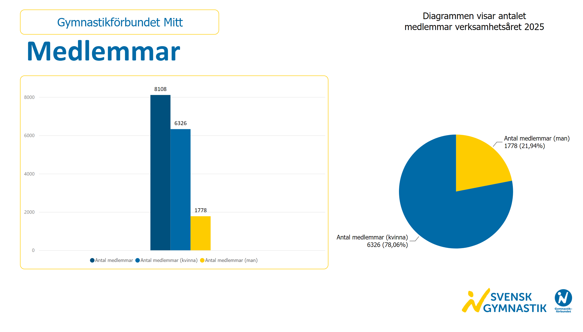
Medlemmar
Notes:
textbox
No alt text provided
textbox
No alt text provided
clusteredColumnChart
No alt text provided
pieChart
No alt text provided
card
No alt text provided
slicer
No alt text provided
image
No alt text provided

Slide 23
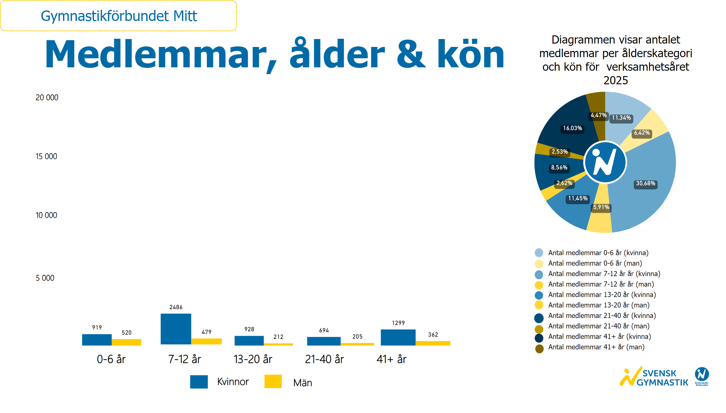
Ålder och kön
Notes:
textbox
No alt text provided
textbox
No alt text provided
image
No alt text provided
textbox
No alt text provided
textbox
No alt text provided
basicShape
No alt text provided
textbox
No alt text provided
basicShape
No alt text provided
textbox
No alt text provided
clusteredColumnChart
No alt text provided
clusteredColumnChart
No alt text provided
clusteredColumnChart
No alt text provided
clusteredColumnChart
No alt text provided
clusteredColumnChart
No alt text provided
donutChart
No alt text provided
textbox
No alt text provided
basicShape
No alt text provided
basicShape
No alt text provided
basicShape
No alt text provided
basicShape
No alt text provided
basicShape
No alt text provided
basicShape
No alt text provided
basicShape
No alt text provided
card
No alt text provided
slicer
No alt text provided
basicShape
No alt text provided
basicShape
No alt text provided
basicShape
No alt text provided
image
No alt text provided

Slide 24
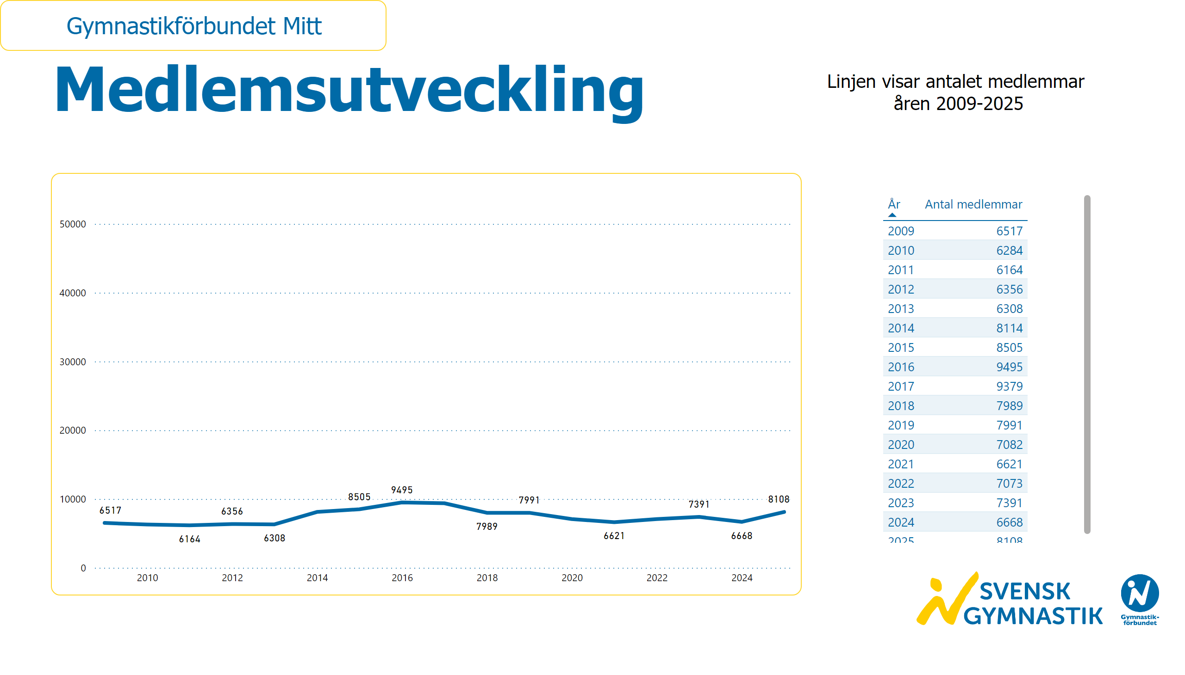
Medlemsutveckling
Notes:
textbox
No alt text provided
textbox
No alt text provided
lineChart
No alt text provided
card
No alt text provided
slicer
No alt text provided
image
No alt text provided
tableEx
No alt text provided

Slide 25
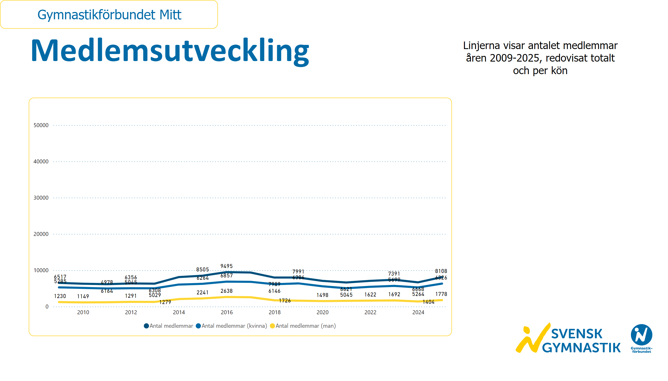
Medlemsutveckling kön
Notes:
textbox
No alt text provided
textbox
No alt text provided
lineChart
No alt text provided
card
No alt text provided
slicer
No alt text provided
image
No alt text provided

Slide 26
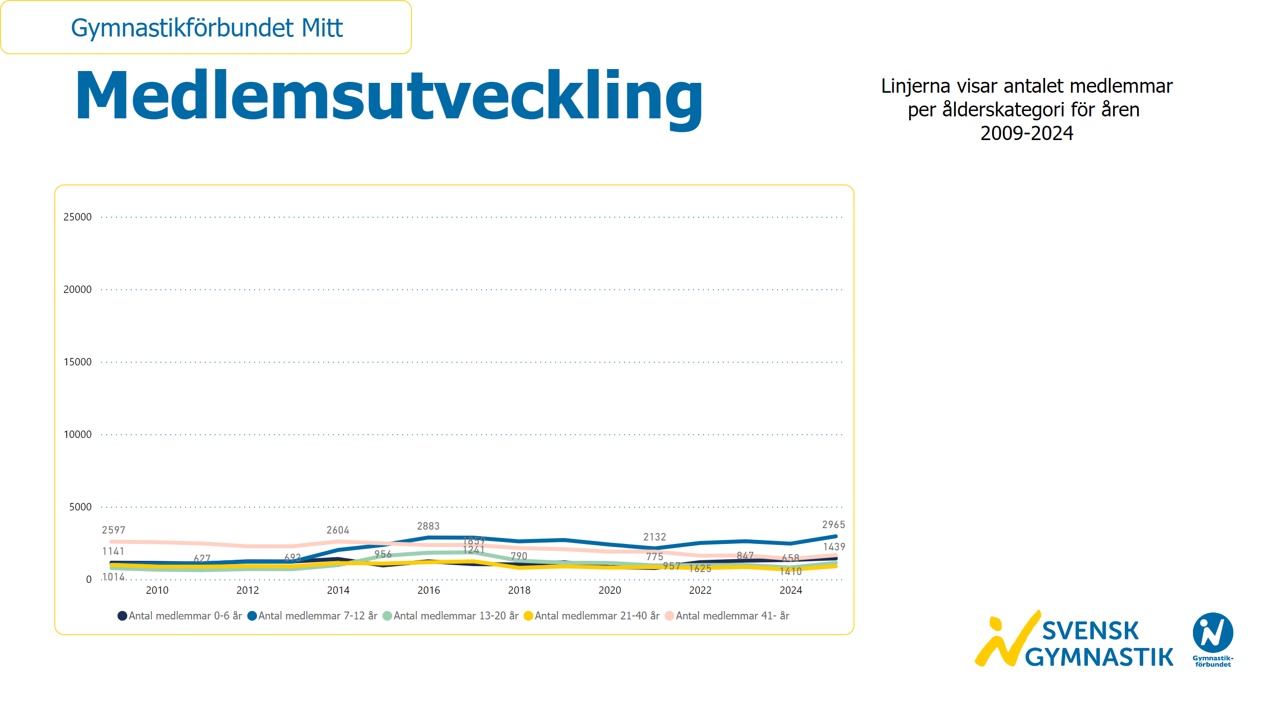
Medlemsutveckling ålder
Notes:
textbox
No alt text provided
textbox
No alt text provided
lineChart
No alt text provided
card
No alt text provided
slicer
No alt text provided
image
No alt text provided

Slide 27
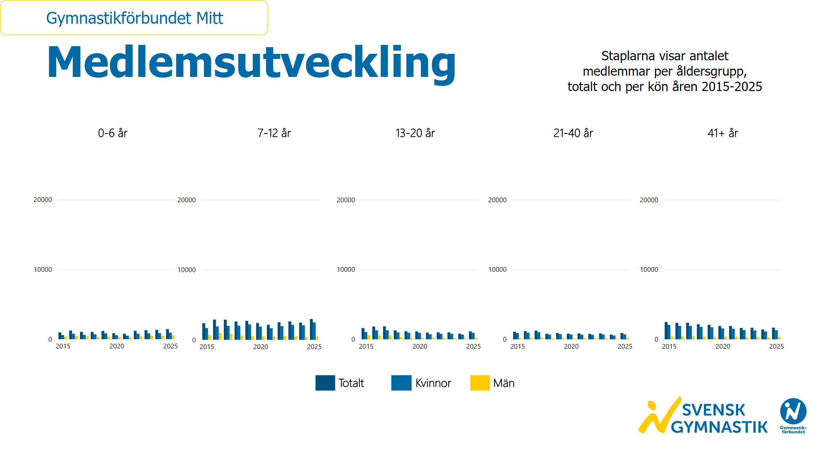
Medlemsutveckling ålder och kön
Notes:
textbox
No alt text provided
textbox
No alt text provided
textbox
No alt text provided
textbox
No alt text provided
textbox
No alt text provided
textbox
No alt text provided
textbox
No alt text provided
basicShape
No alt text provided
textbox
No alt text provided
basicShape
No alt text provided
textbox
No alt text provided
basicShape
No alt text provided
textbox
No alt text provided
clusteredColumnChart
No alt text provided
clusteredColumnChart
No alt text provided
clusteredColumnChart
No alt text provided
clusteredColumnChart
No alt text provided
clusteredColumnChart
No alt text provided
card
No alt text provided
slicer
No alt text provided
image
No alt text provided

Slide 28

Antal ledare
Notes:
textbox
No alt text provided
textbox
No alt text provided
clusteredColumnChart
No alt text provided
pieChart
No alt text provided
card
No alt text provided
slicer
No alt text provided
image
No alt text provided

Slide 29
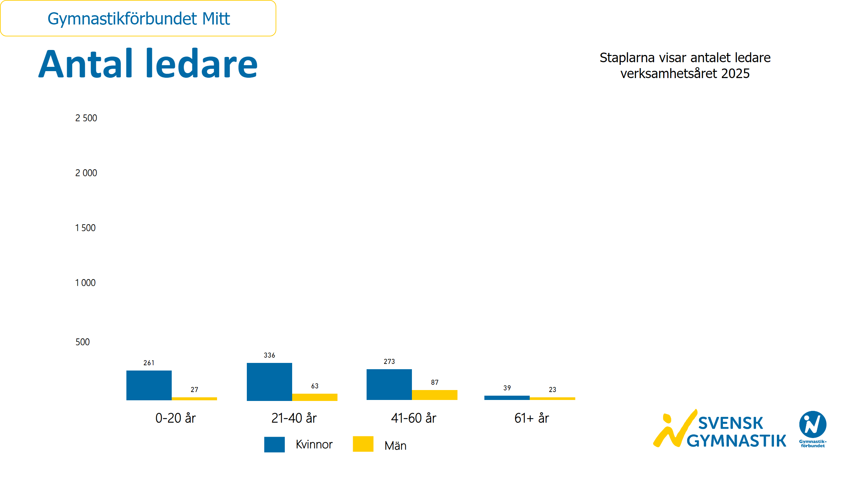
Antal ledare kön och ålder
Notes:
textbox
No alt text provided
textbox
No alt text provided
textbox
No alt text provided
clusteredColumnChart
No alt text provided
clusteredColumnChart
No alt text provided
clusteredColumnChart
No alt text provided
clusteredColumnChart
No alt text provided
textbox
No alt text provided
basicShape
No alt text provided
textbox
No alt text provided
basicShape
No alt text provided
textbox
No alt text provided
card
No alt text provided
slicer
No alt text provided
image
No alt text provided

Slide 30
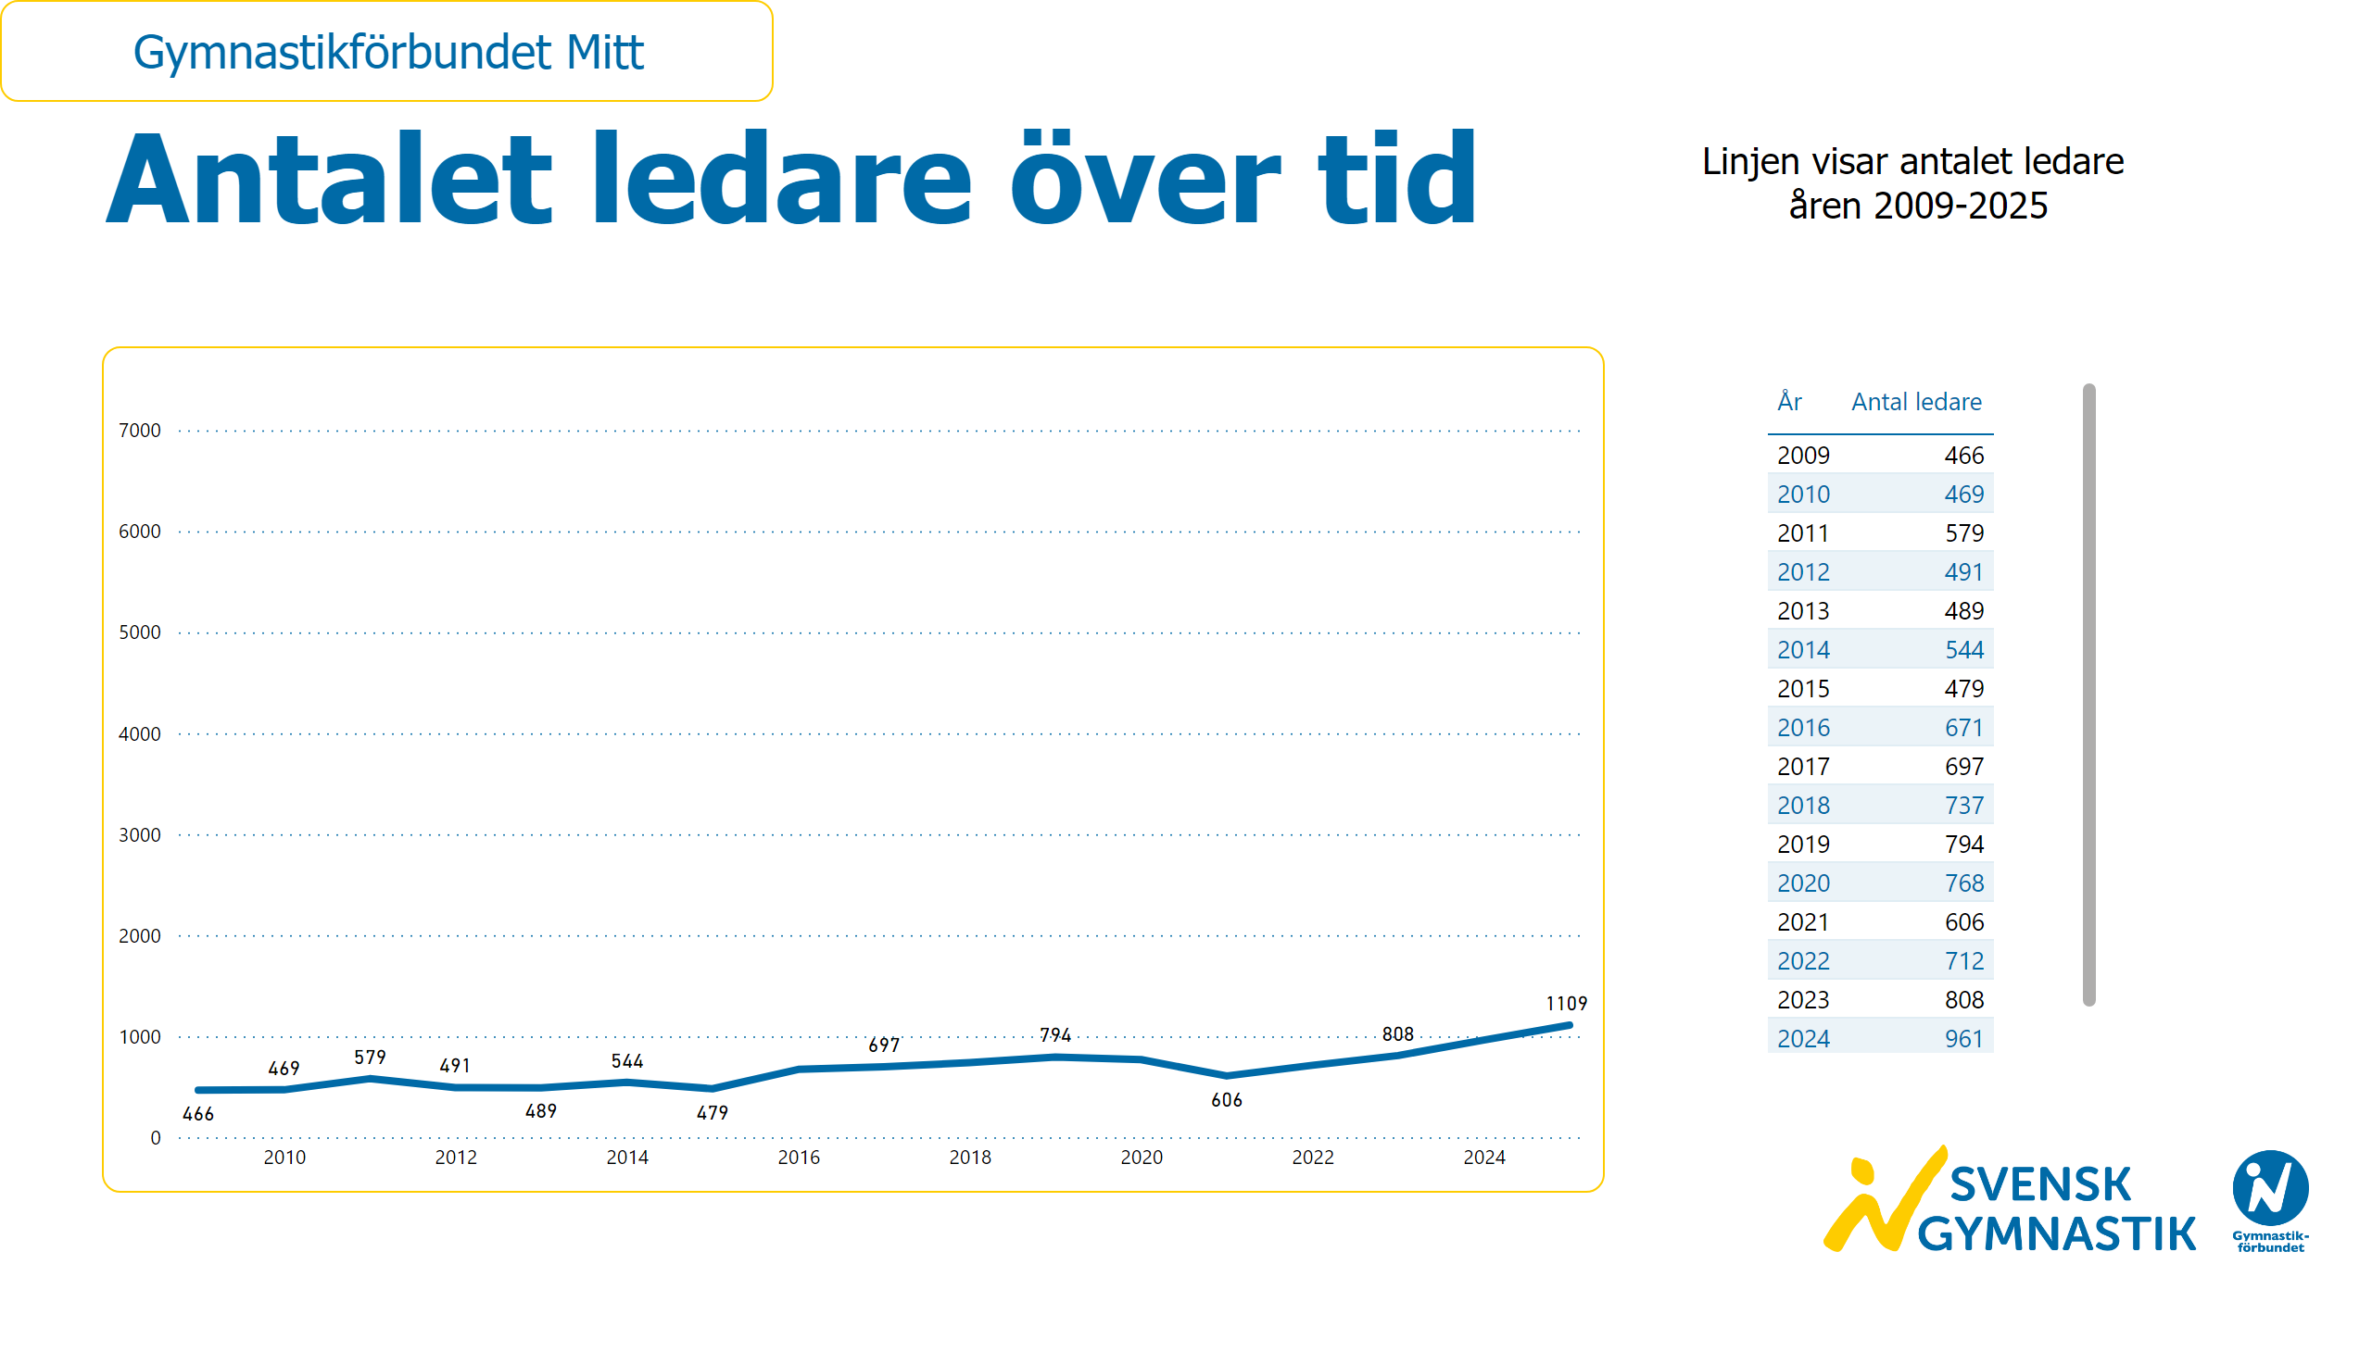
Ledarutveckling
Notes:
textbox
No alt text provided
textbox
No alt text provided
lineChart
No alt text provided
card
No alt text provided
slicer
No alt text provided
image
No alt text provided
tableEx
No alt text provided

Slide 31
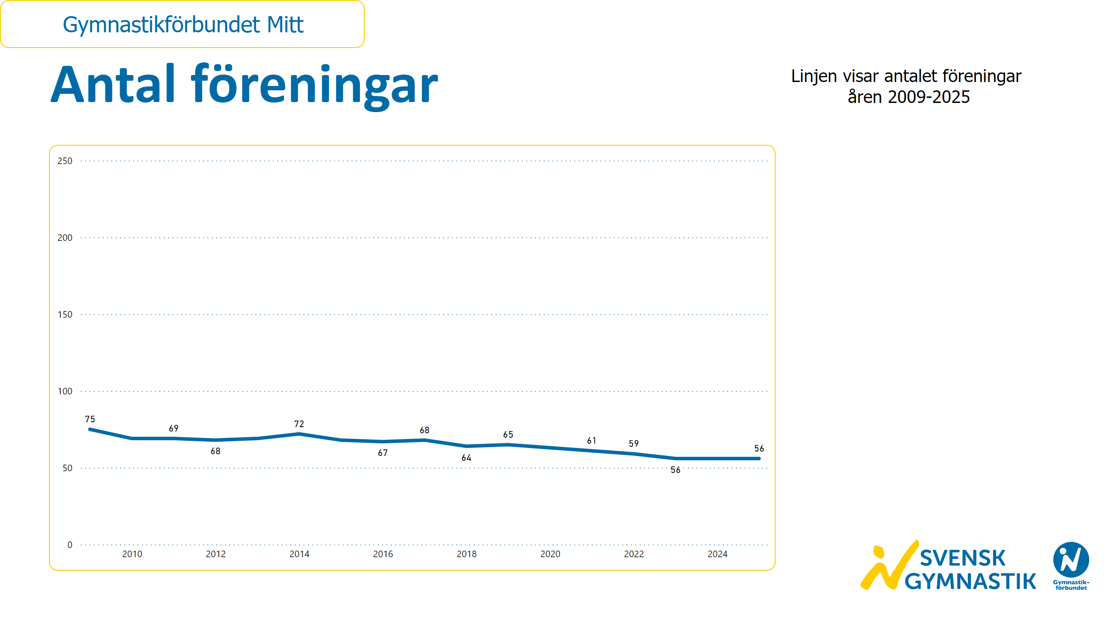
Antal föreningar
Notes:
textbox
No alt text provided
textbox
No alt text provided
lineChart
No alt text provided
card
No alt text provided
slicer
No alt text provided
image
No alt text provided

Slide 32
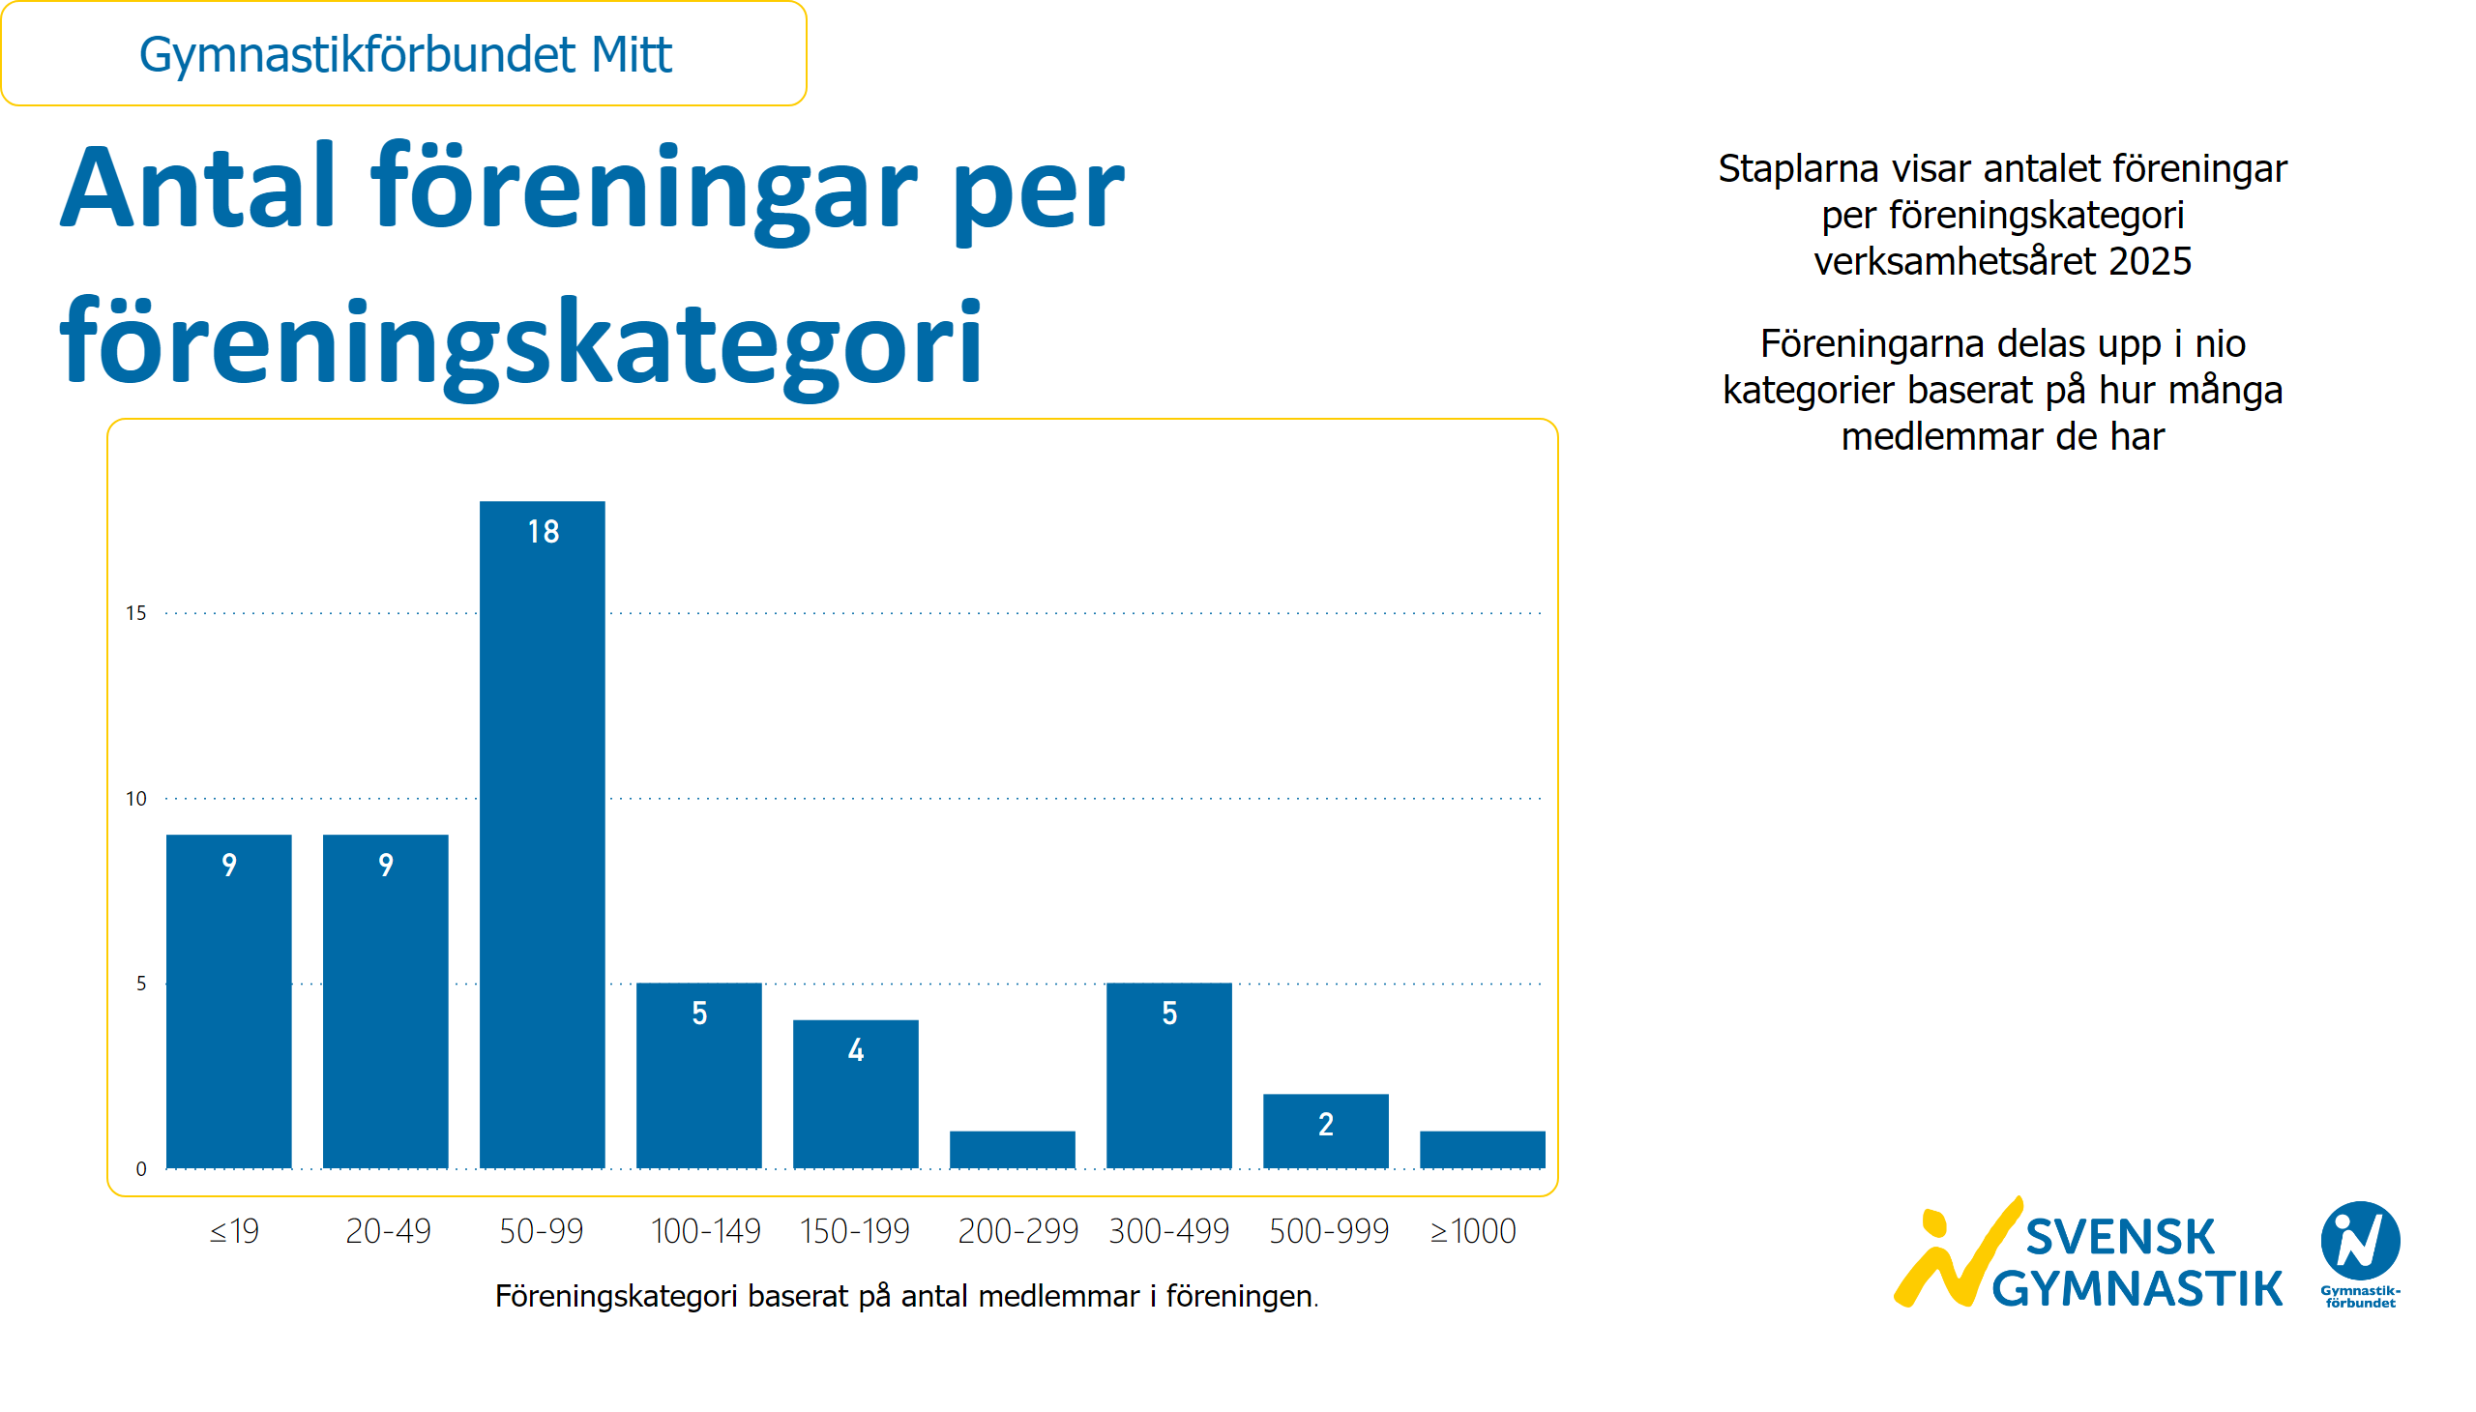
Föreningar per föreningskategori
Notes:
textbox
No alt text provided
textbox
No alt text provided
textbox
No alt text provided
clusteredColumnChart
No alt text provided
textbox
No alt text provided
slicer
No alt text provided
card
No alt text provided
image
No alt text provided

Slide 33
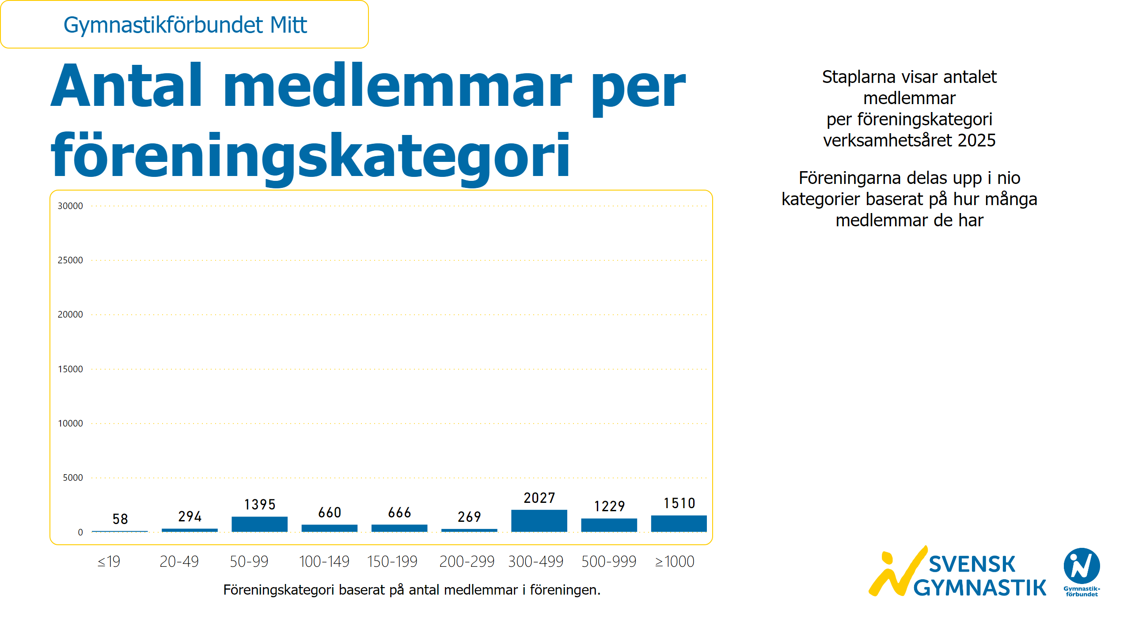
Medlemmar per föreningskategori
Notes:
textbox
No alt text provided
textbox
No alt text provided
textbox
No alt text provided
textbox
No alt text provided
clusteredColumnChart
No alt text provided
slicer
No alt text provided
card
No alt text provided
image
No alt text provided

Slide 34
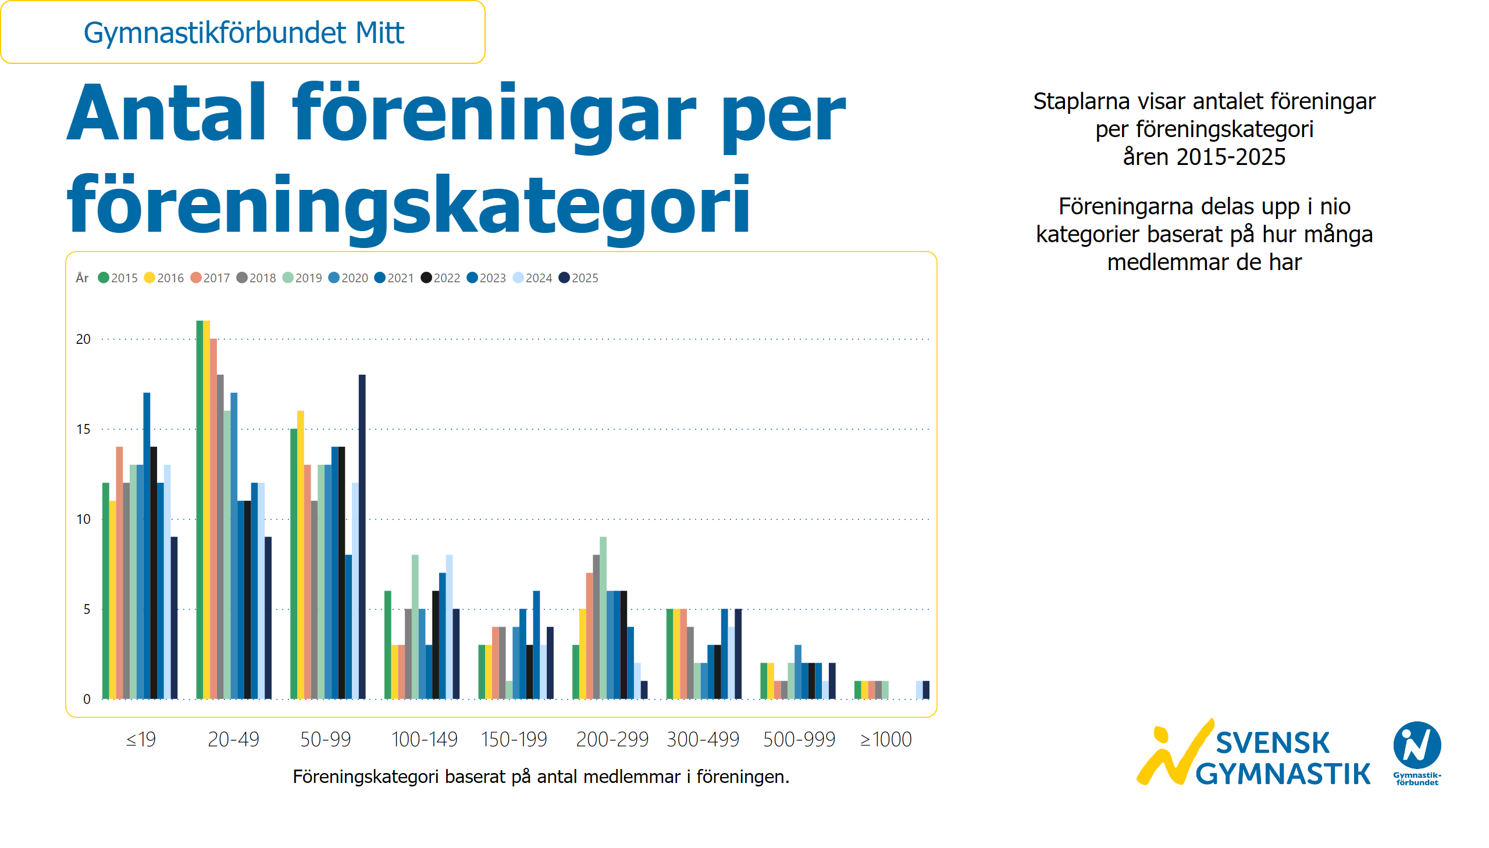
Föreningar per föreningskategori och år
Notes:
textbox
No alt text provided
textbox
No alt text provided
textbox
No alt text provided
textbox
No alt text provided
clusteredColumnChart
No alt text provided
slicer
No alt text provided
card
No alt text provided
image
No alt text provided

Slide 35
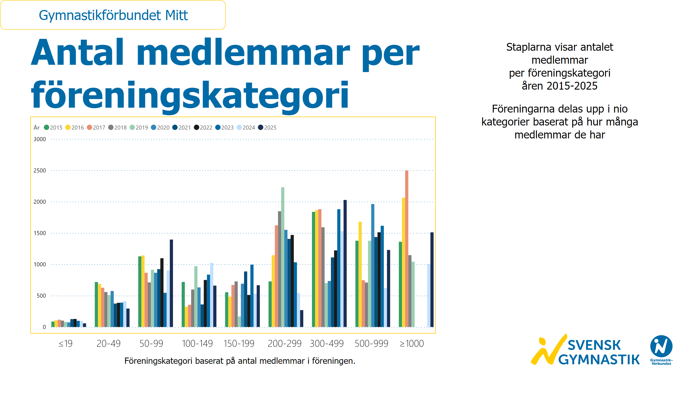
Medlemmar per föreningskategori och år
Notes:
textbox
No alt text provided
textbox
No alt text provided
textbox
No alt text provided
textbox
No alt text provided
clusteredColumnChart
No alt text provided
slicer
No alt text provided
card
No alt text provided
image
No alt text provided

Slide 36
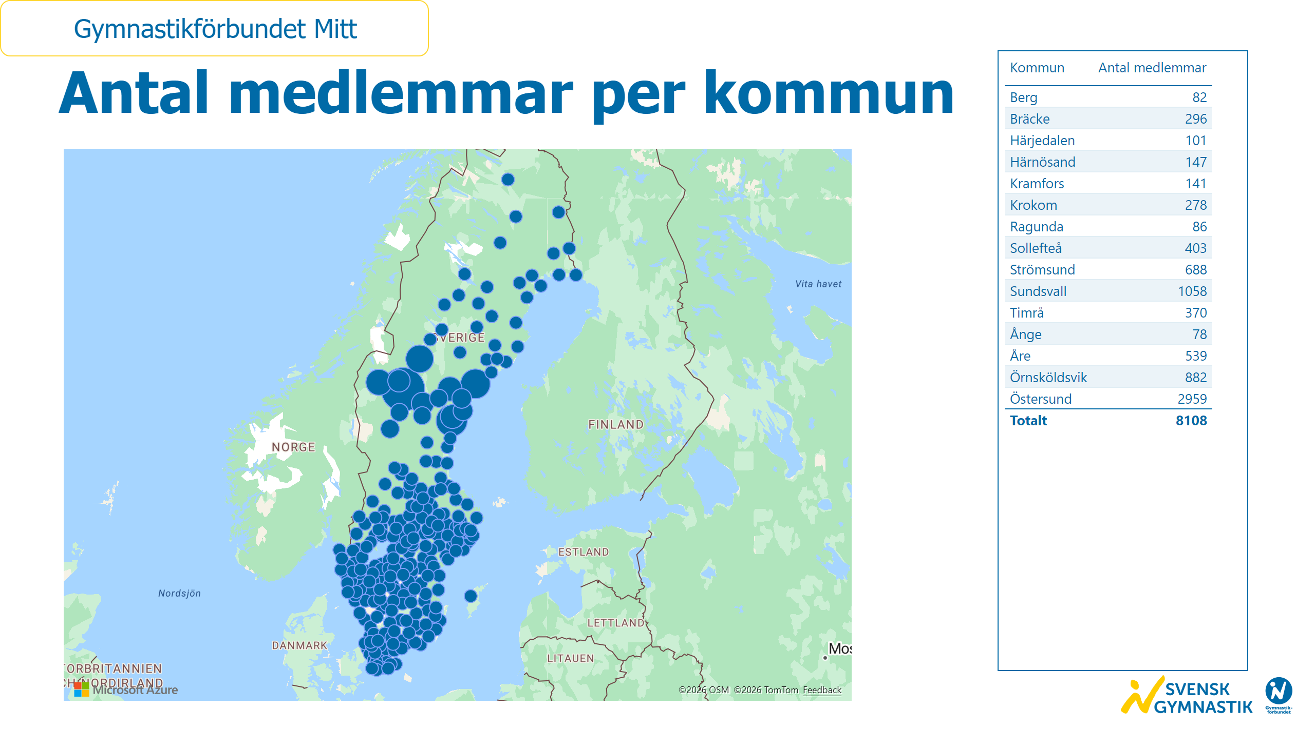
Medlemmar per kommun
Notes:
textbox
No alt text provided
azureMap
No alt text provided
tableEx
No alt text provided
slicer
No alt text provided
card
No alt text provided
image
No alt text provided

Slide 37
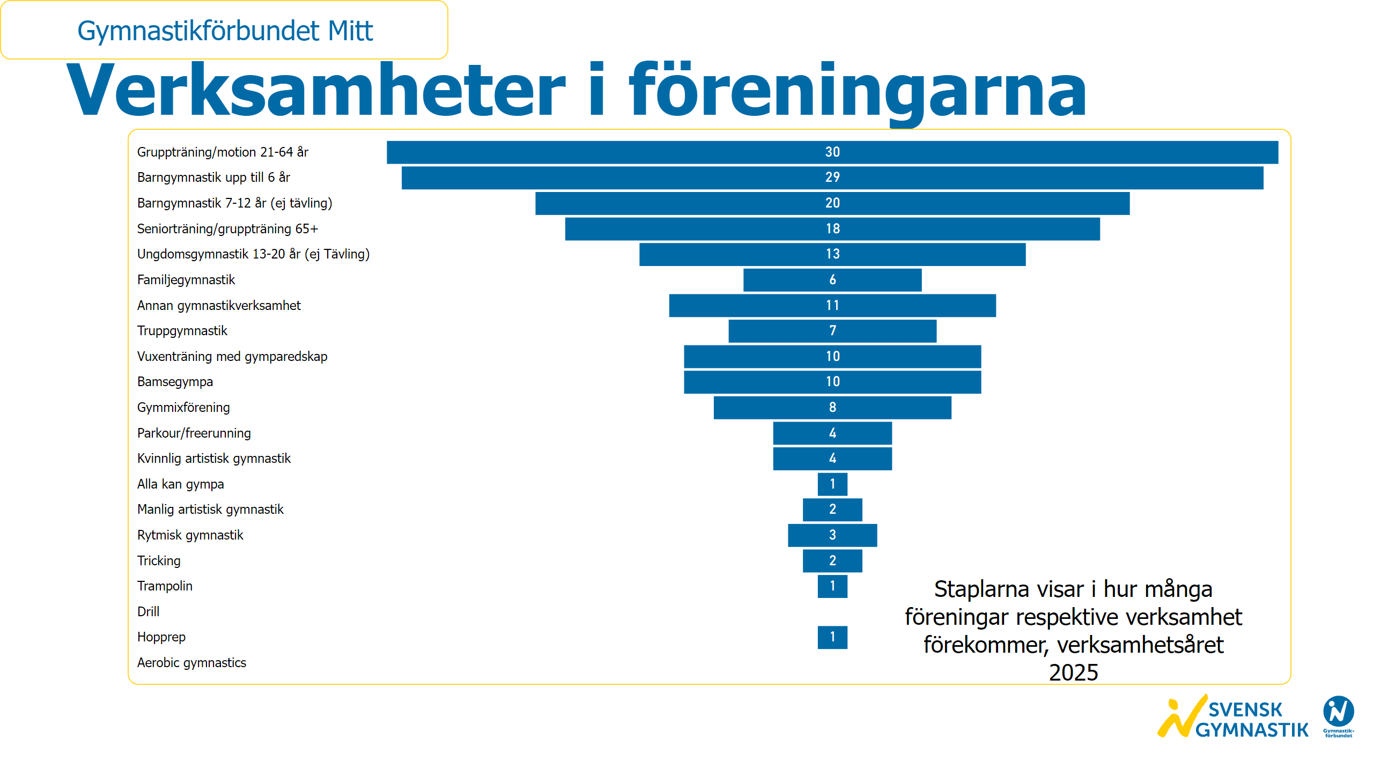
Verksamheter i föreningarna
Notes:
textbox
No alt text provided
textbox
No alt text provided
funnel
No alt text provided
slicer
No alt text provided
card
No alt text provided
image
No alt text provided

Slide 38
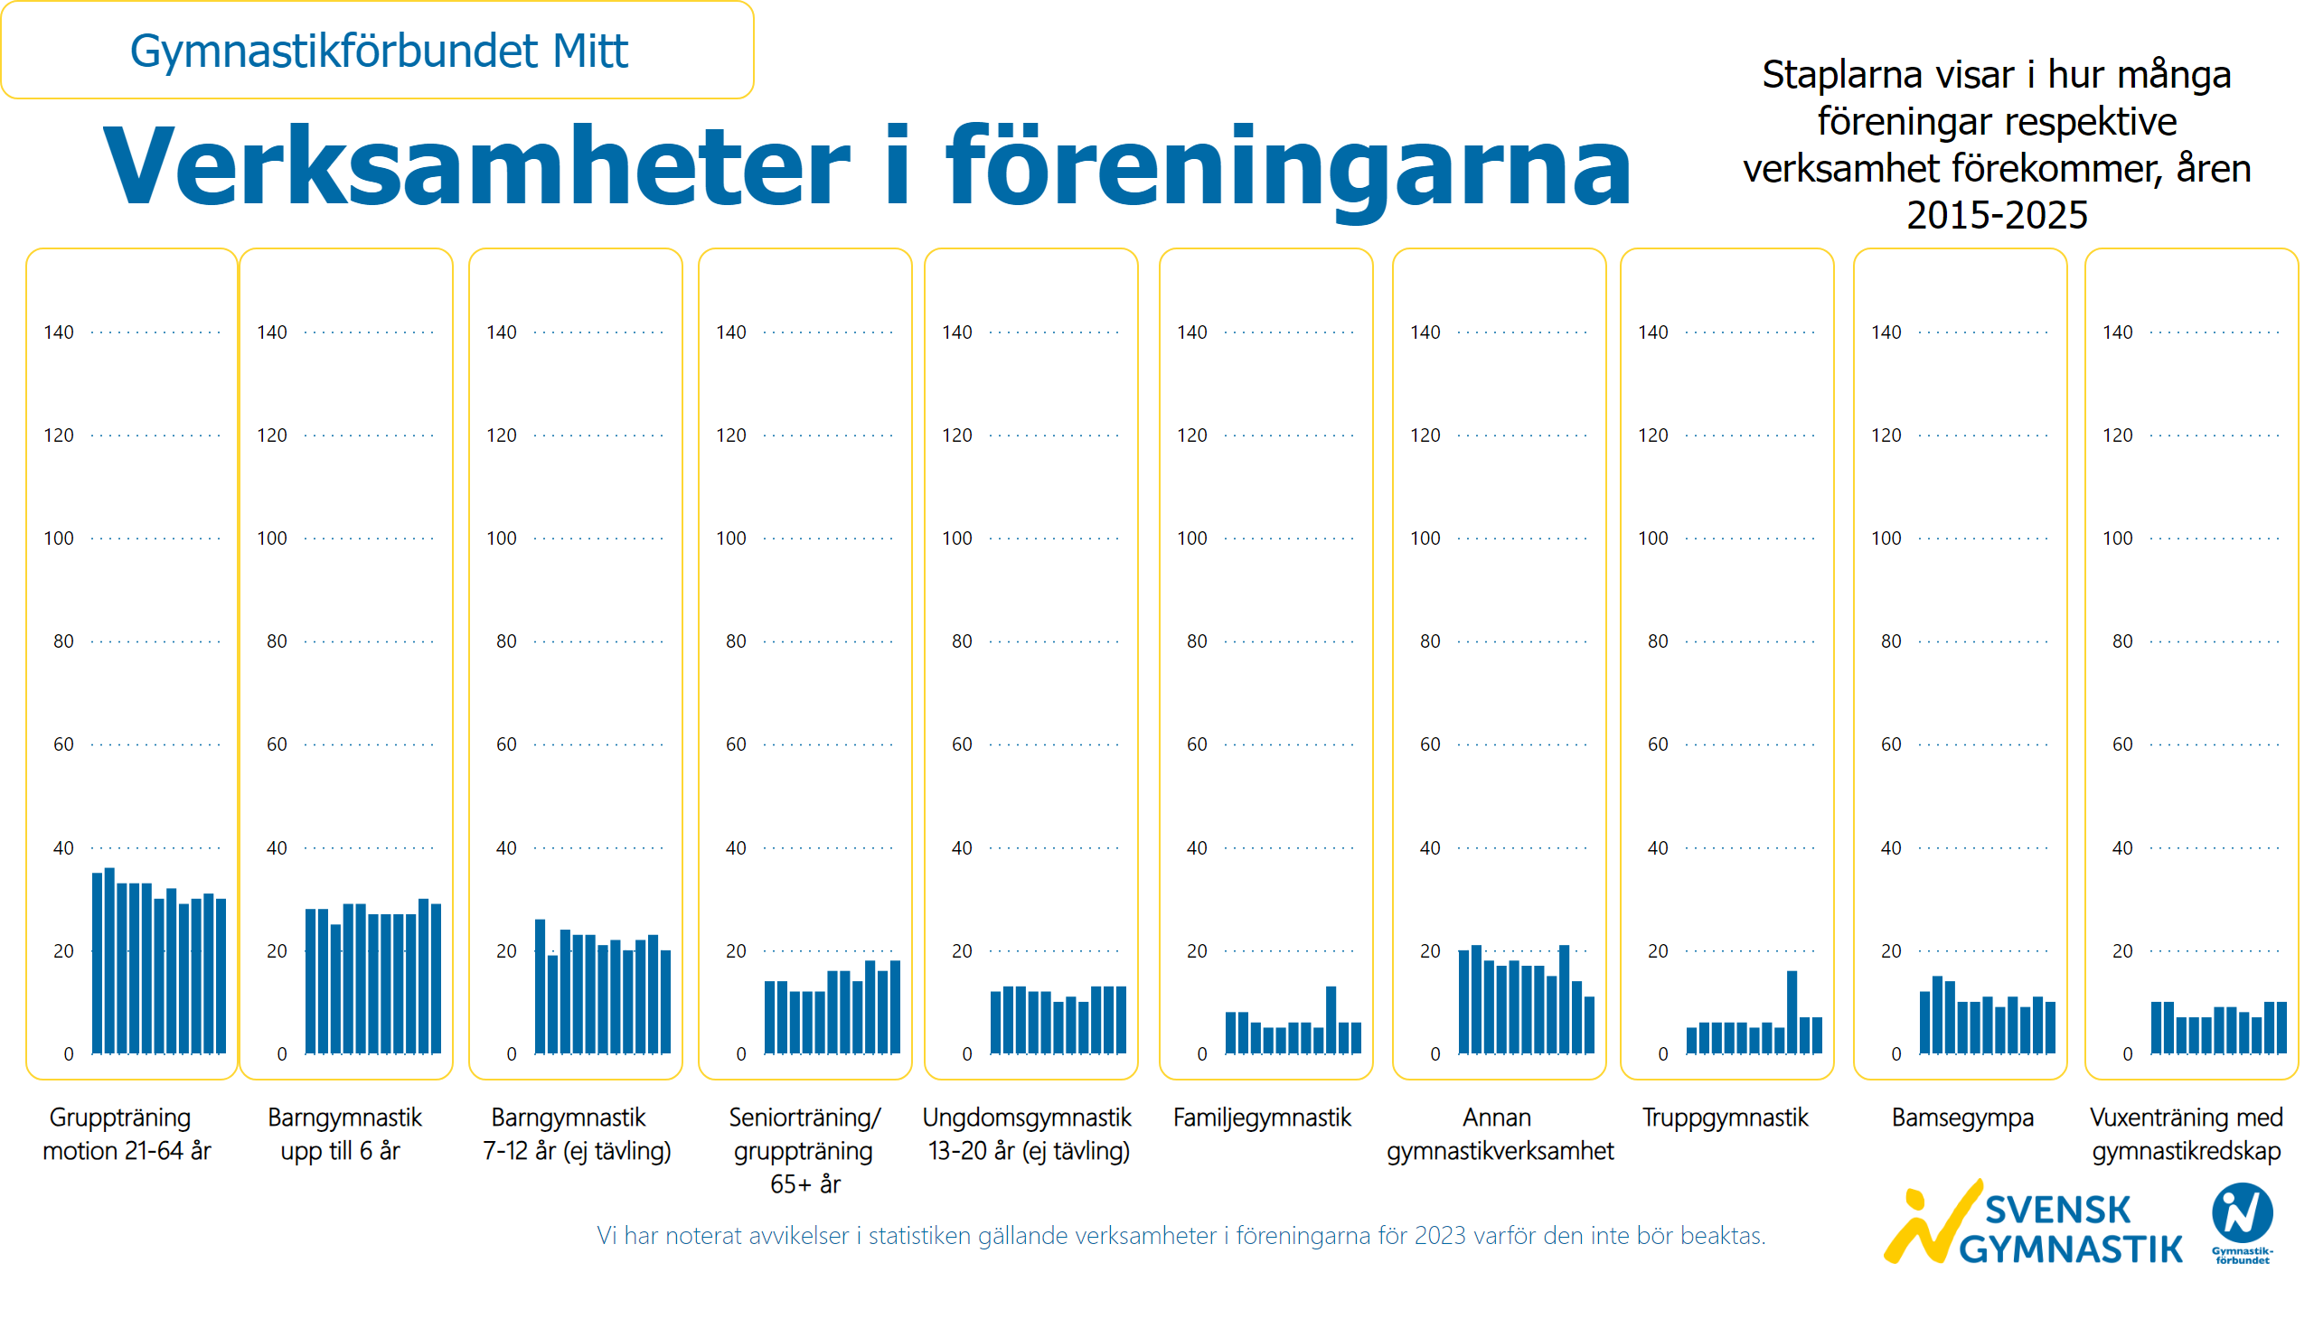
Verksamheter i föreningarna 2015-2025
Notes:
textbox
No alt text provided
textbox
No alt text provided
textbox
No alt text provided
clusteredColumnChart
No alt text provided
clusteredColumnChart
No alt text provided
clusteredColumnChart
No alt text provided
clusteredColumnChart
No alt text provided
clusteredColumnChart
No alt text provided
clusteredColumnChart
No alt text provided
clusteredColumnChart
No alt text provided
clusteredColumnChart
No alt text provided
clusteredColumnChart
No alt text provided
clusteredColumnChart
No alt text provided
slicer
No alt text provided
card
No alt text provided
image
No alt text provided
textbox
No alt text provided
textbox
No alt text provided

Slide 39
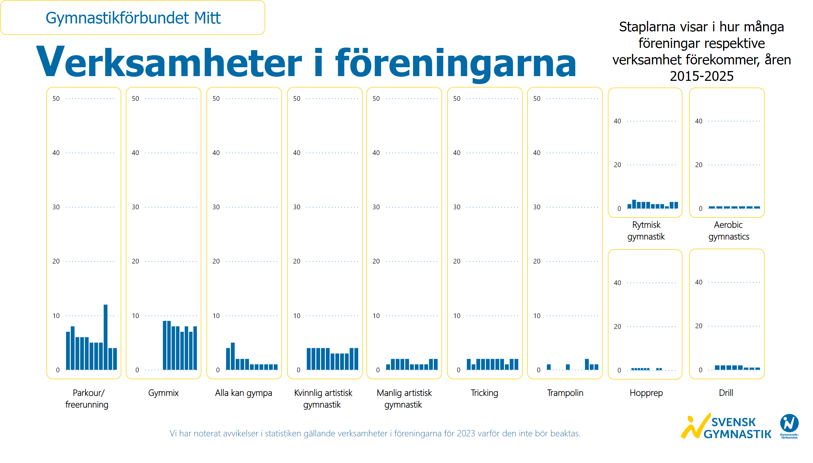
Verksamheter i föreningarna 2015-2025 2
Notes:
textbox
No alt text provided
textbox
No alt text provided
clusteredColumnChart
No alt text provided
clusteredColumnChart
No alt text provided
clusteredColumnChart
No alt text provided
clusteredColumnChart
No alt text provided
clusteredColumnChart
No alt text provided
clusteredColumnChart
No alt text provided
clusteredColumnChart
No alt text provided
clusteredColumnChart
No alt text provided
clusteredColumnChart
No alt text provided
textbox
No alt text provided
clusteredColumnChart
No alt text provided
clusteredColumnChart
No alt text provided
textbox
No alt text provided
textbox
No alt text provided
slicer
No alt text provided
card
No alt text provided
image
No alt text provided

Slide 41
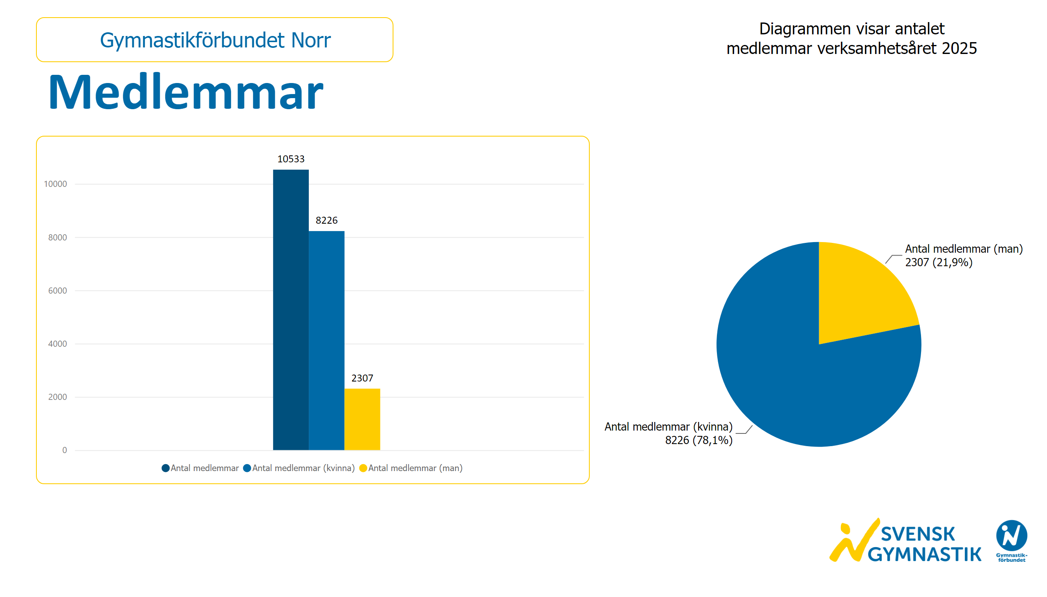
Medlemmar
Notes:
textbox
No alt text provided
textbox
No alt text provided
clusteredColumnChart
No alt text provided
pieChart
No alt text provided
card
No alt text provided
slicer
No alt text provided
image
No alt text provided

Slide 42
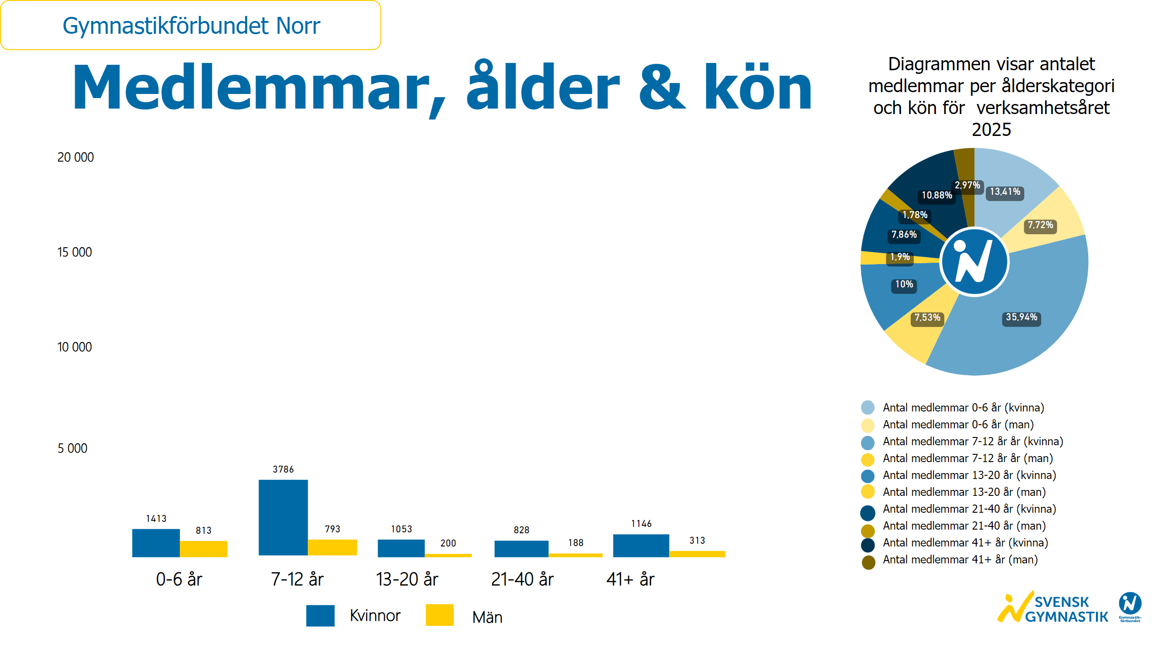
Ålder och kön
Notes:
textbox
No alt text provided
textbox
No alt text provided
image
No alt text provided
textbox
No alt text provided
textbox
No alt text provided
basicShape
No alt text provided
textbox
No alt text provided
basicShape
No alt text provided
textbox
No alt text provided
clusteredColumnChart
No alt text provided
clusteredColumnChart
No alt text provided
clusteredColumnChart
No alt text provided
clusteredColumnChart
No alt text provided
clusteredColumnChart
No alt text provided
donutChart
No alt text provided
textbox
No alt text provided
basicShape
No alt text provided
basicShape
No alt text provided
basicShape
No alt text provided
basicShape
No alt text provided
basicShape
No alt text provided
basicShape
No alt text provided
basicShape
No alt text provided
card
No alt text provided
slicer
No alt text provided
basicShape
No alt text provided
basicShape
No alt text provided
basicShape
No alt text provided
image
No alt text provided

Slide 43
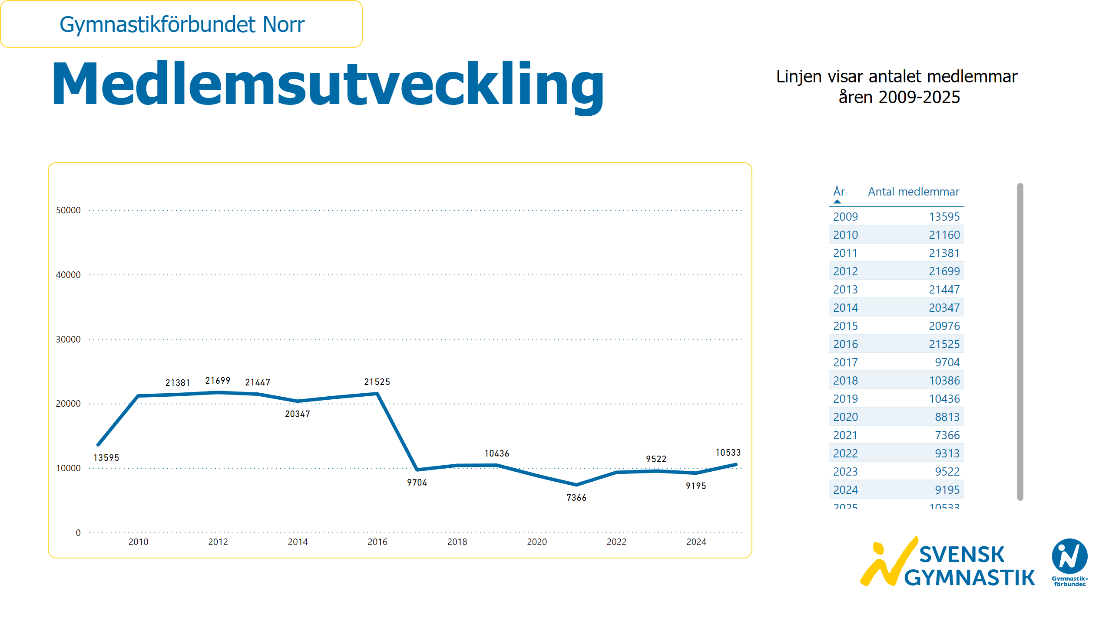
Medlemsutveckling
Notes:
textbox
No alt text provided
textbox
No alt text provided
lineChart
No alt text provided
card
No alt text provided
slicer
No alt text provided
image
No alt text provided
tableEx
No alt text provided

Slide 44
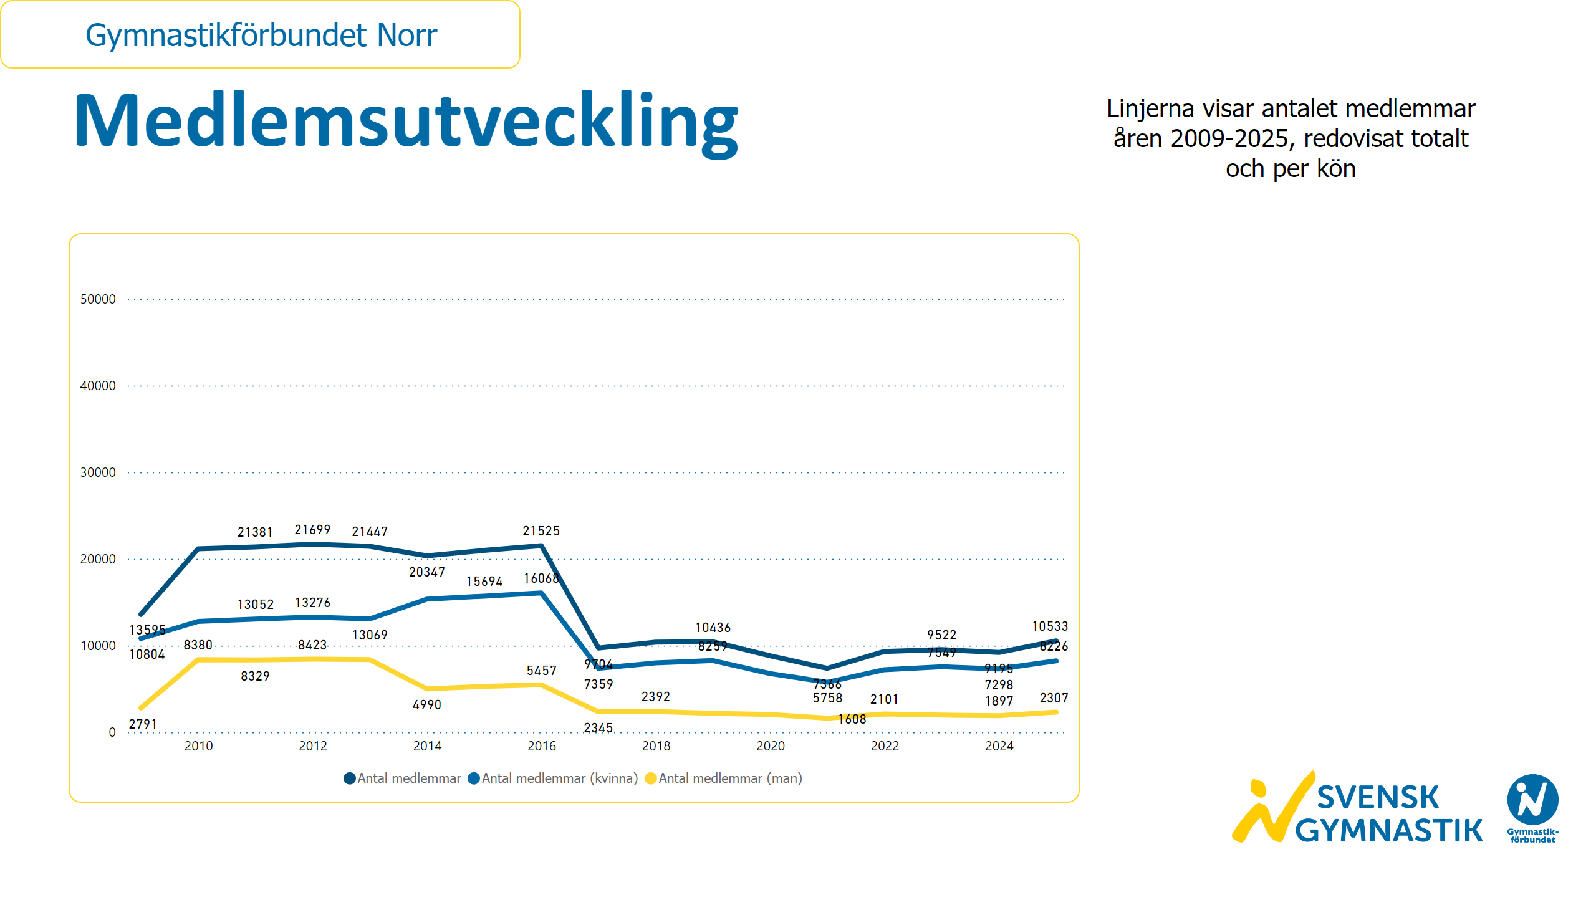
Medlemsutveckling kön
Notes:
textbox
No alt text provided
textbox
No alt text provided
lineChart
No alt text provided
card
No alt text provided
slicer
No alt text provided
image
No alt text provided

Slide 45
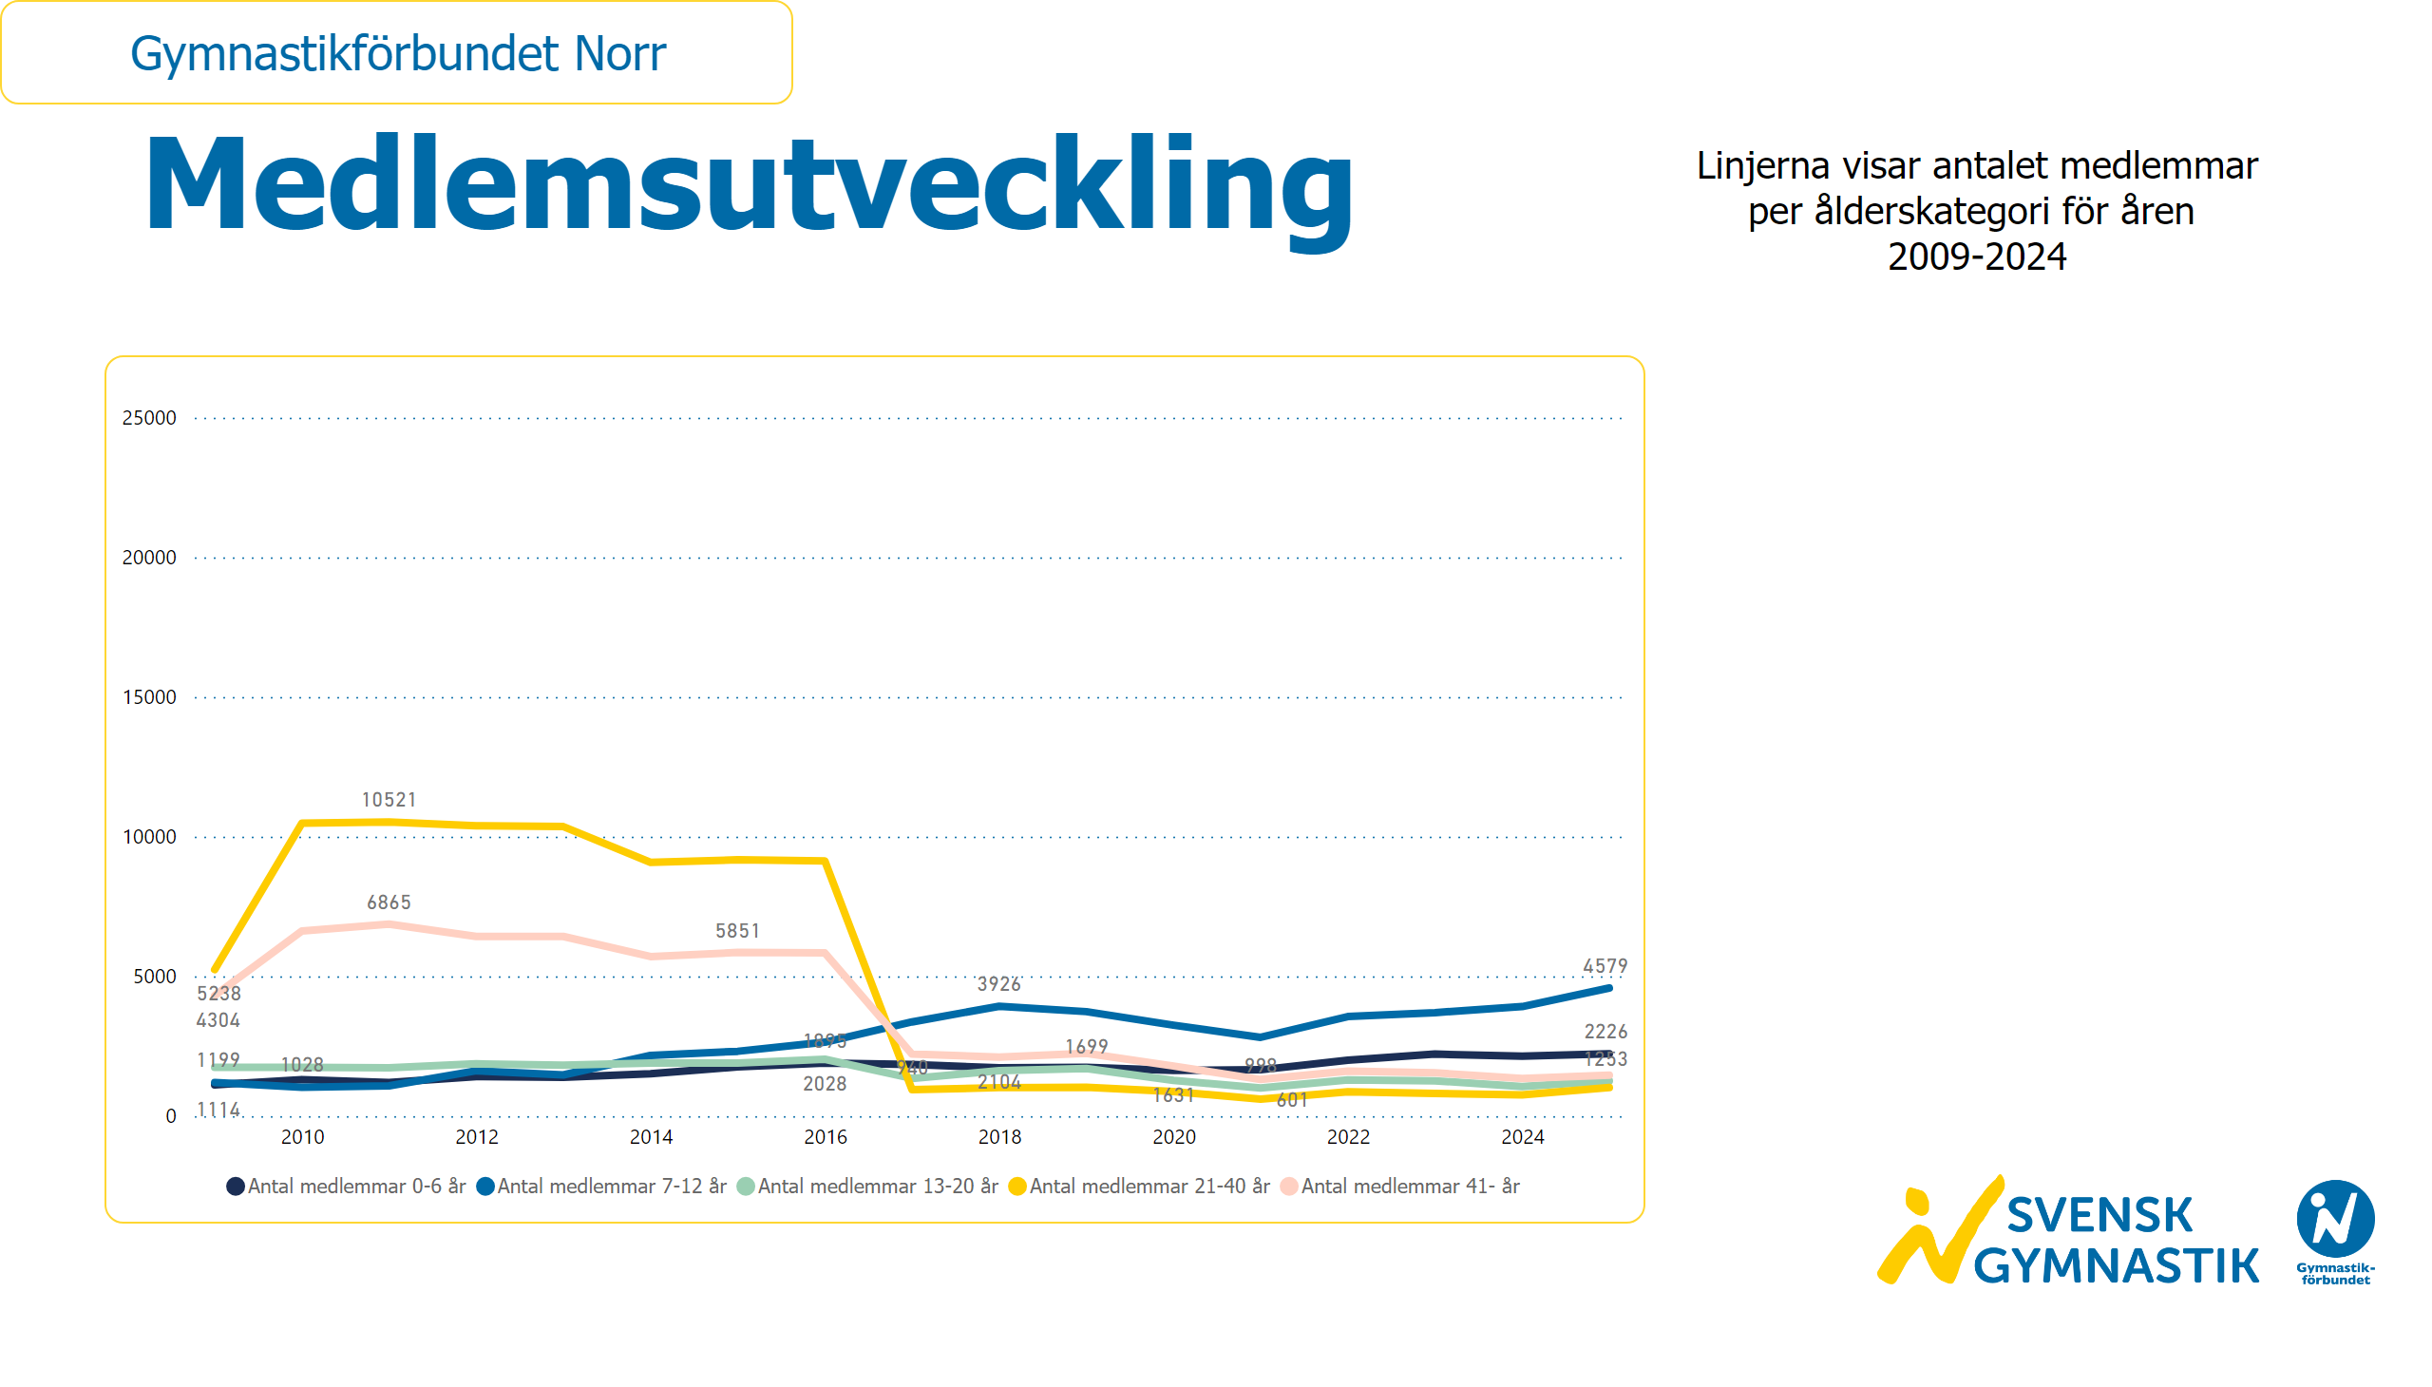
Medlemsutveckling ålder
Notes:
textbox
No alt text provided
textbox
No alt text provided
lineChart
No alt text provided
card
No alt text provided
slicer
No alt text provided
image
No alt text provided

Slide 46
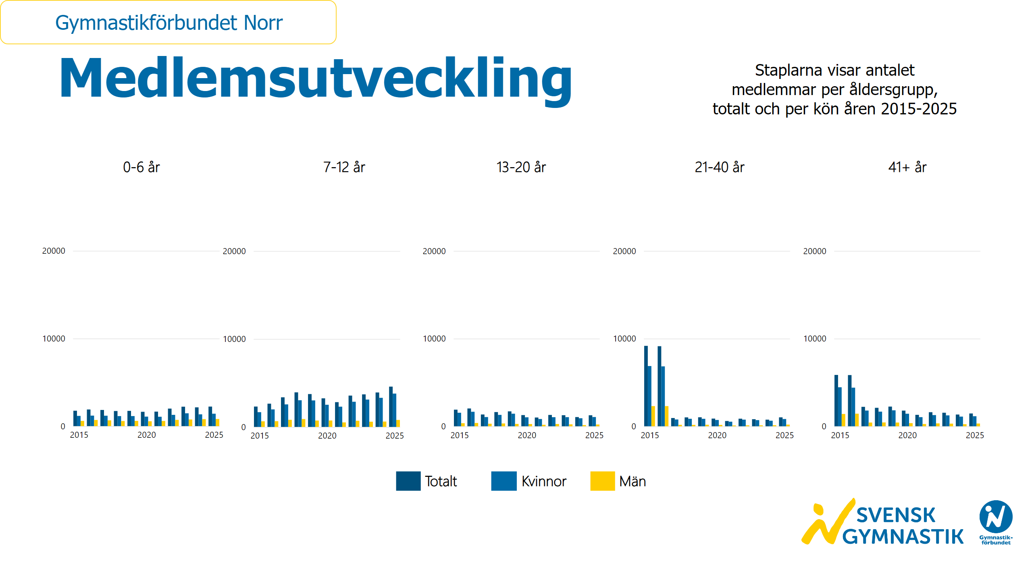
Medlemsutveckling ålder och kön
Notes:
textbox
No alt text provided
textbox
No alt text provided
textbox
No alt text provided
textbox
No alt text provided
textbox
No alt text provided
textbox
No alt text provided
textbox
No alt text provided
basicShape
No alt text provided
textbox
No alt text provided
basicShape
No alt text provided
textbox
No alt text provided
basicShape
No alt text provided
textbox
No alt text provided
clusteredColumnChart
No alt text provided
clusteredColumnChart
No alt text provided
clusteredColumnChart
No alt text provided
clusteredColumnChart
No alt text provided
clusteredColumnChart
No alt text provided
card
No alt text provided
slicer
No alt text provided
image
No alt text provided

Slide 47

Antal ledare
Notes:
textbox
No alt text provided
textbox
No alt text provided
clusteredColumnChart
No alt text provided
pieChart
No alt text provided
card
No alt text provided
slicer
No alt text provided
image
No alt text provided

Slide 48
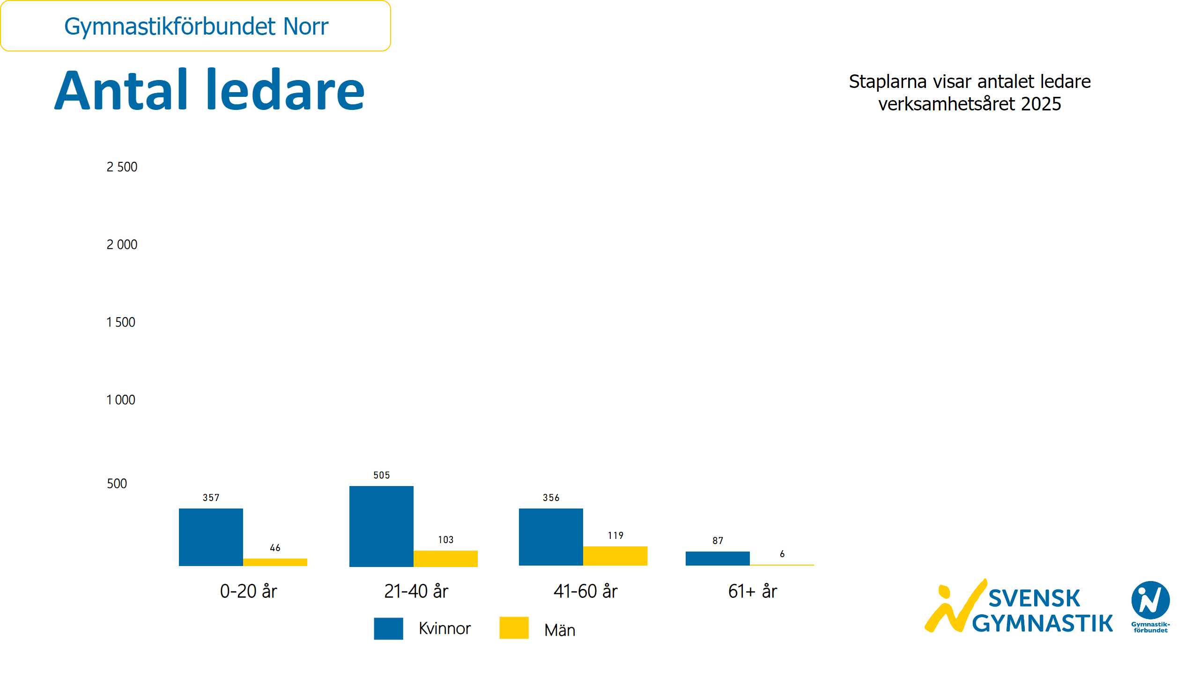
Antal ledare kön och ålder
Notes:
textbox
No alt text provided
textbox
No alt text provided
textbox
No alt text provided
clusteredColumnChart
No alt text provided
clusteredColumnChart
No alt text provided
clusteredColumnChart
No alt text provided
clusteredColumnChart
No alt text provided
textbox
No alt text provided
basicShape
No alt text provided
textbox
No alt text provided
basicShape
No alt text provided
textbox
No alt text provided
card
No alt text provided
slicer
No alt text provided
image
No alt text provided

Slide 49
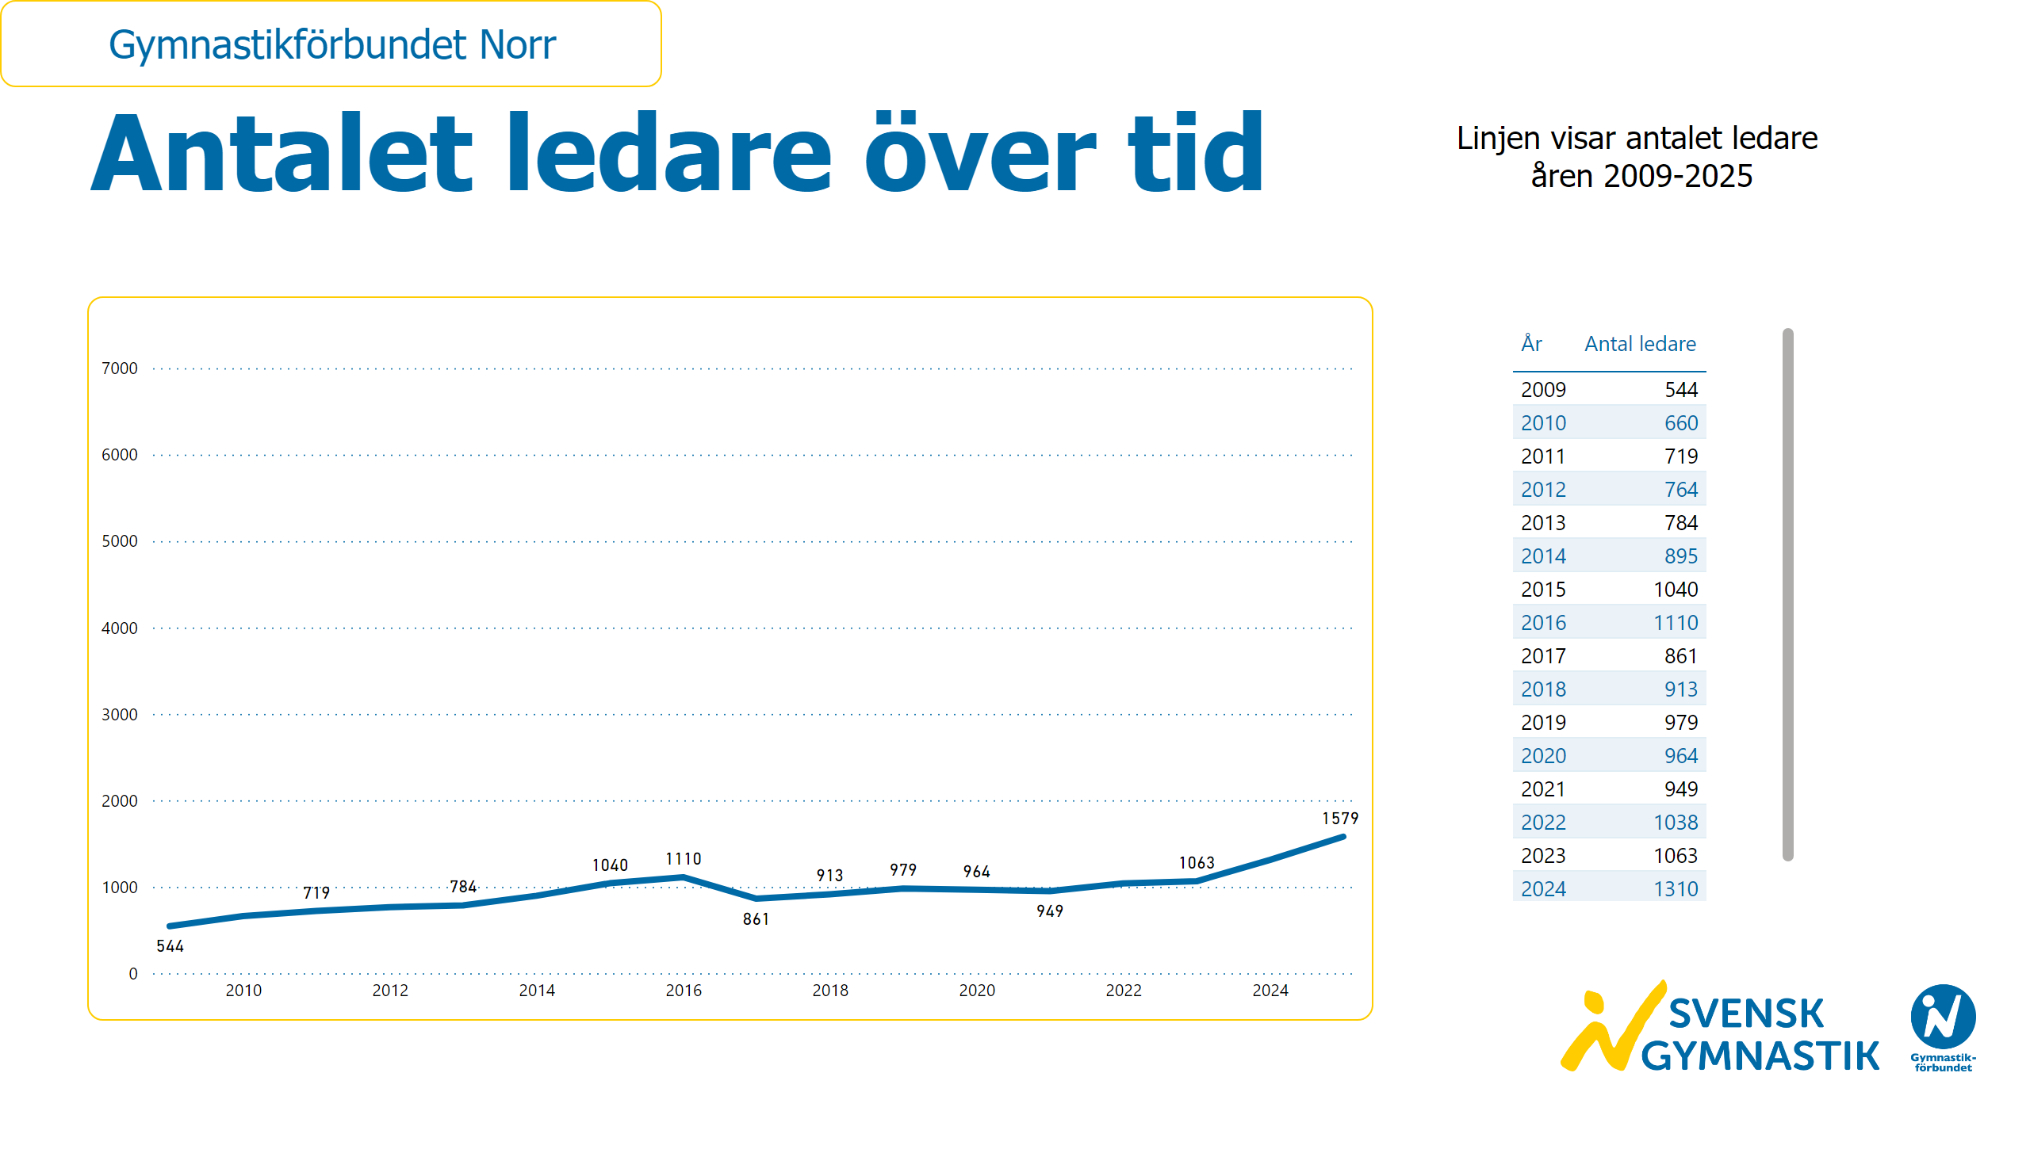
Ledarutveckling
Notes:
textbox
No alt text provided
textbox
No alt text provided
lineChart
No alt text provided
card
No alt text provided
slicer
No alt text provided
image
No alt text provided
tableEx
No alt text provided

Slide 50
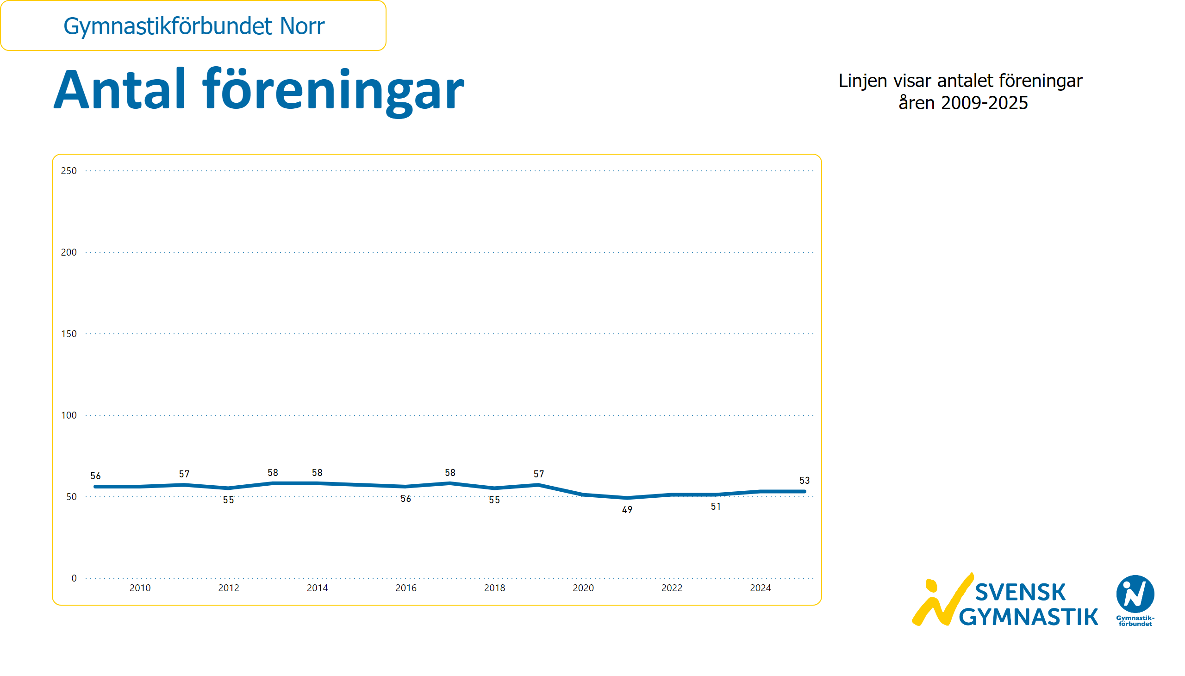
Antal föreningar
Notes:
textbox
No alt text provided
textbox
No alt text provided
lineChart
No alt text provided
card
No alt text provided
slicer
No alt text provided
image
No alt text provided

Slide 51
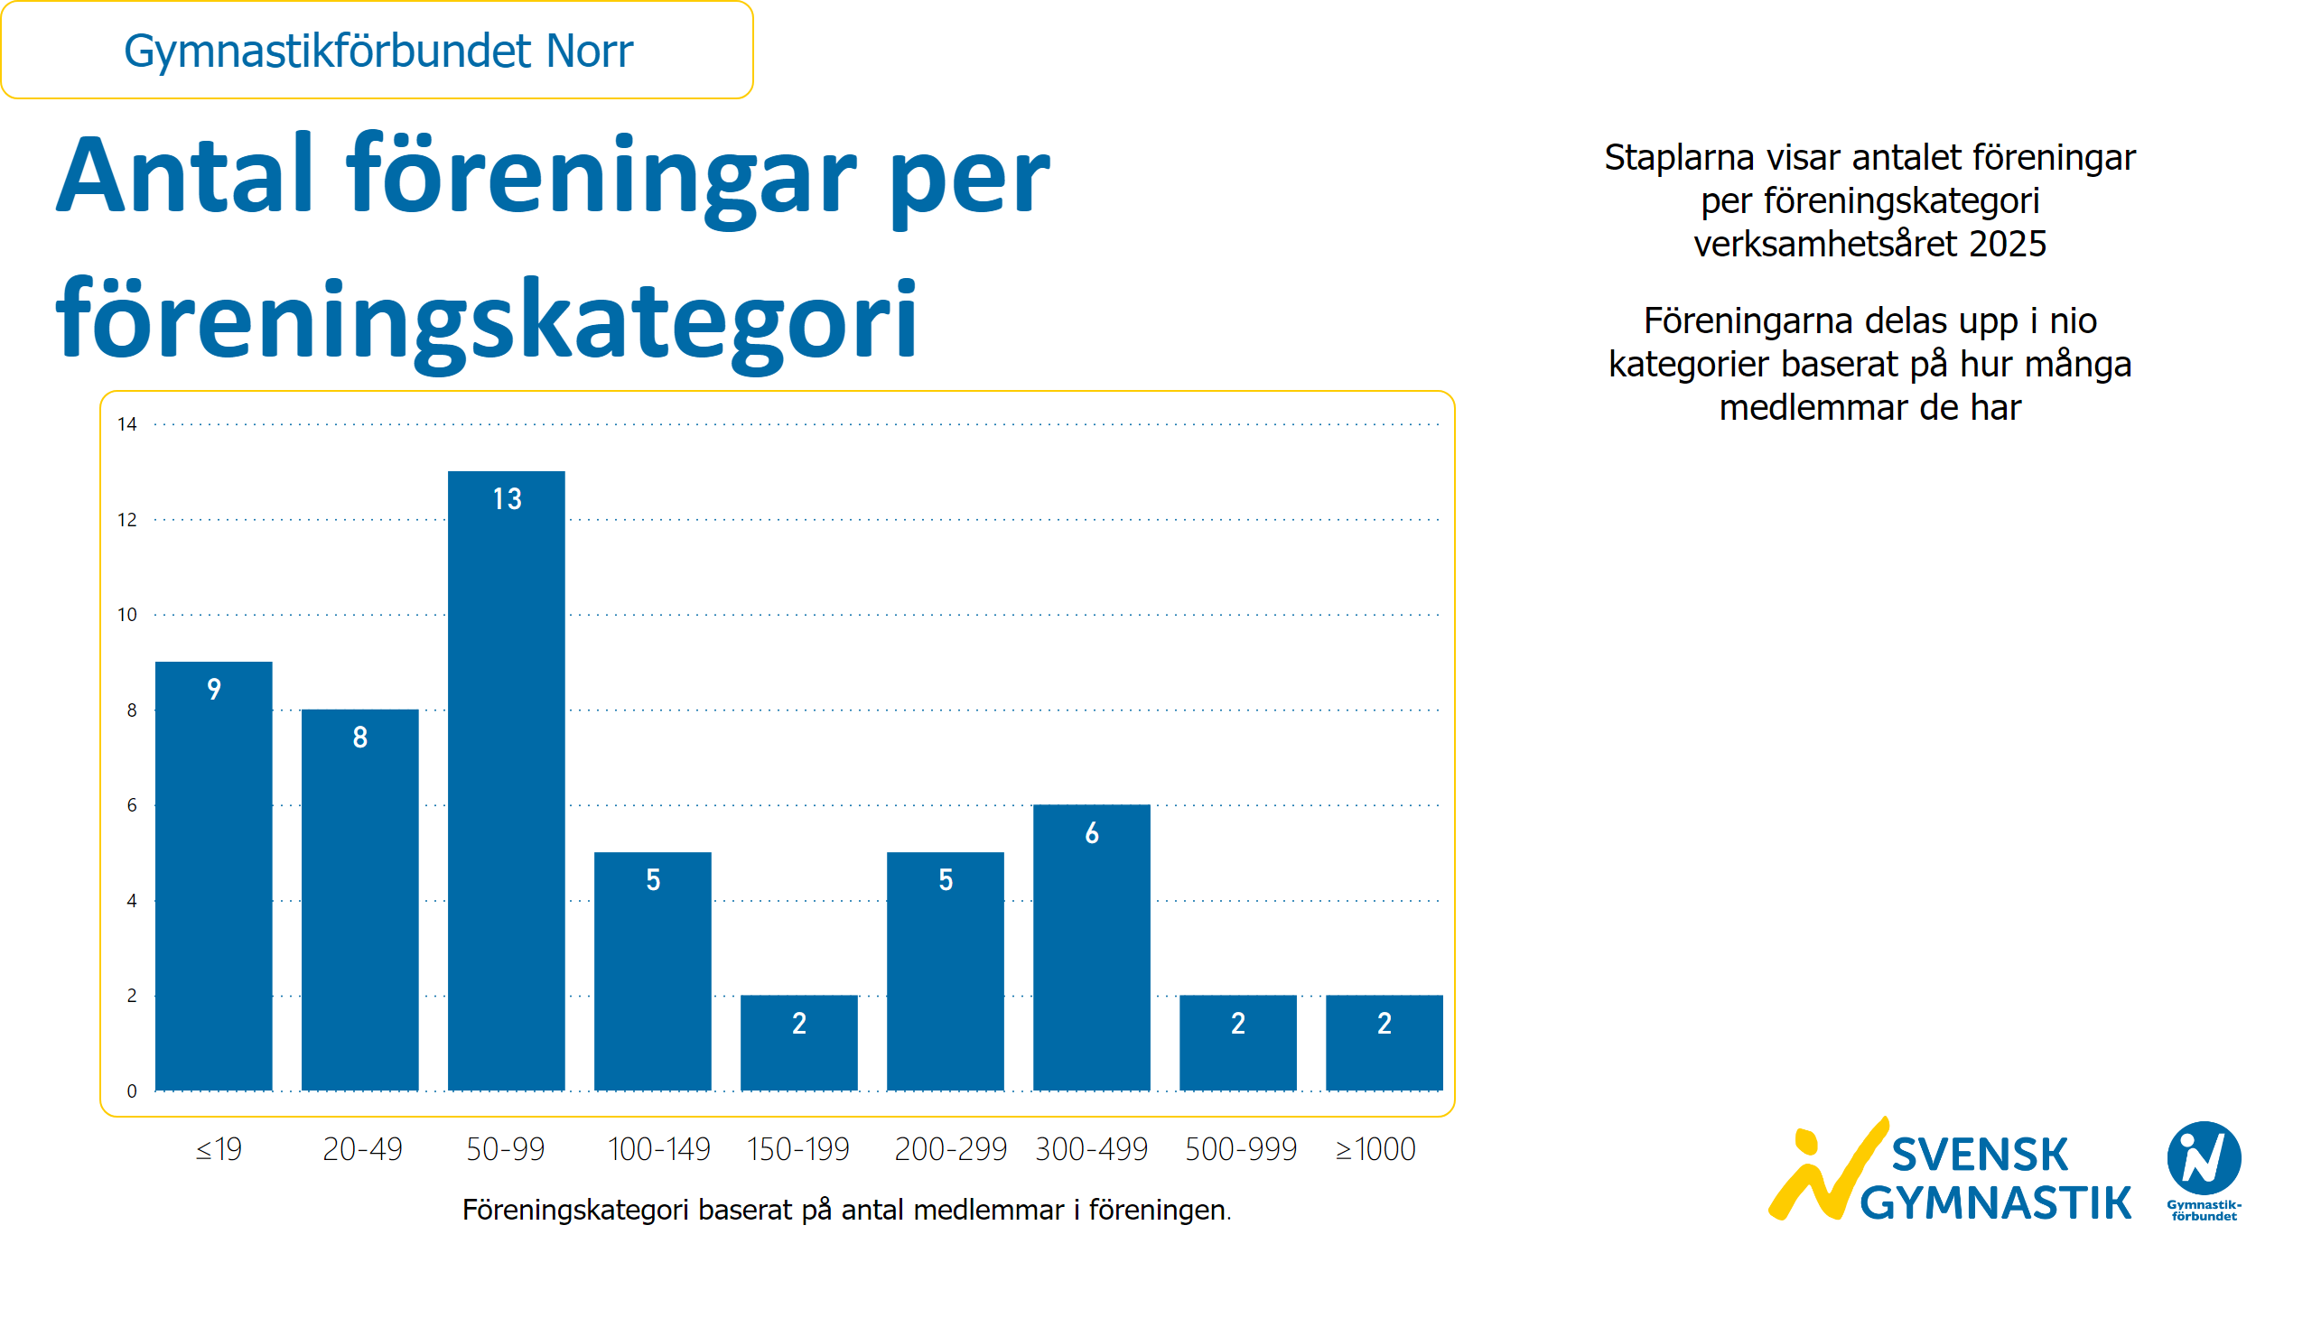
Föreningar per föreningskategori
Notes:
textbox
No alt text provided
textbox
No alt text provided
textbox
No alt text provided
clusteredColumnChart
No alt text provided
textbox
No alt text provided
slicer
No alt text provided
card
No alt text provided
image
No alt text provided

Slide 52
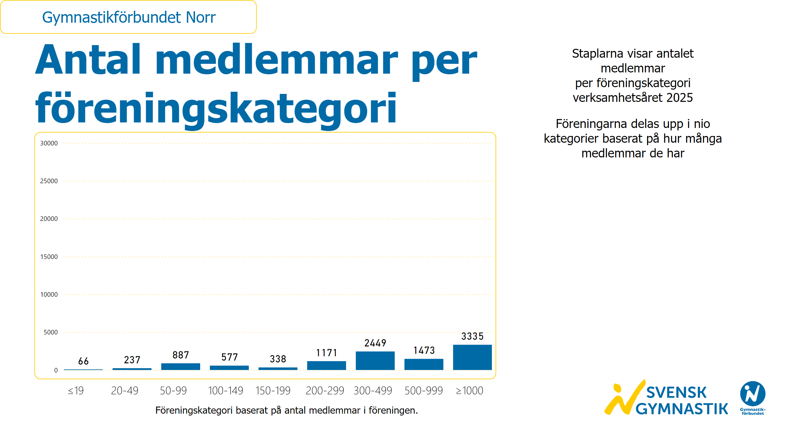
Medlemmar per föreningskategori
Notes:
textbox
No alt text provided
textbox
No alt text provided
textbox
No alt text provided
textbox
No alt text provided
clusteredColumnChart
No alt text provided
slicer
No alt text provided
card
No alt text provided
image
No alt text provided

Slide 53
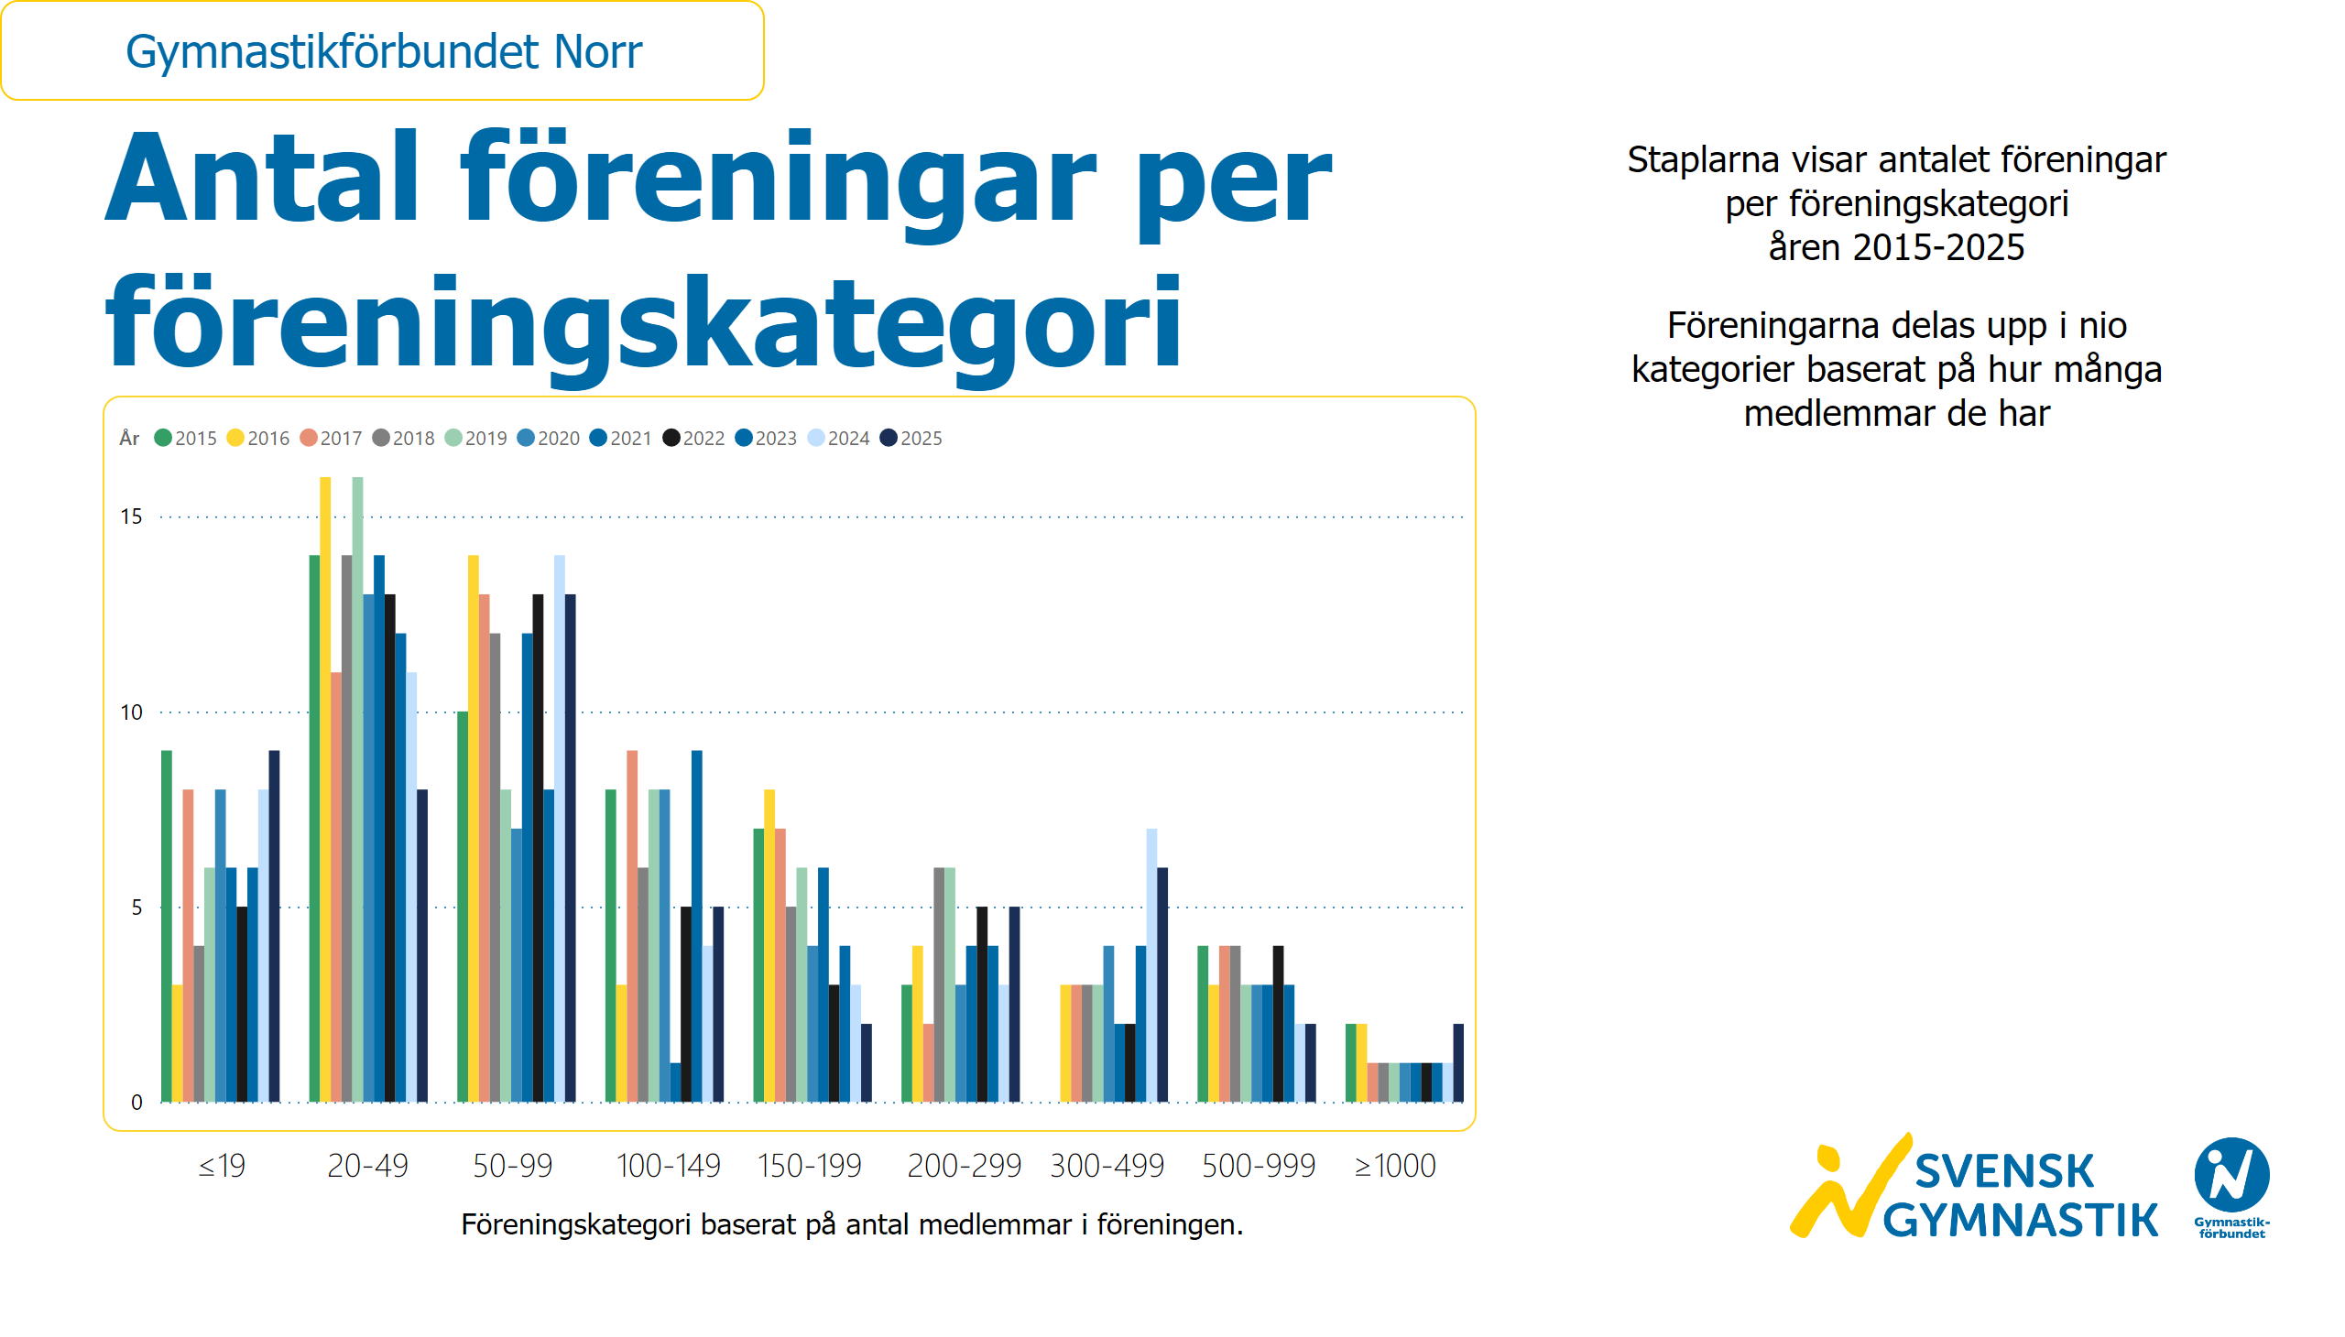
Föreningar per föreningskategori och år
Notes:
textbox
No alt text provided
textbox
No alt text provided
textbox
No alt text provided
textbox
No alt text provided
clusteredColumnChart
No alt text provided
slicer
No alt text provided
card
No alt text provided
image
No alt text provided

Slide 54
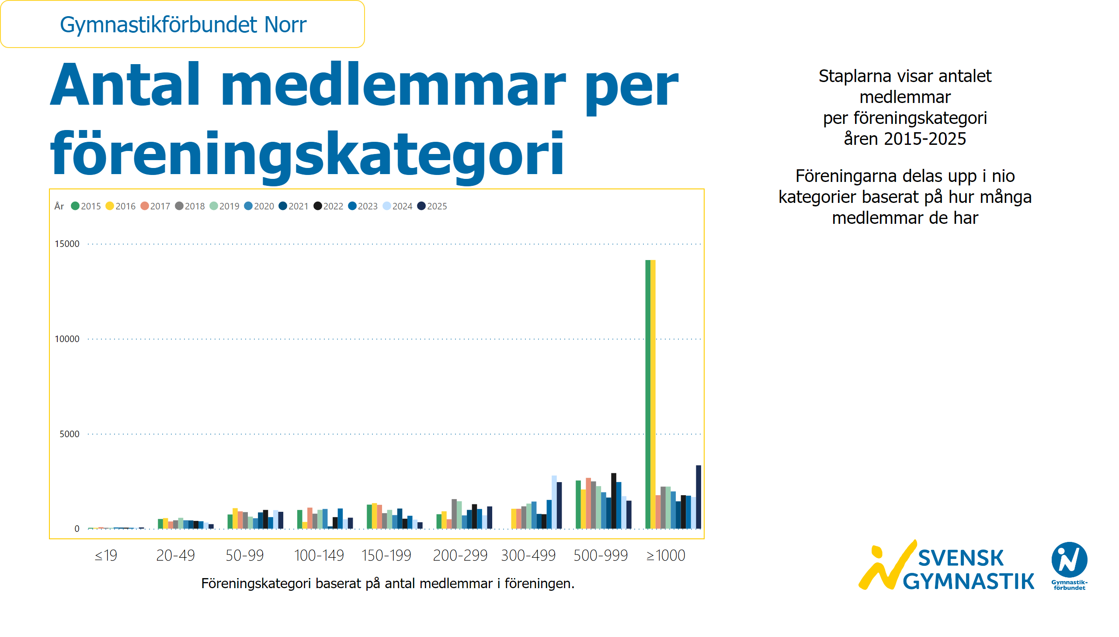
Medlemmar per föreningskategori och år
Notes:
textbox
No alt text provided
textbox
No alt text provided
textbox
No alt text provided
textbox
No alt text provided
clusteredColumnChart
No alt text provided
slicer
No alt text provided
card
No alt text provided
image
No alt text provided

Slide 55
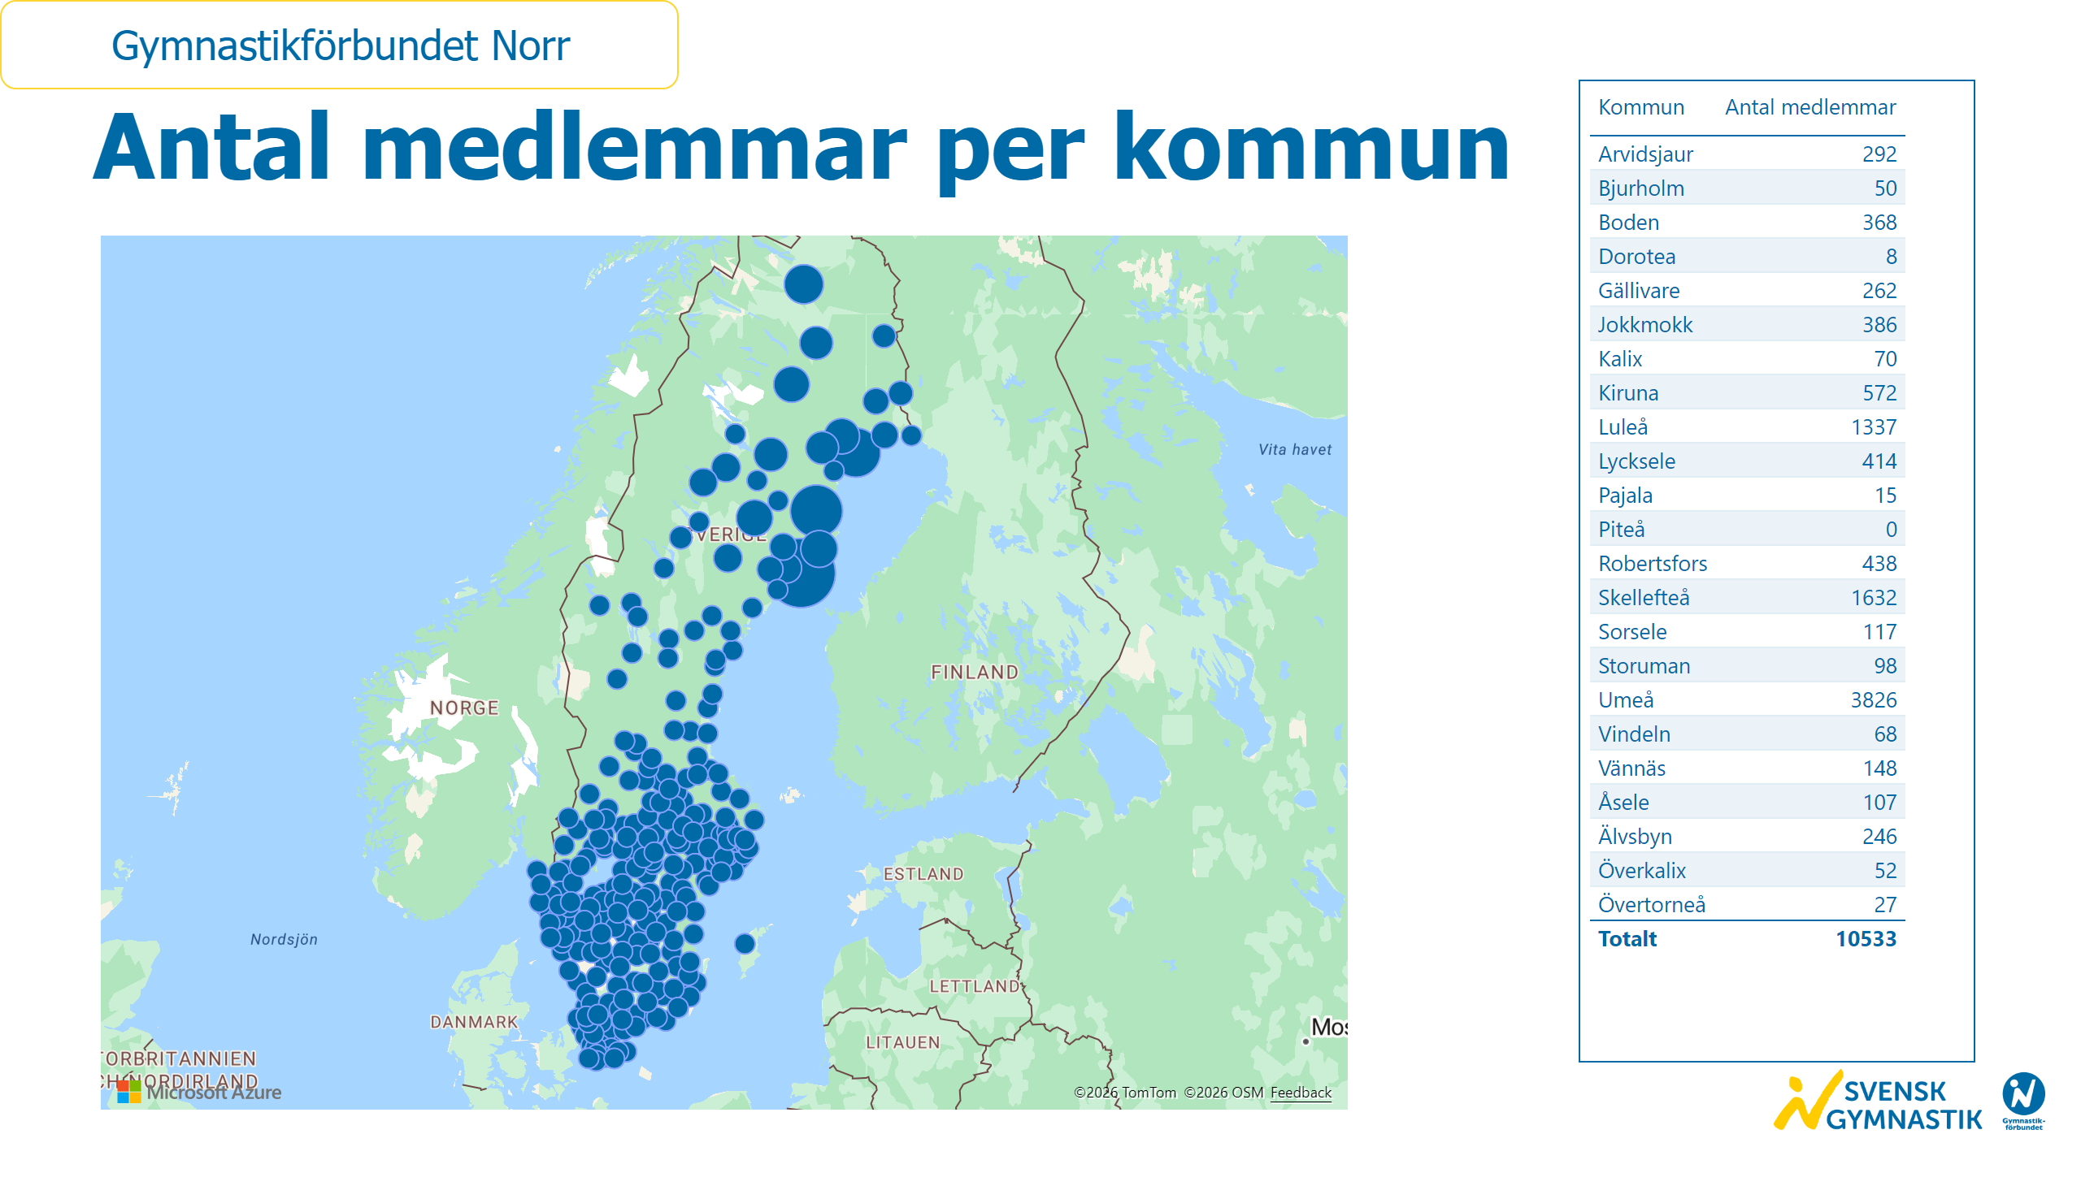
Medlemmar per kommun
Notes:
textbox
No alt text provided
azureMap
No alt text provided
tableEx
No alt text provided
slicer
No alt text provided
card
No alt text provided
image
No alt text provided

Slide 56

Verksamheter i föreningarna
Notes:
textbox
No alt text provided
textbox
No alt text provided
funnel
No alt text provided
slicer
No alt text provided
card
No alt text provided
image
No alt text provided

Slide 57

Verksamheter i föreningarna 2015-2025
Notes:
textbox
No alt text provided
textbox
No alt text provided
textbox
No alt text provided
clusteredColumnChart
No alt text provided
clusteredColumnChart
No alt text provided
clusteredColumnChart
No alt text provided
clusteredColumnChart
No alt text provided
clusteredColumnChart
No alt text provided
clusteredColumnChart
No alt text provided
clusteredColumnChart
No alt text provided
clusteredColumnChart
No alt text provided
clusteredColumnChart
No alt text provided
clusteredColumnChart
No alt text provided
slicer
No alt text provided
card
No alt text provided
image
No alt text provided
textbox
No alt text provided
textbox
No alt text provided

Slide 58

Verksamheter i föreningarna 2015-2025 2
Notes:
textbox
No alt text provided
textbox
No alt text provided
clusteredColumnChart
No alt text provided
clusteredColumnChart
No alt text provided
clusteredColumnChart
No alt text provided
clusteredColumnChart
No alt text provided
clusteredColumnChart
No alt text provided
clusteredColumnChart
No alt text provided
clusteredColumnChart
No alt text provided
clusteredColumnChart
No alt text provided
clusteredColumnChart
No alt text provided
textbox
No alt text provided
clusteredColumnChart
No alt text provided
clusteredColumnChart
No alt text provided
textbox
No alt text provided
textbox
No alt text provided
slicer
No alt text provided
card
No alt text provided
image
No alt text provided

Slide 60

Medlemmar
Notes:
textbox
No alt text provided
textbox
No alt text provided
clusteredColumnChart
No alt text provided
pieChart
No alt text provided
card
No alt text provided
slicer
No alt text provided
image
No alt text provided

Slide 61

Ålder och kön
Notes:
textbox
No alt text provided
textbox
No alt text provided
image
No alt text provided
textbox
No alt text provided
textbox
No alt text provided
basicShape
No alt text provided
textbox
No alt text provided
basicShape
No alt text provided
textbox
No alt text provided
clusteredColumnChart
No alt text provided
clusteredColumnChart
No alt text provided
clusteredColumnChart
No alt text provided
clusteredColumnChart
No alt text provided
clusteredColumnChart
No alt text provided
donutChart
No alt text provided
textbox
No alt text provided
basicShape
No alt text provided
basicShape
No alt text provided
basicShape
No alt text provided
basicShape
No alt text provided
basicShape
No alt text provided
basicShape
No alt text provided
basicShape
No alt text provided
card
No alt text provided
slicer
No alt text provided
basicShape
No alt text provided
basicShape
No alt text provided
basicShape
No alt text provided
image
No alt text provided

Slide 62

Medlemsutveckling
Notes:
textbox
No alt text provided
textbox
No alt text provided
lineChart
No alt text provided
card
No alt text provided
slicer
No alt text provided
image
No alt text provided
tableEx
No alt text provided

Slide 63

Medlemsutveckling kön
Notes:
textbox
No alt text provided
textbox
No alt text provided
lineChart
No alt text provided
card
No alt text provided
slicer
No alt text provided
image
No alt text provided

Slide 64

Medlemsutveckling ålder
Notes:
textbox
No alt text provided
textbox
No alt text provided
lineChart
No alt text provided
card
No alt text provided
slicer
No alt text provided
image
No alt text provided

Slide 65

Medlemsutveckling ålder och kön
Notes:
textbox
No alt text provided
textbox
No alt text provided
textbox
No alt text provided
textbox
No alt text provided
textbox
No alt text provided
textbox
No alt text provided
textbox
No alt text provided
basicShape
No alt text provided
textbox
No alt text provided
basicShape
No alt text provided
textbox
No alt text provided
basicShape
No alt text provided
textbox
No alt text provided
clusteredColumnChart
No alt text provided
clusteredColumnChart
No alt text provided
clusteredColumnChart
No alt text provided
clusteredColumnChart
No alt text provided
clusteredColumnChart
No alt text provided
card
No alt text provided
slicer
No alt text provided
image
No alt text provided

Slide 66

Antal ledare
Notes:
textbox
No alt text provided
textbox
No alt text provided
clusteredColumnChart
No alt text provided
pieChart
No alt text provided
card
No alt text provided
slicer
No alt text provided
image
No alt text provided

Slide 67

Antal ledare kön och ålder
Notes:
textbox
No alt text provided
textbox
No alt text provided
textbox
No alt text provided
clusteredColumnChart
No alt text provided
clusteredColumnChart
No alt text provided
clusteredColumnChart
No alt text provided
clusteredColumnChart
No alt text provided
textbox
No alt text provided
basicShape
No alt text provided
textbox
No alt text provided
basicShape
No alt text provided
textbox
No alt text provided
card
No alt text provided
slicer
No alt text provided
image
No alt text provided

Slide 68

Ledarutveckling
Notes:
textbox
No alt text provided
textbox
No alt text provided
lineChart
No alt text provided
card
No alt text provided
slicer
No alt text provided
image
No alt text provided
tableEx
No alt text provided

Slide 69

Antal föreningar
Notes:
textbox
No alt text provided
textbox
No alt text provided
lineChart
No alt text provided
card
No alt text provided
slicer
No alt text provided
image
No alt text provided

Slide 70

Föreningar per föreningskategori
Notes:
textbox
No alt text provided
textbox
No alt text provided
textbox
No alt text provided
clusteredColumnChart
No alt text provided
textbox
No alt text provided
slicer
No alt text provided
card
No alt text provided
image
No alt text provided

Slide 71

Medlemmar per föreningskategori
Notes:
textbox
No alt text provided
textbox
No alt text provided
textbox
No alt text provided
textbox
No alt text provided
clusteredColumnChart
No alt text provided
slicer
No alt text provided
card
No alt text provided
image
No alt text provided

Slide 72

Föreningar per föreningskategori och år
Notes:
textbox
No alt text provided
textbox
No alt text provided
textbox
No alt text provided
textbox
No alt text provided
clusteredColumnChart
No alt text provided
slicer
No alt text provided
card
No alt text provided
image
No alt text provided

Slide 73

Medlemmar per föreningskategori och år
Notes:
textbox
No alt text provided
textbox
No alt text provided
textbox
No alt text provided
textbox
No alt text provided
clusteredColumnChart
No alt text provided
slicer
No alt text provided
card
No alt text provided
image
No alt text provided

Slide 74

Medlemmar per kommun
Notes:
textbox
No alt text provided
azureMap
No alt text provided
tableEx
No alt text provided
slicer
No alt text provided
card
No alt text provided
image
No alt text provided

Slide 75

Verksamheter i föreningarna
Notes:
textbox
No alt text provided
textbox
No alt text provided
funnel
No alt text provided
slicer
No alt text provided
card
No alt text provided
image
No alt text provided

Slide 76

Verksamheter i föreningarna 2015-2025
Notes:
textbox
No alt text provided
textbox
No alt text provided
textbox
No alt text provided
clusteredColumnChart
No alt text provided
clusteredColumnChart
No alt text provided
clusteredColumnChart
No alt text provided
clusteredColumnChart
No alt text provided
clusteredColumnChart
No alt text provided
clusteredColumnChart
No alt text provided
clusteredColumnChart
No alt text provided
clusteredColumnChart
No alt text provided
clusteredColumnChart
No alt text provided
clusteredColumnChart
No alt text provided
slicer
No alt text provided
card
No alt text provided
image
No alt text provided
textbox
No alt text provided
textbox
No alt text provided

Slide 77

Verksamheter i föreningarna 2015-2025 2
Notes:
textbox
No alt text provided
textbox
No alt text provided
clusteredColumnChart
No alt text provided
clusteredColumnChart
No alt text provided
clusteredColumnChart
No alt text provided
clusteredColumnChart
No alt text provided
clusteredColumnChart
No alt text provided
clusteredColumnChart
No alt text provided
clusteredColumnChart
No alt text provided
clusteredColumnChart
No alt text provided
clusteredColumnChart
No alt text provided
textbox
No alt text provided
clusteredColumnChart
No alt text provided
clusteredColumnChart
No alt text provided
textbox
No alt text provided
textbox
No alt text provided
slicer
No alt text provided
card
No alt text provided
image
No alt text provided

Slide 79

Medlemmar
Notes:
textbox
No alt text provided
textbox
No alt text provided
clusteredColumnChart
No alt text provided
pieChart
No alt text provided
card
No alt text provided
slicer
No alt text provided
image
No alt text provided

Slide 80

Ålder och kön
Notes:
textbox
No alt text provided
textbox
No alt text provided
image
No alt text provided
textbox
No alt text provided
textbox
No alt text provided
basicShape
No alt text provided
textbox
No alt text provided
basicShape
No alt text provided
textbox
No alt text provided
clusteredColumnChart
No alt text provided
clusteredColumnChart
No alt text provided
clusteredColumnChart
No alt text provided
clusteredColumnChart
No alt text provided
clusteredColumnChart
No alt text provided
donutChart
No alt text provided
textbox
No alt text provided
basicShape
No alt text provided
basicShape
No alt text provided
basicShape
No alt text provided
basicShape
No alt text provided
basicShape
No alt text provided
basicShape
No alt text provided
basicShape
No alt text provided
card
No alt text provided
slicer
No alt text provided
basicShape
No alt text provided
basicShape
No alt text provided
basicShape
No alt text provided
image
No alt text provided

Slide 81

Medlemsutveckling
Notes:
textbox
No alt text provided
textbox
No alt text provided
lineChart
No alt text provided
card
No alt text provided
slicer
No alt text provided
image
No alt text provided
tableEx
No alt text provided

Slide 82

Medlemsutveckling kön
Notes:
textbox
No alt text provided
textbox
No alt text provided
lineChart
No alt text provided
card
No alt text provided
slicer
No alt text provided
image
No alt text provided

Slide 83

Medlemsutveckling ålder
Notes:
textbox
No alt text provided
textbox
No alt text provided
lineChart
No alt text provided
card
No alt text provided
slicer
No alt text provided
image
No alt text provided

Slide 84

Medlemsutveckling ålder och kön
Notes:
textbox
No alt text provided
textbox
No alt text provided
textbox
No alt text provided
textbox
No alt text provided
textbox
No alt text provided
textbox
No alt text provided
textbox
No alt text provided
basicShape
No alt text provided
textbox
No alt text provided
basicShape
No alt text provided
textbox
No alt text provided
basicShape
No alt text provided
textbox
No alt text provided
clusteredColumnChart
No alt text provided
clusteredColumnChart
No alt text provided
clusteredColumnChart
No alt text provided
clusteredColumnChart
No alt text provided
clusteredColumnChart
No alt text provided
card
No alt text provided
slicer
No alt text provided
image
No alt text provided

Slide 85

Antal ledare
Notes:
textbox
No alt text provided
textbox
No alt text provided
clusteredColumnChart
No alt text provided
pieChart
No alt text provided
card
No alt text provided
slicer
No alt text provided
image
No alt text provided

Slide 86

Antal ledare kön och ålder
Notes:
textbox
No alt text provided
textbox
No alt text provided
textbox
No alt text provided
clusteredColumnChart
No alt text provided
clusteredColumnChart
No alt text provided
clusteredColumnChart
No alt text provided
clusteredColumnChart
No alt text provided
textbox
No alt text provided
basicShape
No alt text provided
textbox
No alt text provided
basicShape
No alt text provided
textbox
No alt text provided
card
No alt text provided
slicer
No alt text provided
image
No alt text provided

Slide 87

Ledarutveckling
Notes:
textbox
No alt text provided
textbox
No alt text provided
lineChart
No alt text provided
card
No alt text provided
slicer
No alt text provided
image
No alt text provided
tableEx
No alt text provided

Slide 88

Antal föreningar
Notes:
textbox
No alt text provided
textbox
No alt text provided
lineChart
No alt text provided
card
No alt text provided
slicer
No alt text provided
image
No alt text provided

Slide 89

Föreningar per föreningskategori
Notes:
textbox
No alt text provided
textbox
No alt text provided
textbox
No alt text provided
clusteredColumnChart
No alt text provided
textbox
No alt text provided
slicer
No alt text provided
card
No alt text provided
image
No alt text provided

Slide 90

Medlemmar per föreningskategori
Notes:
textbox
No alt text provided
textbox
No alt text provided
textbox
No alt text provided
textbox
No alt text provided
clusteredColumnChart
No alt text provided
slicer
No alt text provided
card
No alt text provided
image
No alt text provided

Slide 91

Föreningar per föreningskategori och år
Notes:
textbox
No alt text provided
textbox
No alt text provided
textbox
No alt text provided
textbox
No alt text provided
clusteredColumnChart
No alt text provided
slicer
No alt text provided
card
No alt text provided
image
No alt text provided

Slide 92

Medlemmar per föreningskategori och år
Notes:
textbox
No alt text provided
textbox
No alt text provided
textbox
No alt text provided
textbox
No alt text provided
clusteredColumnChart
No alt text provided
slicer
No alt text provided
card
No alt text provided
image
No alt text provided

Slide 93

Medlemmar per kommun
Notes:
textbox
No alt text provided
azureMap
No alt text provided
tableEx
No alt text provided
slicer
No alt text provided
card
No alt text provided
image
No alt text provided

Slide 94

Verksamheter i föreningarna
Notes:
textbox
No alt text provided
textbox
No alt text provided
funnel
No alt text provided
slicer
No alt text provided
card
No alt text provided
image
No alt text provided

Slide 95

Verksamheter i föreningarna 2015-2025
Notes:
textbox
No alt text provided
textbox
No alt text provided
textbox
No alt text provided
clusteredColumnChart
No alt text provided
clusteredColumnChart
No alt text provided
clusteredColumnChart
No alt text provided
clusteredColumnChart
No alt text provided
clusteredColumnChart
No alt text provided
clusteredColumnChart
No alt text provided
clusteredColumnChart
No alt text provided
clusteredColumnChart
No alt text provided
clusteredColumnChart
No alt text provided
clusteredColumnChart
No alt text provided
slicer
No alt text provided
card
No alt text provided
image
No alt text provided
textbox
No alt text provided
textbox
No alt text provided

Slide 96

Verksamheter i föreningarna 2015-2025 2
Notes:
textbox
No alt text provided
textbox
No alt text provided
clusteredColumnChart
No alt text provided
clusteredColumnChart
No alt text provided
clusteredColumnChart
No alt text provided
clusteredColumnChart
No alt text provided
clusteredColumnChart
No alt text provided
clusteredColumnChart
No alt text provided
clusteredColumnChart
No alt text provided
clusteredColumnChart
No alt text provided
clusteredColumnChart
No alt text provided
textbox
No alt text provided
clusteredColumnChart
No alt text provided
clusteredColumnChart
No alt text provided
textbox
No alt text provided
textbox
No alt text provided
slicer
No alt text provided
card
No alt text provided
image
No alt text provided

Slide 97

Medlemmar
Notes:
textbox
No alt text provided
textbox
No alt text provided
clusteredColumnChart
No alt text provided
pieChart
No alt text provided
card
No alt text provided
slicer
No alt text provided
image
No alt text provided

Slide 98

Ålder och kön
Notes:
textbox
No alt text provided
textbox
No alt text provided
image
No alt text provided
textbox
No alt text provided
textbox
No alt text provided
basicShape
No alt text provided
textbox
No alt text provided
basicShape
No alt text provided
textbox
No alt text provided
clusteredColumnChart
No alt text provided
clusteredColumnChart
No alt text provided
clusteredColumnChart
No alt text provided
clusteredColumnChart
No alt text provided
clusteredColumnChart
No alt text provided
donutChart
No alt text provided
textbox
No alt text provided
basicShape
No alt text provided
basicShape
No alt text provided
basicShape
No alt text provided
basicShape
No alt text provided
basicShape
No alt text provided
basicShape
No alt text provided
basicShape
No alt text provided
card
No alt text provided
slicer
No alt text provided
basicShape
No alt text provided
basicShape
No alt text provided
basicShape
No alt text provided
image
No alt text provided

Slide 99

Medlemsutveckling
Notes:
textbox
No alt text provided
textbox
No alt text provided
lineChart
No alt text provided
card
No alt text provided
slicer
No alt text provided
image
No alt text provided
tableEx
No alt text provided

Slide 100

Medlemsutveckling kön
Notes:
textbox
No alt text provided
textbox
No alt text provided
lineChart
No alt text provided
card
No alt text provided
slicer
No alt text provided
image
No alt text provided

Slide 101

Medlemsutveckling ålder
Notes:
textbox
No alt text provided
textbox
No alt text provided
lineChart
No alt text provided
card
No alt text provided
slicer
No alt text provided
image
No alt text provided

Slide 102

Medlemsutveckling ålder och kön
Notes:
textbox
No alt text provided
textbox
No alt text provided
textbox
No alt text provided
textbox
No alt text provided
textbox
No alt text provided
textbox
No alt text provided
textbox
No alt text provided
basicShape
No alt text provided
textbox
No alt text provided
basicShape
No alt text provided
textbox
No alt text provided
basicShape
No alt text provided
textbox
No alt text provided
clusteredColumnChart
No alt text provided
clusteredColumnChart
No alt text provided
clusteredColumnChart
No alt text provided
clusteredColumnChart
No alt text provided
clusteredColumnChart
No alt text provided
card
No alt text provided
slicer
No alt text provided
image
No alt text provided

Slide 103

Antal ledare
Notes:
textbox
No alt text provided
textbox
No alt text provided
clusteredColumnChart
No alt text provided
pieChart
No alt text provided
card
No alt text provided
slicer
No alt text provided
image
No alt text provided

Slide 104

Antal ledare kön och ålder
Notes:
textbox
No alt text provided
textbox
No alt text provided
textbox
No alt text provided
clusteredColumnChart
No alt text provided
clusteredColumnChart
No alt text provided
clusteredColumnChart
No alt text provided
clusteredColumnChart
No alt text provided
textbox
No alt text provided
basicShape
No alt text provided
textbox
No alt text provided
basicShape
No alt text provided
textbox
No alt text provided
card
No alt text provided
slicer
No alt text provided
image
No alt text provided

Slide 105

Ledarutveckling
Notes:
textbox
No alt text provided
textbox
No alt text provided
lineChart
No alt text provided
card
No alt text provided
slicer
No alt text provided
image
No alt text provided
tableEx
No alt text provided

Slide 106

Antal föreningar
Notes:
textbox
No alt text provided
textbox
No alt text provided
lineChart
No alt text provided
card
No alt text provided
slicer
No alt text provided
image
No alt text provided

Slide 107

Föreningar per föreningskategori
Notes:
textbox
No alt text provided
textbox
No alt text provided
textbox
No alt text provided
clusteredColumnChart
No alt text provided
textbox
No alt text provided
slicer
No alt text provided
card
No alt text provided
image
No alt text provided

Slide 108

Medlemmar per föreningskategori
Notes:
textbox
No alt text provided
textbox
No alt text provided
textbox
No alt text provided
textbox
No alt text provided
clusteredColumnChart
No alt text provided
slicer
No alt text provided
card
No alt text provided
image
No alt text provided

Slide 109

Föreningar per föreningskategori och år
Notes:
textbox
No alt text provided
textbox
No alt text provided
textbox
No alt text provided
textbox
No alt text provided
clusteredColumnChart
No alt text provided
slicer
No alt text provided
card
No alt text provided
image
No alt text provided

Slide 110

Medlemmar per föreningskategori och år
Notes:
textbox
No alt text provided
textbox
No alt text provided
textbox
No alt text provided
textbox
No alt text provided
clusteredColumnChart
No alt text provided
slicer
No alt text provided
card
No alt text provided
image
No alt text provided

Slide 111

Medlemmar per kommun
Notes:
textbox
No alt text provided
azureMap
No alt text provided
tableEx
No alt text provided
slicer
No alt text provided
card
No alt text provided
image
No alt text provided

Slide 112

Verksamheter i föreningarna
Notes:
textbox
No alt text provided
textbox
No alt text provided
funnel
No alt text provided
slicer
No alt text provided
card
No alt text provided
image
No alt text provided

Slide 113

Verksamheter i föreningarna 2015-2025
Notes:
textbox
No alt text provided
textbox
No alt text provided
textbox
No alt text provided
clusteredColumnChart
No alt text provided
clusteredColumnChart
No alt text provided
clusteredColumnChart
No alt text provided
clusteredColumnChart
No alt text provided
clusteredColumnChart
No alt text provided
clusteredColumnChart
No alt text provided
clusteredColumnChart
No alt text provided
clusteredColumnChart
No alt text provided
clusteredColumnChart
No alt text provided
clusteredColumnChart
No alt text provided
slicer
No alt text provided
card
No alt text provided
image
No alt text provided
textbox
No alt text provided
textbox
No alt text provided

Slide 114

Verksamheter i föreningarna 2015-2025 2
Notes:
textbox
No alt text provided
textbox
No alt text provided
clusteredColumnChart
No alt text provided
clusteredColumnChart
No alt text provided
clusteredColumnChart
No alt text provided
clusteredColumnChart
No alt text provided
clusteredColumnChart
No alt text provided
clusteredColumnChart
No alt text provided
clusteredColumnChart
No alt text provided
clusteredColumnChart
No alt text provided
clusteredColumnChart
No alt text provided
textbox
No alt text provided
clusteredColumnChart
No alt text provided
clusteredColumnChart
No alt text provided
textbox
No alt text provided
textbox
No alt text provided
slicer
No alt text provided
card
No alt text provided
image
No alt text provided

Slide 115

Medlemmar
Notes:
textbox
No alt text provided
textbox
No alt text provided
clusteredColumnChart
No alt text provided
pieChart
No alt text provided
card
No alt text provided
slicer
No alt text provided
image
No alt text provided

Slide 116

Ålder och kön
Notes:
textbox
No alt text provided
textbox
No alt text provided
image
No alt text provided
textbox
No alt text provided
textbox
No alt text provided
basicShape
No alt text provided
textbox
No alt text provided
basicShape
No alt text provided
textbox
No alt text provided
clusteredColumnChart
No alt text provided
clusteredColumnChart
No alt text provided
clusteredColumnChart
No alt text provided
clusteredColumnChart
No alt text provided
clusteredColumnChart
No alt text provided
donutChart
No alt text provided
textbox
No alt text provided
basicShape
No alt text provided
basicShape
No alt text provided
basicShape
No alt text provided
basicShape
No alt text provided
basicShape
No alt text provided
basicShape
No alt text provided
basicShape
No alt text provided
card
No alt text provided
slicer
No alt text provided
basicShape
No alt text provided
basicShape
No alt text provided
basicShape
No alt text provided
image
No alt text provided

Slide 117

Medlemsutveckling
Notes:
textbox
No alt text provided
textbox
No alt text provided
lineChart
No alt text provided
card
No alt text provided
slicer
No alt text provided
image
No alt text provided
tableEx
No alt text provided

Slide 118

Medlemsutveckling kön
Notes:
textbox
No alt text provided
textbox
No alt text provided
lineChart
No alt text provided
card
No alt text provided
slicer
No alt text provided
image
No alt text provided

Slide 119

Medlemsutveckling ålder
Notes:
textbox
No alt text provided
textbox
No alt text provided
lineChart
No alt text provided
card
No alt text provided
slicer
No alt text provided
image
No alt text provided

Slide 120

Medlemsutveckling ålder och kön
Notes:
textbox
No alt text provided
textbox
No alt text provided
textbox
No alt text provided
textbox
No alt text provided
textbox
No alt text provided
textbox
No alt text provided
textbox
No alt text provided
basicShape
No alt text provided
textbox
No alt text provided
basicShape
No alt text provided
textbox
No alt text provided
basicShape
No alt text provided
textbox
No alt text provided
clusteredColumnChart
No alt text provided
clusteredColumnChart
No alt text provided
clusteredColumnChart
No alt text provided
clusteredColumnChart
No alt text provided
clusteredColumnChart
No alt text provided
card
No alt text provided
slicer
No alt text provided
image
No alt text provided

Slide 121

Antal ledare
Notes:
textbox
No alt text provided
textbox
No alt text provided
clusteredColumnChart
No alt text provided
pieChart
No alt text provided
card
No alt text provided
slicer
No alt text provided
image
No alt text provided

Slide 122

Antal ledare kön och ålder
Notes:
textbox
No alt text provided
textbox
No alt text provided
textbox
No alt text provided
clusteredColumnChart
No alt text provided
clusteredColumnChart
No alt text provided
clusteredColumnChart
No alt text provided
clusteredColumnChart
No alt text provided
textbox
No alt text provided
basicShape
No alt text provided
textbox
No alt text provided
basicShape
No alt text provided
textbox
No alt text provided
card
No alt text provided
slicer
No alt text provided
image
No alt text provided

Slide 123

Ledarutveckling
Notes:
textbox
No alt text provided
textbox
No alt text provided
lineChart
No alt text provided
card
No alt text provided
slicer
No alt text provided
image
No alt text provided
tableEx
No alt text provided

Slide 124

Antal föreningar
Notes:
textbox
No alt text provided
textbox
No alt text provided
lineChart
No alt text provided
card
No alt text provided
slicer
No alt text provided
image
No alt text provided

Slide 125

Föreningar per föreningskategori
Notes:
textbox
No alt text provided
textbox
No alt text provided
textbox
No alt text provided
clusteredColumnChart
No alt text provided
textbox
No alt text provided
slicer
No alt text provided
card
No alt text provided
image
No alt text provided

Slide 126

Medlemmar per föreningskategori
Notes:
textbox
No alt text provided
textbox
No alt text provided
textbox
No alt text provided
textbox
No alt text provided
clusteredColumnChart
No alt text provided
slicer
No alt text provided
card
No alt text provided
image
No alt text provided

Slide 127

Föreningar per föreningskategori och år
Notes:
textbox
No alt text provided
textbox
No alt text provided
textbox
No alt text provided
textbox
No alt text provided
clusteredColumnChart
No alt text provided
slicer
No alt text provided
card
No alt text provided
image
No alt text provided

Slide 128

Medlemmar per föreningskategori och år
Notes:
textbox
No alt text provided
textbox
No alt text provided
textbox
No alt text provided
textbox
No alt text provided
clusteredColumnChart
No alt text provided
slicer
No alt text provided
card
No alt text provided
image
No alt text provided

Slide 129

Medlemmar per kommun
Notes:
textbox
No alt text provided
azureMap
No alt text provided
tableEx
No alt text provided
slicer
No alt text provided
card
No alt text provided
image
No alt text provided

Slide 130

Verksamheter i föreningarna
Notes:
textbox
No alt text provided
textbox
No alt text provided
funnel
No alt text provided
slicer
No alt text provided
card
No alt text provided
image
No alt text provided

Slide 131

Verksamheter i föreningarna 2015-2025
Notes:
textbox
No alt text provided
textbox
No alt text provided
textbox
No alt text provided
clusteredColumnChart
No alt text provided
clusteredColumnChart
No alt text provided
clusteredColumnChart
No alt text provided
clusteredColumnChart
No alt text provided
clusteredColumnChart
No alt text provided
clusteredColumnChart
No alt text provided
clusteredColumnChart
No alt text provided
clusteredColumnChart
No alt text provided
clusteredColumnChart
No alt text provided
clusteredColumnChart
No alt text provided
slicer
No alt text provided
card
No alt text provided
image
No alt text provided
textbox
No alt text provided
textbox
No alt text provided

Slide 132

Verksamheter i föreningarna 2015-2025 2
Notes:
textbox
No alt text provided
textbox
No alt text provided
clusteredColumnChart
No alt text provided
clusteredColumnChart
No alt text provided
clusteredColumnChart
No alt text provided
clusteredColumnChart
No alt text provided
clusteredColumnChart
No alt text provided
clusteredColumnChart
No alt text provided
clusteredColumnChart
No alt text provided
clusteredColumnChart
No alt text provided
clusteredColumnChart
No alt text provided
textbox
No alt text provided
clusteredColumnChart
No alt text provided
clusteredColumnChart
No alt text provided
textbox
No alt text provided
textbox
No alt text provided
slicer
No alt text provided
card
No alt text provided
image
No alt text provided

Slide 133

Medlemmar
Notes:
textbox
No alt text provided
textbox
No alt text provided
clusteredColumnChart
No alt text provided
pieChart
No alt text provided
card
No alt text provided
slicer
No alt text provided
image
No alt text provided

Slide 134

Ålder och kön
Notes:
textbox
No alt text provided
textbox
No alt text provided
image
No alt text provided
textbox
No alt text provided
textbox
No alt text provided
basicShape
No alt text provided
textbox
No alt text provided
basicShape
No alt text provided
textbox
No alt text provided
clusteredColumnChart
No alt text provided
clusteredColumnChart
No alt text provided
clusteredColumnChart
No alt text provided
clusteredColumnChart
No alt text provided
clusteredColumnChart
No alt text provided
donutChart
No alt text provided
textbox
No alt text provided
basicShape
No alt text provided
basicShape
No alt text provided
basicShape
No alt text provided
basicShape
No alt text provided
basicShape
No alt text provided
basicShape
No alt text provided
basicShape
No alt text provided
card
No alt text provided
slicer
No alt text provided
basicShape
No alt text provided
basicShape
No alt text provided
basicShape
No alt text provided
image
No alt text provided

Slide 135

Medlemsutveckling
Notes:
textbox
No alt text provided
textbox
No alt text provided
lineChart
No alt text provided
card
No alt text provided
slicer
No alt text provided
image
No alt text provided
tableEx
No alt text provided

Slide 136

Medlemsutveckling kön
Notes:
textbox
No alt text provided
textbox
No alt text provided
lineChart
No alt text provided
card
No alt text provided
slicer
No alt text provided
image
No alt text provided

Slide 137

Medlemsutveckling ålder
Notes:
textbox
No alt text provided
textbox
No alt text provided
lineChart
No alt text provided
card
No alt text provided
slicer
No alt text provided
image
No alt text provided

Slide 138

Medlemsutveckling ålder och kön
Notes:
textbox
No alt text provided
textbox
No alt text provided
textbox
No alt text provided
textbox
No alt text provided
textbox
No alt text provided
textbox
No alt text provided
textbox
No alt text provided
basicShape
No alt text provided
textbox
No alt text provided
basicShape
No alt text provided
textbox
No alt text provided
basicShape
No alt text provided
textbox
No alt text provided
clusteredColumnChart
No alt text provided
clusteredColumnChart
No alt text provided
clusteredColumnChart
No alt text provided
clusteredColumnChart
No alt text provided
clusteredColumnChart
No alt text provided
card
No alt text provided
slicer
No alt text provided
image
No alt text provided

Slide 139

Antal ledare
Notes:
textbox
No alt text provided
textbox
No alt text provided
clusteredColumnChart
No alt text provided
pieChart
No alt text provided
card
No alt text provided
slicer
No alt text provided
image
No alt text provided

Slide 140

Antal ledare kön och ålder
Notes:
textbox
No alt text provided
textbox
No alt text provided
textbox
No alt text provided
clusteredColumnChart
No alt text provided
clusteredColumnChart
No alt text provided
clusteredColumnChart
No alt text provided
clusteredColumnChart
No alt text provided
textbox
No alt text provided
basicShape
No alt text provided
textbox
No alt text provided
basicShape
No alt text provided
textbox
No alt text provided
card
No alt text provided
slicer
No alt text provided
image
No alt text provided

Slide 141

Ledarutveckling
Notes:
textbox
No alt text provided
textbox
No alt text provided
lineChart
No alt text provided
card
No alt text provided
slicer
No alt text provided
image
No alt text provided
tableEx
No alt text provided

Slide 142

Antal föreningar
Notes:
textbox
No alt text provided
textbox
No alt text provided
lineChart
No alt text provided
card
No alt text provided
slicer
No alt text provided
image
No alt text provided

Slide 143

Föreningar per föreningskategori
Notes:
textbox
No alt text provided
textbox
No alt text provided
textbox
No alt text provided
clusteredColumnChart
No alt text provided
textbox
No alt text provided
slicer
No alt text provided
card
No alt text provided
image
No alt text provided

Slide 144

Medlemmar per föreningskategori
Notes:
textbox
No alt text provided
textbox
No alt text provided
textbox
No alt text provided
textbox
No alt text provided
clusteredColumnChart
No alt text provided
slicer
No alt text provided
card
No alt text provided
image
No alt text provided

Slide 145

Föreningar per föreningskategori och år
Notes:
textbox
No alt text provided
textbox
No alt text provided
textbox
No alt text provided
textbox
No alt text provided
clusteredColumnChart
No alt text provided
slicer
No alt text provided
card
No alt text provided
image
No alt text provided

Slide 146

Medlemmar per föreningskategori och år
Notes:
textbox
No alt text provided
textbox
No alt text provided
textbox
No alt text provided
textbox
No alt text provided
clusteredColumnChart
No alt text provided
slicer
No alt text provided
card
No alt text provided
image
No alt text provided

Slide 147

Medlemmar per kommun
Notes:
textbox
No alt text provided
azureMap
No alt text provided
tableEx
No alt text provided
slicer
No alt text provided
card
No alt text provided
image
No alt text provided

Slide 148

Verksamheter i föreningarna
Notes:
textbox
No alt text provided
textbox
No alt text provided
funnel
No alt text provided
slicer
No alt text provided
card
No alt text provided
image
No alt text provided

Slide 149

Verksamheter i föreningarna 2015-2025
Notes:
textbox
No alt text provided
textbox
No alt text provided
textbox
No alt text provided
clusteredColumnChart
No alt text provided
clusteredColumnChart
No alt text provided
clusteredColumnChart
No alt text provided
clusteredColumnChart
No alt text provided
clusteredColumnChart
No alt text provided
clusteredColumnChart
No alt text provided
clusteredColumnChart
No alt text provided
clusteredColumnChart
No alt text provided
clusteredColumnChart
No alt text provided
clusteredColumnChart
No alt text provided
slicer
No alt text provided
card
No alt text provided
image
No alt text provided
textbox
No alt text provided
textbox
No alt text provided

Slide 150

Verksamheter i föreningarna 2015-2025 2
Notes:
textbox
No alt text provided
textbox
No alt text provided
clusteredColumnChart
No alt text provided
clusteredColumnChart
No alt text provided
clusteredColumnChart
No alt text provided
clusteredColumnChart
No alt text provided
clusteredColumnChart
No alt text provided
clusteredColumnChart
No alt text provided
clusteredColumnChart
No alt text provided
clusteredColumnChart
No alt text provided
clusteredColumnChart
No alt text provided
textbox
No alt text provided
clusteredColumnChart
No alt text provided
clusteredColumnChart
No alt text provided
textbox
No alt text provided
textbox
No alt text provided
slicer
No alt text provided
card
No alt text provided
image
No alt text provided

